Slide 1
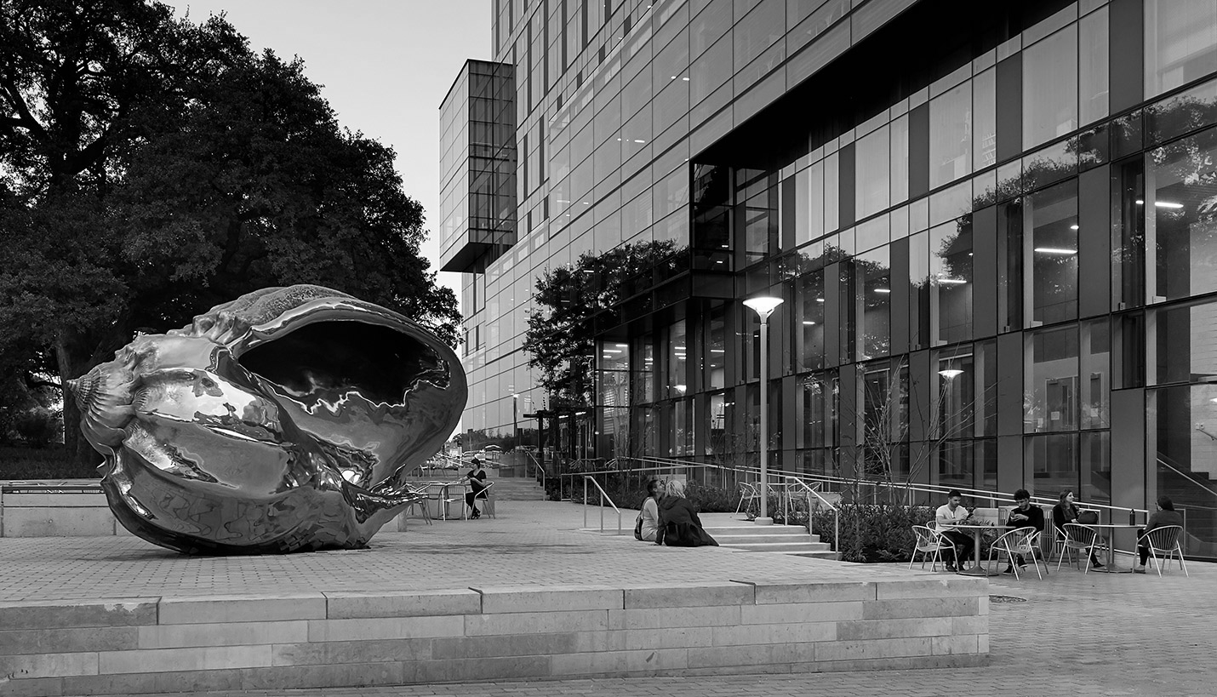
Hispanic Health Professions Organization
Information Body Meeting
February 5th, 2018, 6:45 pm
MEZ B0.036
Sign In Here:
https://bit.ly/2DcygC0

Slide 2
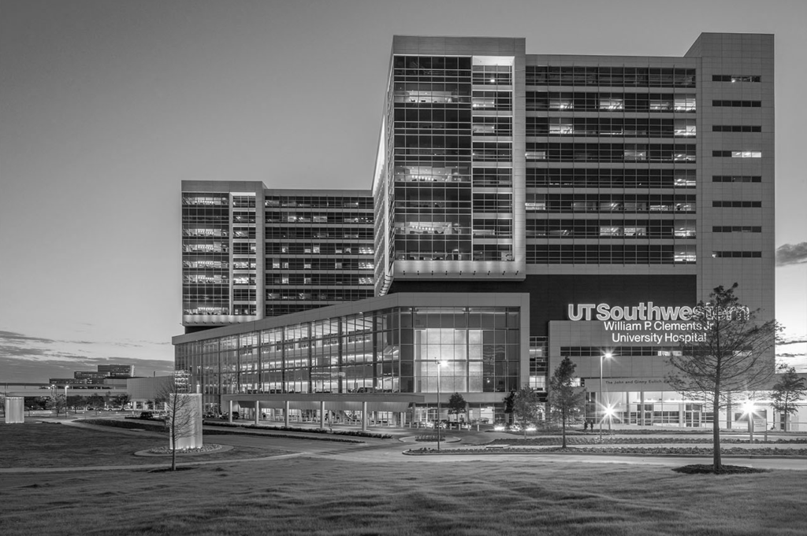
Our History
Founded in 1972
The Hispanic Health Professions Organization was established at The University of Texas at Austin as the National Chicano Health Organization. Their mission was to provide cultural fellowship for health, pre-med, and pre-dental students. Years later, they changed their name to Mexican American Health Organization

Slide 3
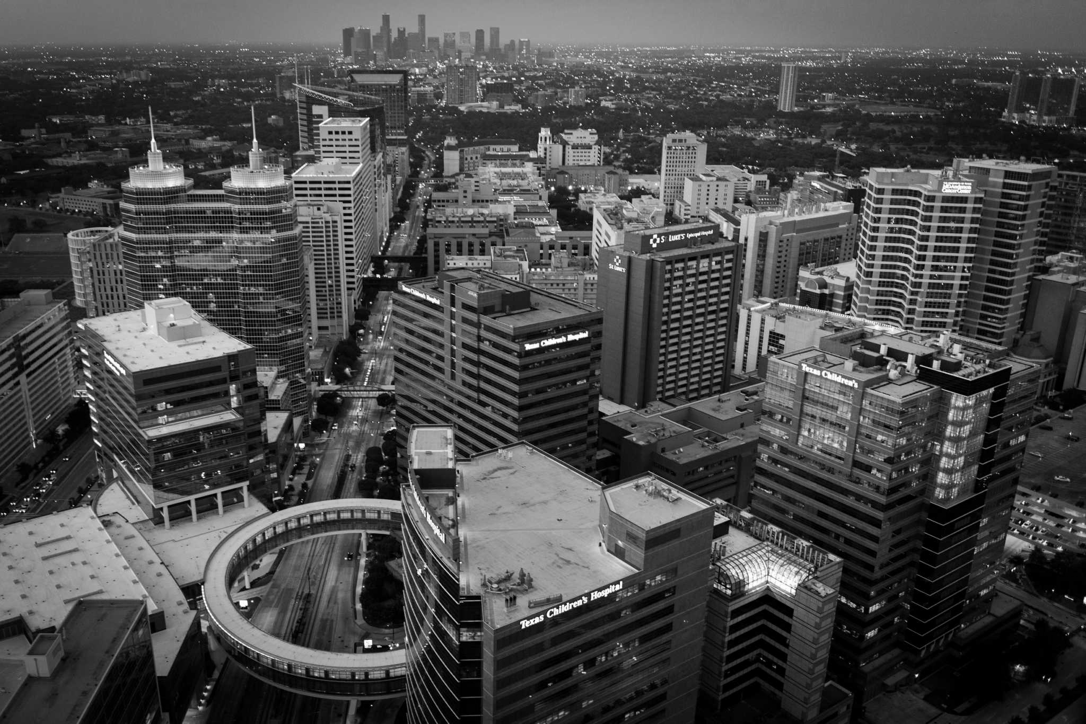
Who We Are Now
Our Mission
Throughout the years, HHPO evolved to an organization that acts as a stepping stone for students in pre-health professions.
Our purpose is to provide pre-health profession students with academic resources, opportunities in clinical settings and peer support. We also strive to promote cultural fellowship and impact Hispanic health through service in underrepresented communities.

Slide 4
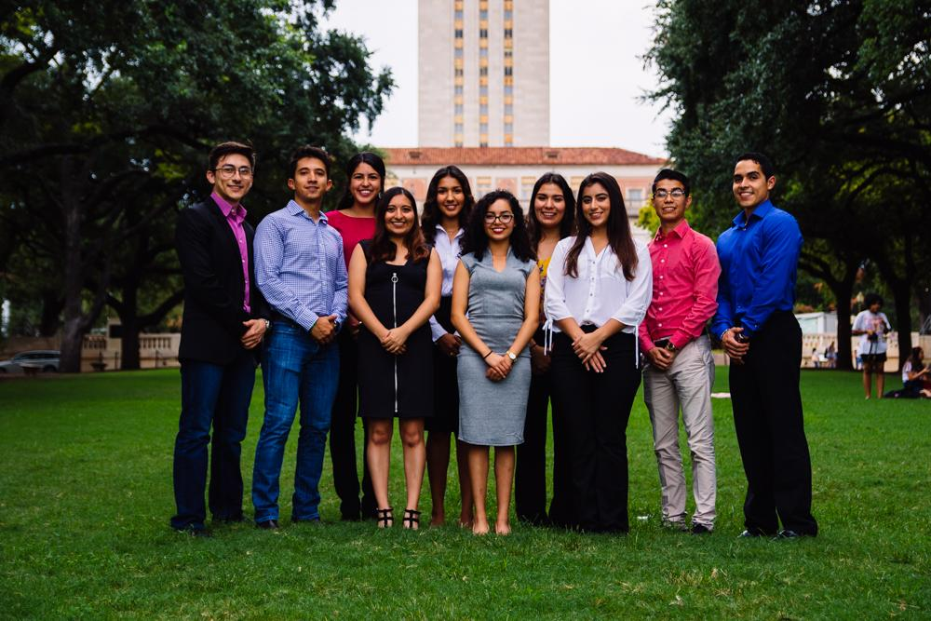
Meet the Board!
Notes:
https://bit.ly/2EPs4DM

Slide 5
Icebreaker
Which population are you most interested in helping?
Notes:
Youth - Cesar + Jessica
Elderly - Manny + Chelo
Poor (Homeless included) - Javi + Andrea
Incarcerated - Suzett + Valeria
Community Health - Eva

Slide 6
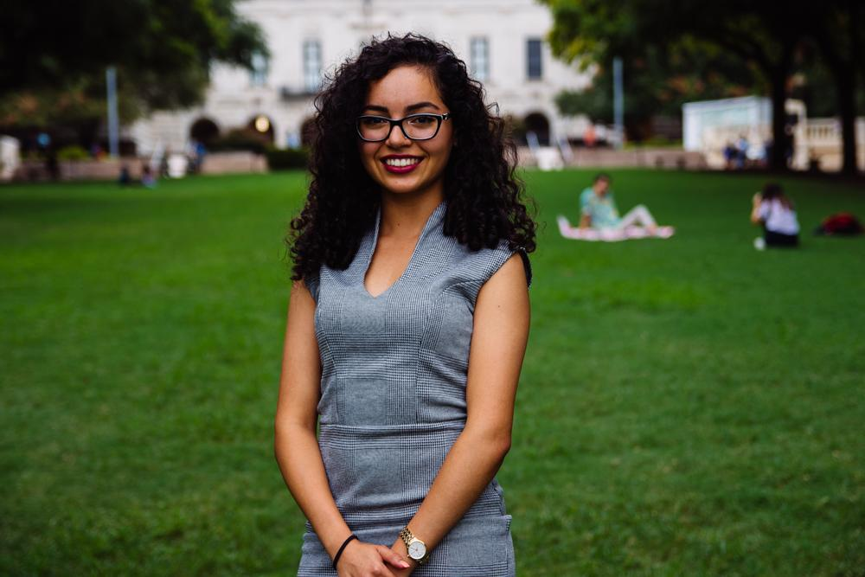
Eva Vaghefi
President
Psychology & Nutrition Double Major
5th Year
Fort Worth, TX
Over break I….started bullet journaling!

Slide 7
T-shirts
Notes:
-Raise your hand if this is the first time you’ve attended an HHPO meeting!
-Raise your hand if you’ve paid your dues but received your t-shirt yet!

Slide 8
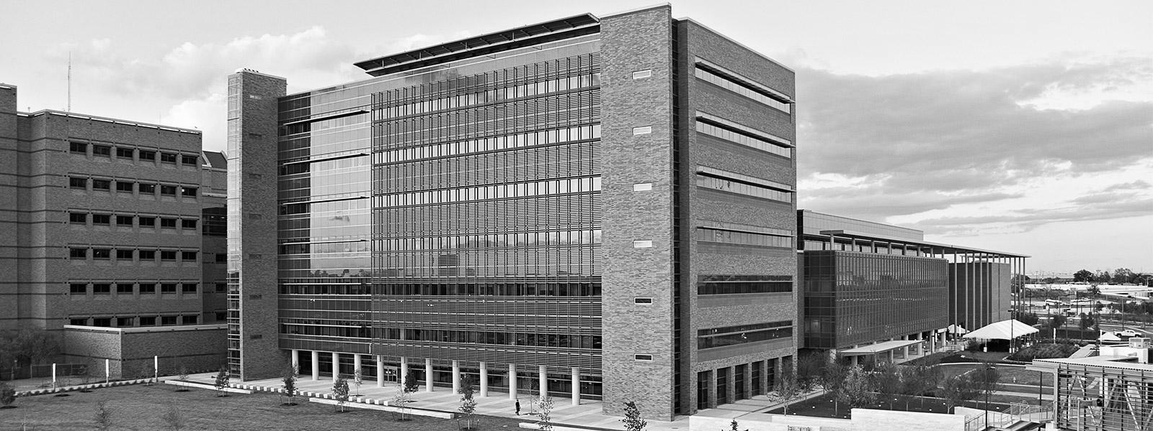
Council for Diversity Engagement
Freshman/Sophomore Representative
Join me in attending weekly meetings with The College of Natural Sciences CDE to address issues related to our community!
Meetings are Fridays from 2-3 PM in PAI 5.42
Talk to me after the meeting to learn more.
Notes:
I am reaching out to HHPO since we are lacking a member of your organization to be on the council. Historically we have had representatives from Black Health Professions as well as Hispanic Health Professions. The council meets biweekly with Dean Vanden Bout and Elizabeth Morgan, our advisor and Student Life Coordinator, to address issues related to the support and success of these historically under-served communities in the college. We also host various events throughout the year to create a space for students to feel welcome and to connect with peers from similar backgrounds. Our big events include the CDE Beginning of the year Kick-Off, Pass the Baton, and Aspire. Additionally, we serve as official college ambassadors to help increase our representation in CNS. This means councilmembers have the opportunity to be on the forefront of encouraging students of color to attend UT at recruiting events both on and off campus. We meet Fridays from 2-3pm in PAI 5.42.

Slide 9
Texas 2-Step CPR
Dell Med Emergency Medicine Interest Group
What is it?
5 min. Demonstration on how to perform hands-only CPR
Nationwide initiative used to teach general public how to simply perform CPR, decreasing mortality while waiting for medical attention.
When and Where?
February 9th @ HOPE Farmer’s Market
February 10th @ Mueller Lake Park Amphitheater
11 AM - 2 PM

Slide 10
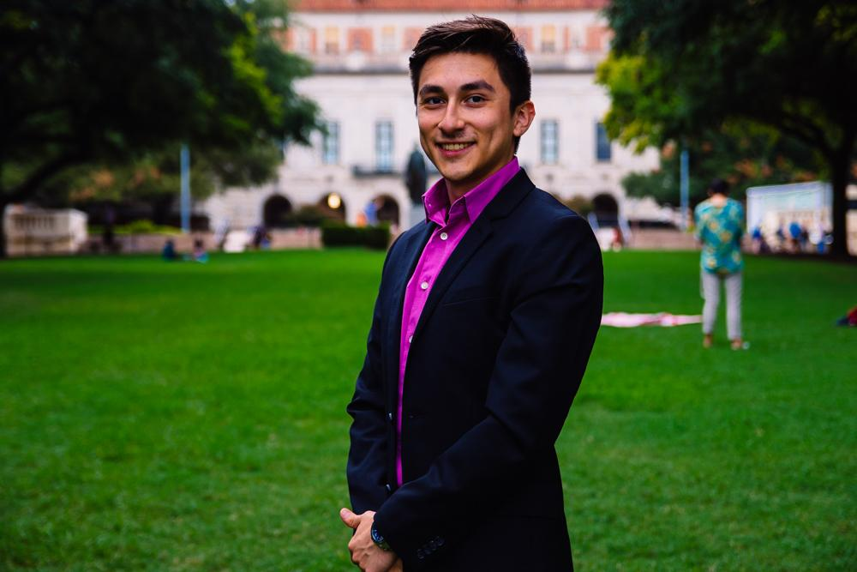
Cesar Gonzalez
VP of Professional Development
Neuroscience Major
Visual Media Minor
3rd Year
Roma, TX
Over break I… self care

Slide 11
Professional Workshop
Discussion Panel with the board
Topics such as gap years
Careers outside professionals schools
Time management in college
Keeping a healthy mindset

Slide 12
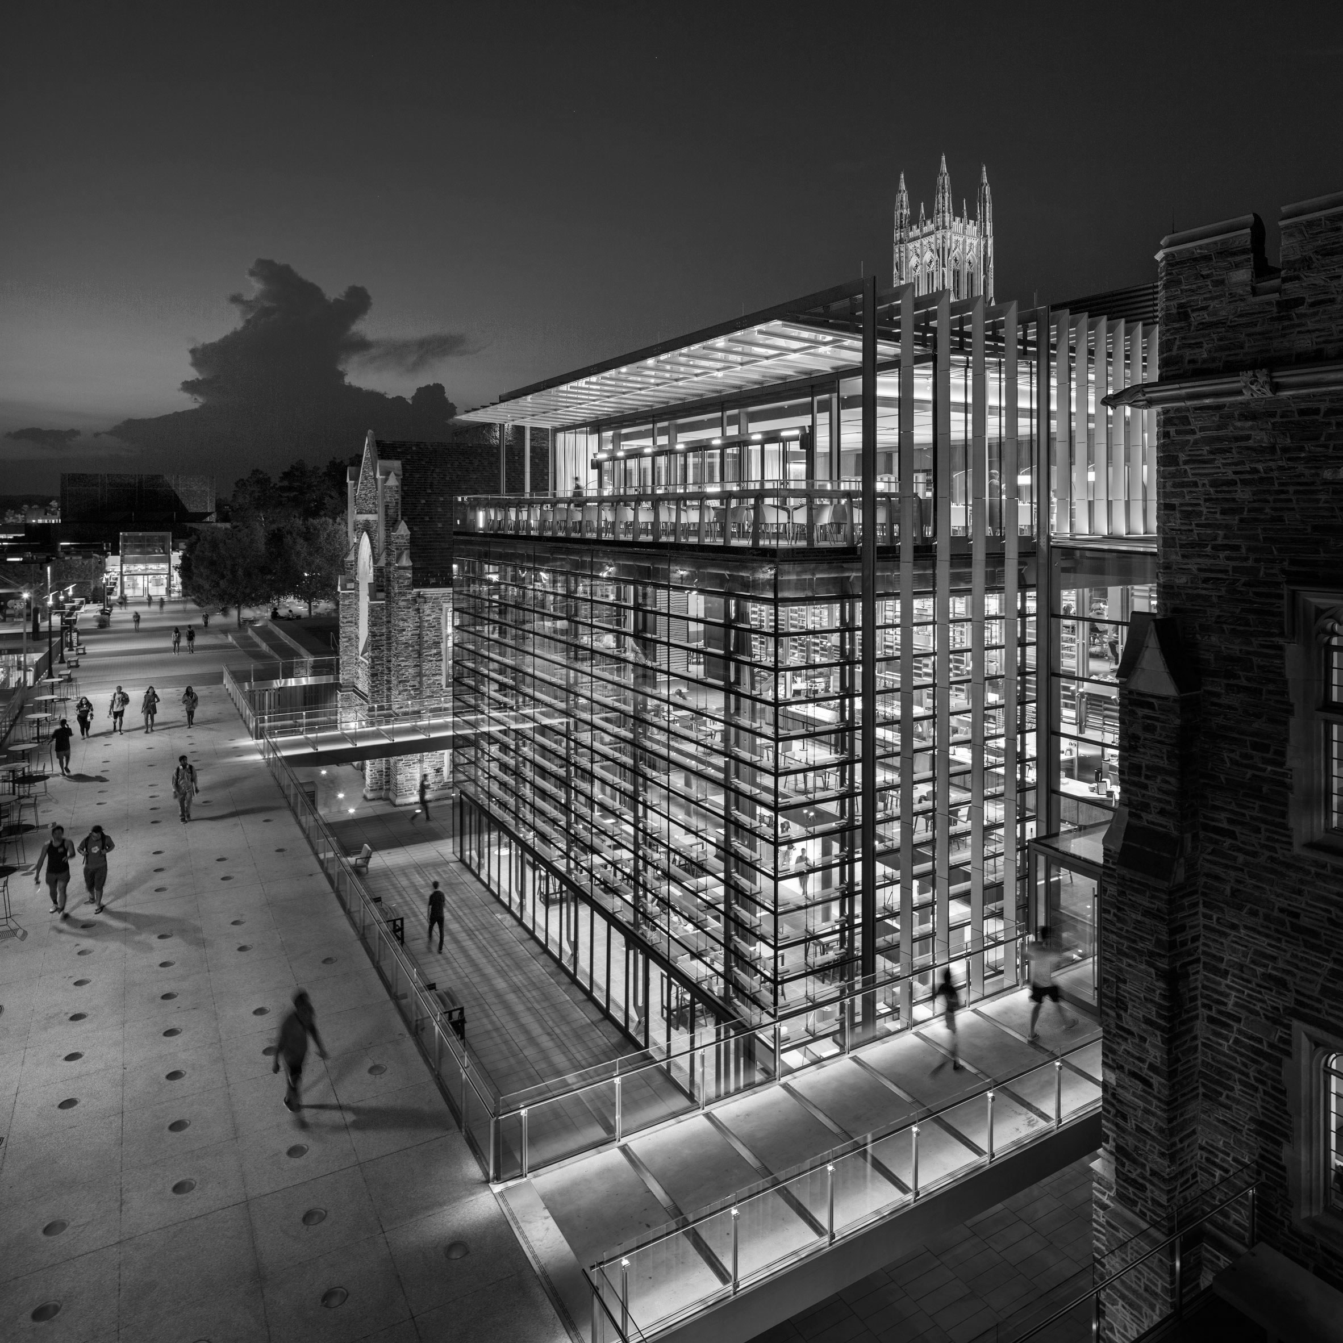
Vision in Focus: A Diverse Lens
Saturday, February 16
Departing February 15 - Time TBA
Rides will be provided

Slide 13
Preceptorship
Program
Current participants expect an email from me this week.

Slide 14
Entrance Exam Preparation
15% discount - prep courses
10% discount one on one tutoring
Our Partner

Slide 15
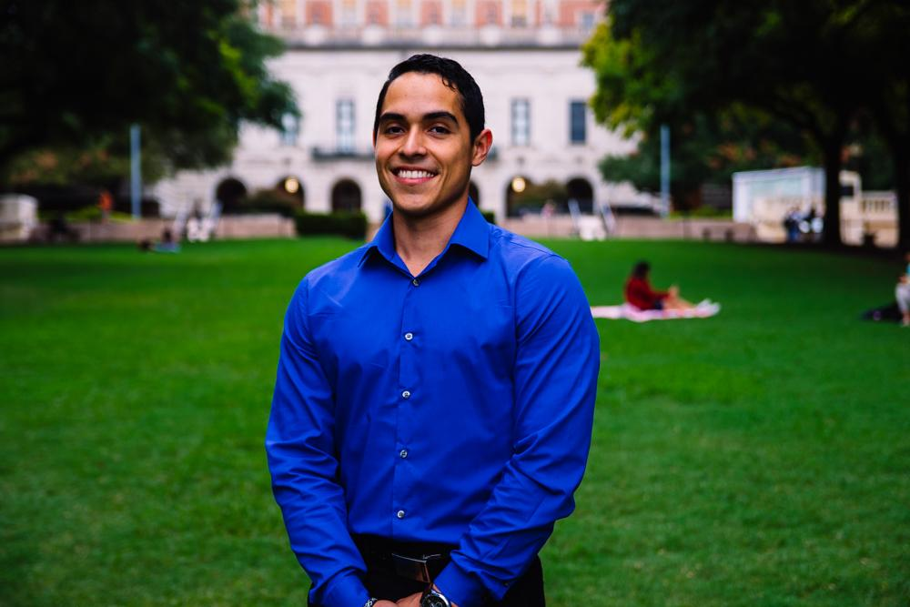
Javier Flores
VP of Community Development
Psychology Major, Pre-PA
3rd Year
Eagle Pass, TX
Fun Fact: I am shadowing a Pediatrician and Nurse Practitioner in my free time.

Slide 16
Cesar E. Chavez Blood Drive
Date: Monday, March 11th
Time: TBD
Location: TBD
Why donate?
You save lives!!

Slide 17
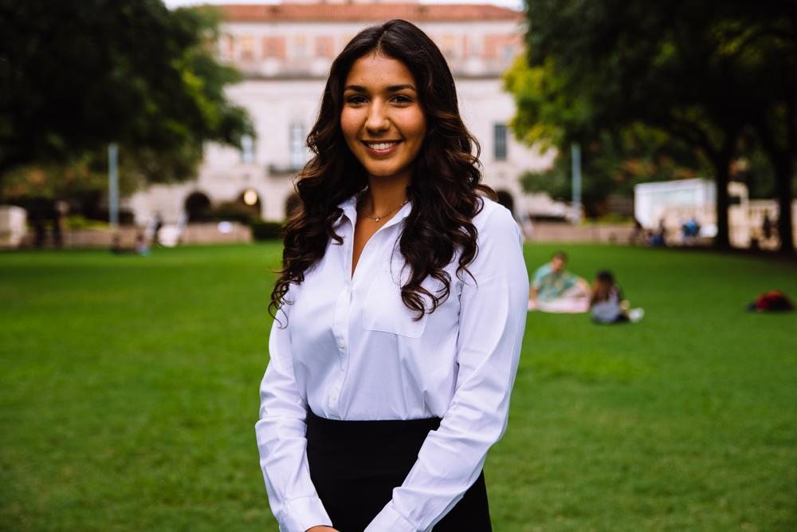
Bianca Garcia
Secretary
Kinesiology Major
3rd Year
Houston, TX
Fun Fact: I shadowed 3 specialities this break in Spain! Message me if you want to learn more!

Slide 18
ACTIVE MEMBER POINTS
FIVE Volunteer
THREE Social
THREE Professional
THREE Fundraising
THREE General Body Meetings
The point sheet is up to date: https://tinyurl.com/yc85l9aq
Let me know if you have any questions!!
biancagarcia207@utexas.edu

Slide 19
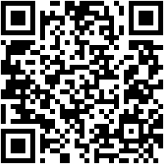
Join the GroupMe!

Slide 20
For ALL events involving head counts and ride confirmations, cancellation notice needs to be given 48 hours in advance with valid reasoning to officer hosting event.
** If no notification is received & you are not present at the event, points that would have been earned will be deducted from that respective category of points (volunteering, fundraising, etc.)**
Notes:
This includes

Slide 21
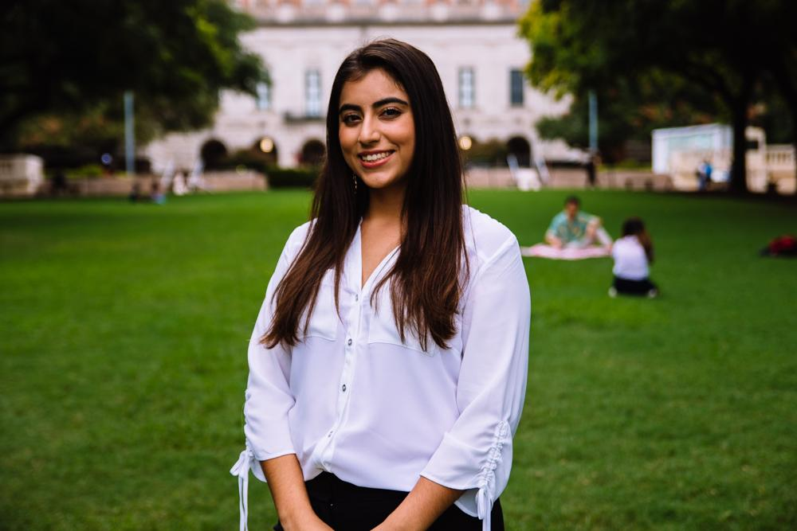
Suzett Fernandez
Financial Director
Human Development and Family Sciences Major
3rd Year
Eagle Pass, TX

Slide 22
DUES
$ 30 Returning Members
$35 New Members
Includes a Tshirt!
Venmo: @Texas-HHPO
(Please state New/Returner)
Paypal: texashhpo@gmail.com ($2 fee)
Cash or Card
**Email: sfdzz97@gmail.com
- include your name, EID, phone number
** Increases by $10 after 3rd GBM**

Slide 23
Valentines Bake Sale
Do you want to earn both a fundraising and social point?
Baking Day *Social Point*
When: Wednesday, February 13th
Tme: 7pm-9pm
Where: 4510 W. Guadalupe St. Apt C223
Bake Sale *Fundraising Point for Buying or Selling*
When: Thursday, February 14th
Time: 10AM-1PM
Where: In front of Greg
LINK TO SIGN UP: https://docs.google.com/spreadsheets/d/1TOh4cm6XaoloF7GHhBD3EhJ2naF67D6fM0HZkPfU-P4

Slide 24
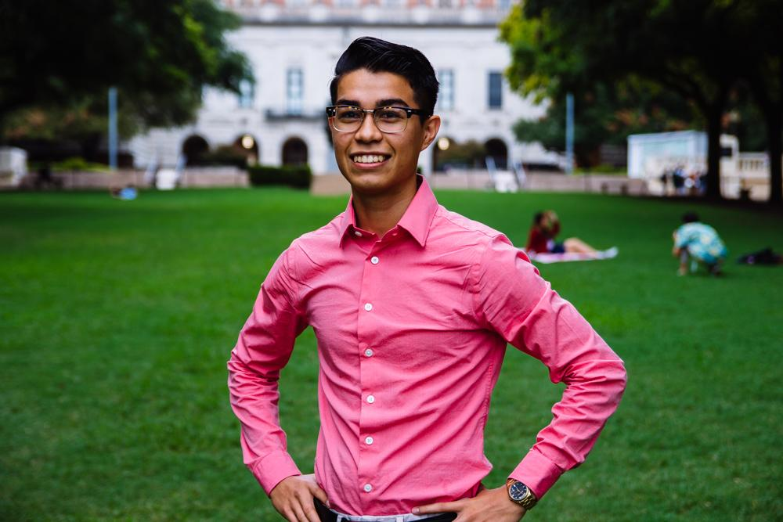
Emmanuel Rayas
Volunteer Director
Biochemistry, BSA
4th Year
San Antonio, TX
I shadowed a shock trauma intensive care unit (once) and got into contact with one mentor. Have yet to meet with the other.
Notes:
I’ve been saying I am going to meal prep this semester.. but it is already the third week of school and...

Slide 25
Population Based Volunteering
The Youth
Communities in Schools
The Elderly
Bingo at The Nursing Home
The Homeless
Homecooked Fridays
The Incarcerated
Inside Books
The Public
We Are Blood

Slide 26
Recurring on your Schedule
Thursday
Inside Books
7-11PM
3121 E 12th St
Austin, TX 78702
insidebooksproject@gmail.com
Friday
Homecooked Fridays
1-3PM & 3-5PM
209 W. 27th St. Austin, TX 78705
Sign-up found on digest.
HHPO Bingo at the Nursing Home
7-8PM
2806 Real St Austin, TX 7872*
Bus Route 18 on MLK & Trinity
Sunday
Inside Books
5-9PM
3121 E 12th St
Austin, TX 78702
insidebooksproject@gmail.com

Slide 27
Special Cause Events
Diversely Impactful
Reach and influence various causes, events, and charities.
Professionally Preparing
All will require you to exercise and practice some form of professional skill while others might be quite demanding.
Socially Engaging
Typically on a weekend, these events are great for taking time to relax, have fun, and socialize with fellow pre-health students.

Slide 28
First Special-Cause Event
Austin Marathon
Austin Marathon is inviting CPR/First Aid Certified members to patrol the route and act as first responders in the case of a medical emergency.
Non-certified members will volunteer together in either crowd control or the recovery zone (TBD).
Long/short sleeve shirts, breakfast, lunch, snacks & refreshments will be provided Results may vary.
Sunday, February 17th
7:00-11:30 AM
erayas@utexas.edu

Slide 29
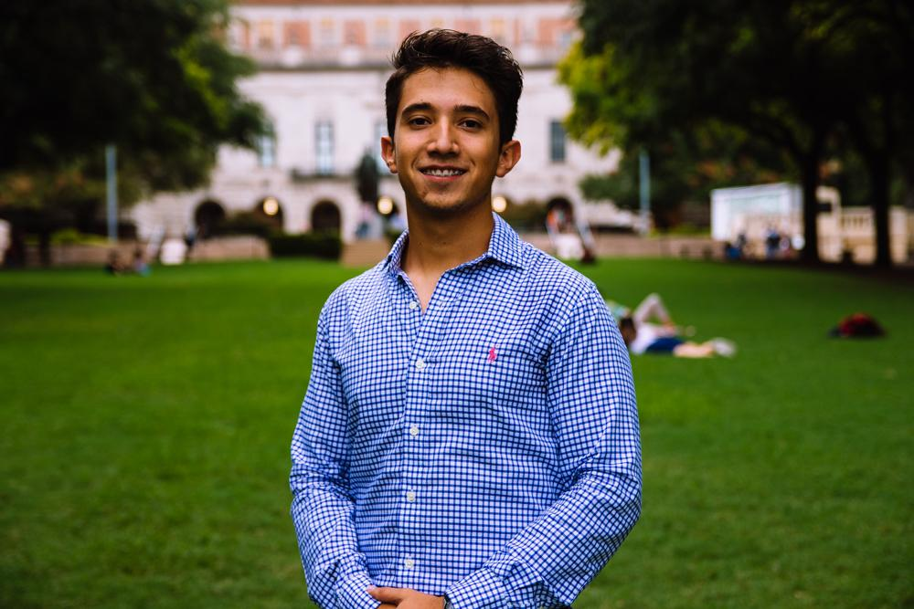
Marcelo Pintos
Social Director
Biochemistry BSA Major
3rd Year
Mcallen, TX
I went back to Mexico and spent a lot of time with the fam.

Slide 30
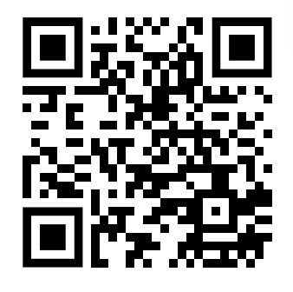
How to get social points?
Comiendo con amigos! - Take a picture with your fellow hhpo members and get a social point each
Social Events survey

Slide 31
EYHO with HHPO

Slide 32
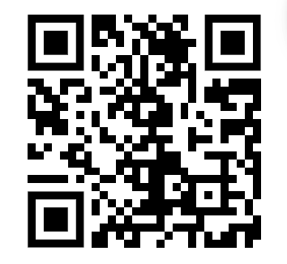
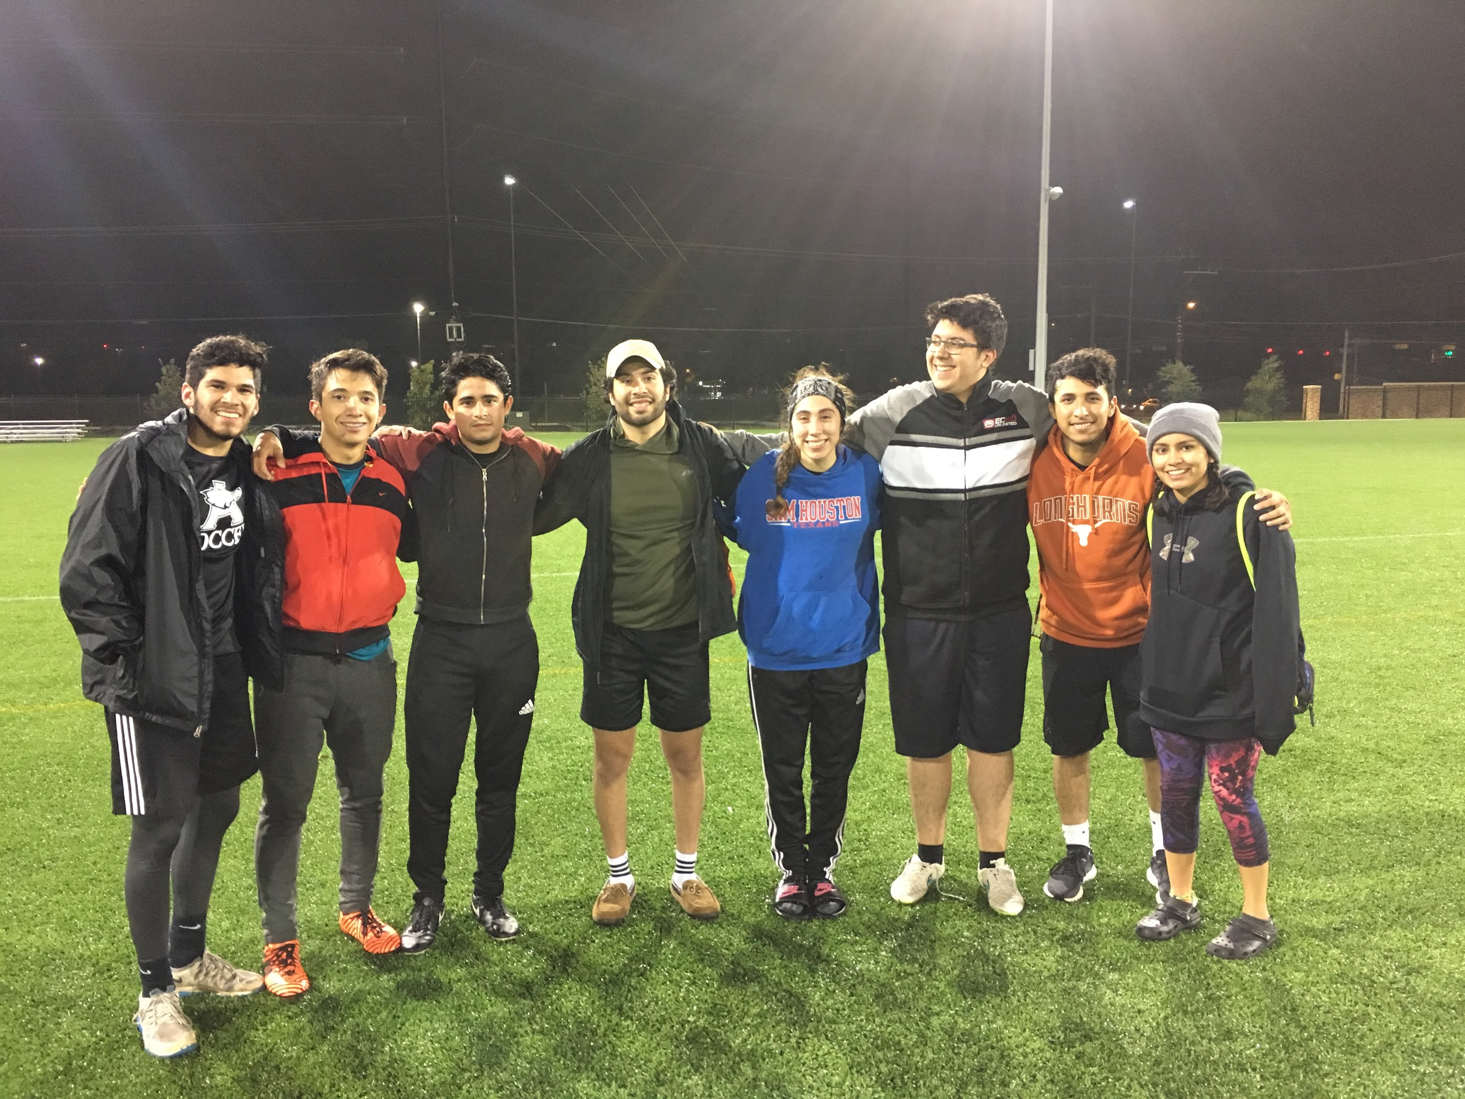
Leaving It All On The Field!!
IM Soccer Team 2k18
We will play Thursdays at 7pm this semester, sign up!

Slide 33
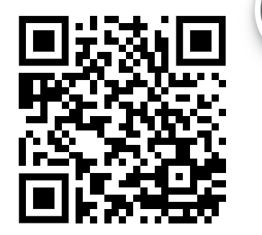
BUDDY System
Sign up to pair up with other people taking your classes!
The sooner the better

Slide 34
SNEAK PEEK

Slide 35
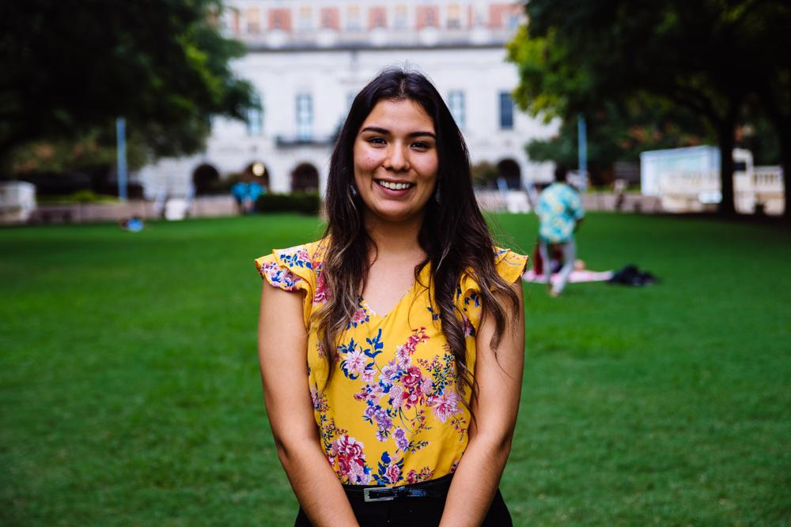
Andrea Martinez
Archives Director
Human Development and Family Sciences Major
3rd Year
Eagle Pass, TX
I spent winter break visiting my sister in Idaho & helping her plan her wedding!

Slide 36
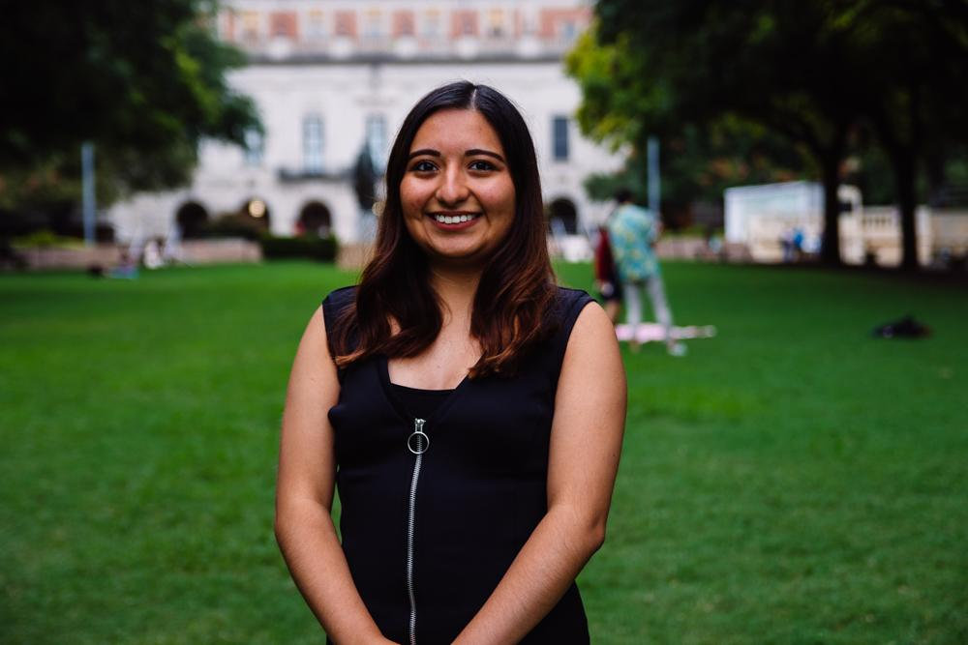
Valeria Sornia
Public Relations Director
Neuroscience Major
3rd Year
Eagle Pass, TX
I stayed home over the break and went to the casino for the first time!

Slide 37
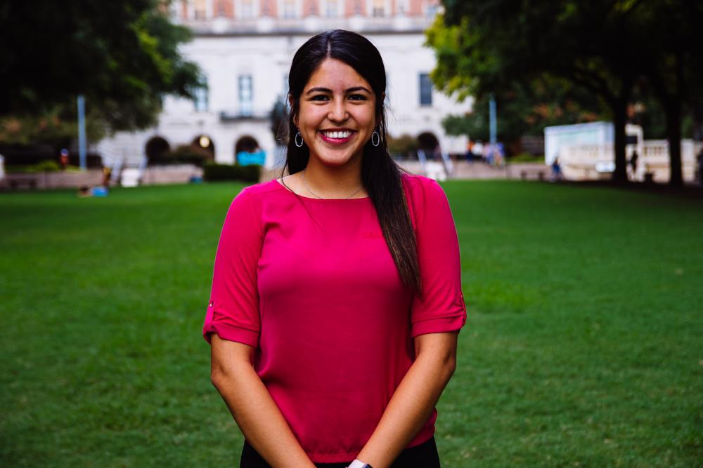
Jessica Medrano
IT Director
Neuroscience Major
3rd Year
Houston, TX
I went to Maryland for New Year’s and celebrated my cousin’s 21st!

Slide 38
Let us know if you have any questions!!

Slide 39
Thank You for Coming!!
Sign in here:
https://bit.ly/2DcygC0
1st General Body Meeting:
19 February 2019
6:45 pm
Texashhpo.weebly.com
texashhpo@gmail.com
HHPO (Hispanic Health Professions Organization)
@texashhpo

