Slide 1
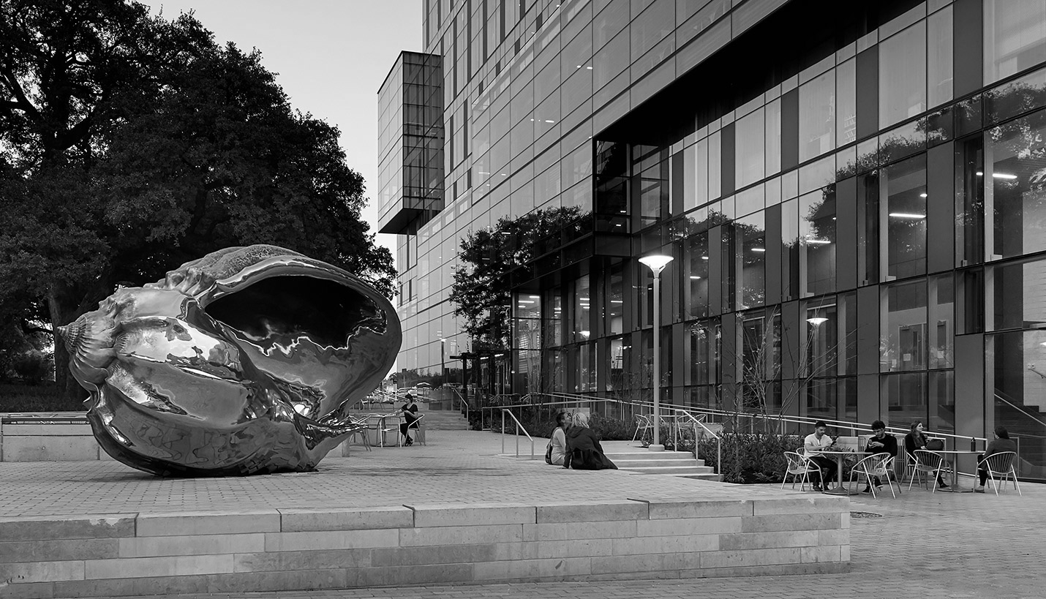

Hispanic Health Professions Organization
5th General Body Meeting
November 27, 2018, 6:45 pm
PAR 201
Sign In Here: https://tinyurl.com/y8lss86o

Slide 2
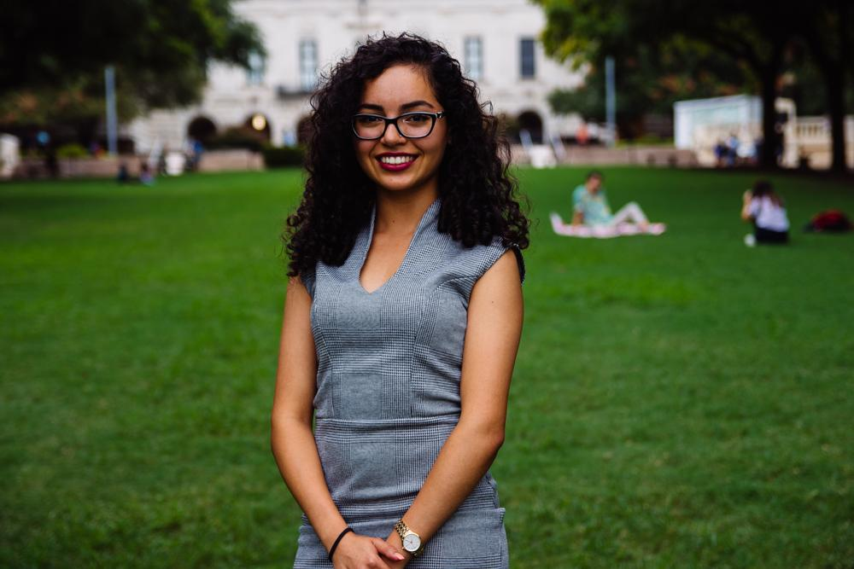
Evangelina Vaghefi
President
Psychology & Nutrition Double Major
5th Year
Fort Worth, TX
I like eating yogurt with chips :-)

Slide 3


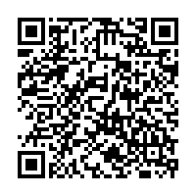
Dell Med
Student
Mixer
Location: Haymaker
  2310 Manor Rd, Austin, TX 78722
Rides Provided!
RSVP by Wednesday 11/28
Friday November 30th
5-6:30PM

Slide 4
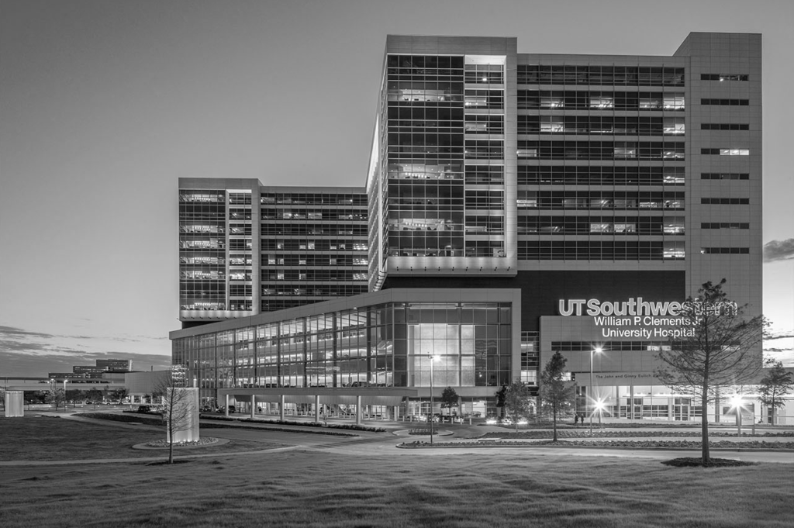
2019 Summer Research Trainee Program
Massachusetts General Hospital
Paid research opportunity at Harvard’s Medical School teaching hospital.
Deadline to apply: January 25, 2019
http://www.mghsrtp.org
Notes:
Below is a fantastic - and paid - opportunity to get involved in research next summer at Mass General in Boston (HMS teaching hospital). You'll be paired with a mentor based on your research interests which can be anything from basic science to translational or clinical. They cover your housing and all the summer trainees live in the same building, people come from all over.
This internship is a great opportunity and foot in the door to the Harvard network. I did this back in 2014- having this on my CV helped me get a job after the summer and I haven't left Boston since. Let me know if you have any questions about the application (due 1/25).
The Massachusetts General Hospital (MGH) Center for Diversity and Inclusion runs the Summer Research Trainee Program (SRTP). Founded in 1992, SRTP attracts college and medical students from around the nation to MGH. The goal of this program is to inspire students who are underrepresented in medicine (URM)* to consider careers in academic medicine by immersing them in cutting-edge research opportunities. Twenty students, selected from a nationwide competition, join SRTP each summer. Each student is assigned to a specific MGH laboratory, clinical site, health policy, or health services research area where they undertake an original research project under the mentorship and guidance of an MGH investigator. Assignments are carefully considered and are made with the student's research and career interests in mind. In addition to this unique research experience, students participate in weekly didactic seminars and career mentoring sessions and have opportunities for clinical shadowing at MGH.

Slide 5
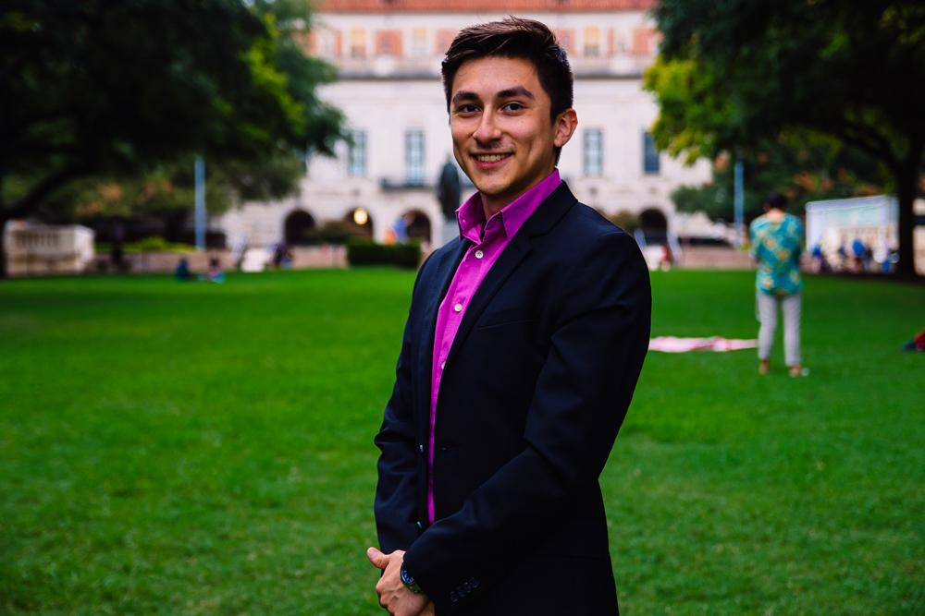
Cesar Gonzalez
VP of Professional Development
Neuroscience Major
Visual Media Minor
3rd Year
Roma, TX
Fun Fact:

Slide 6
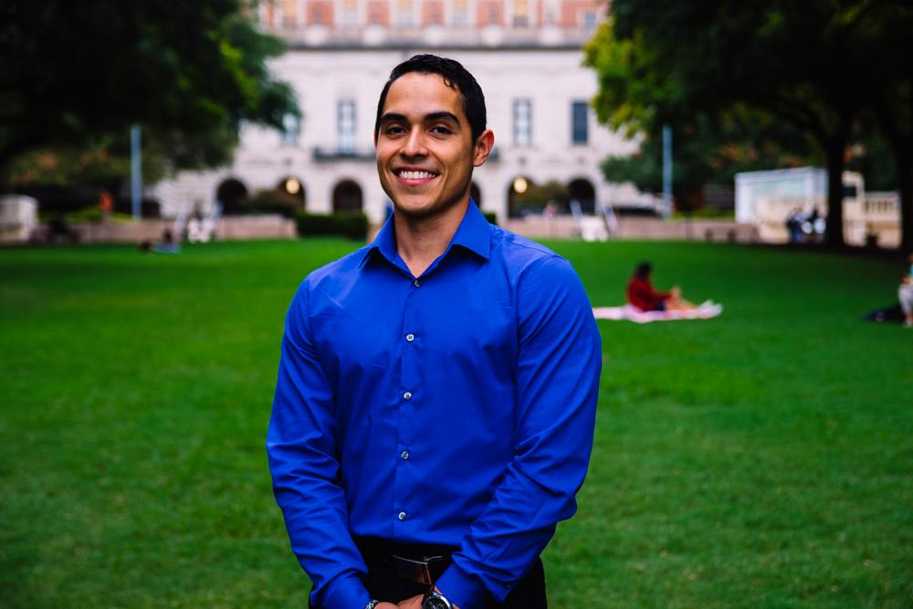
Javier Flores
VP of Community Development
Psychology Major, Pre-PA
3rd Year
Eagle Pass, TX
Fun Fact: I don’t have any finals.. :)

Slide 7
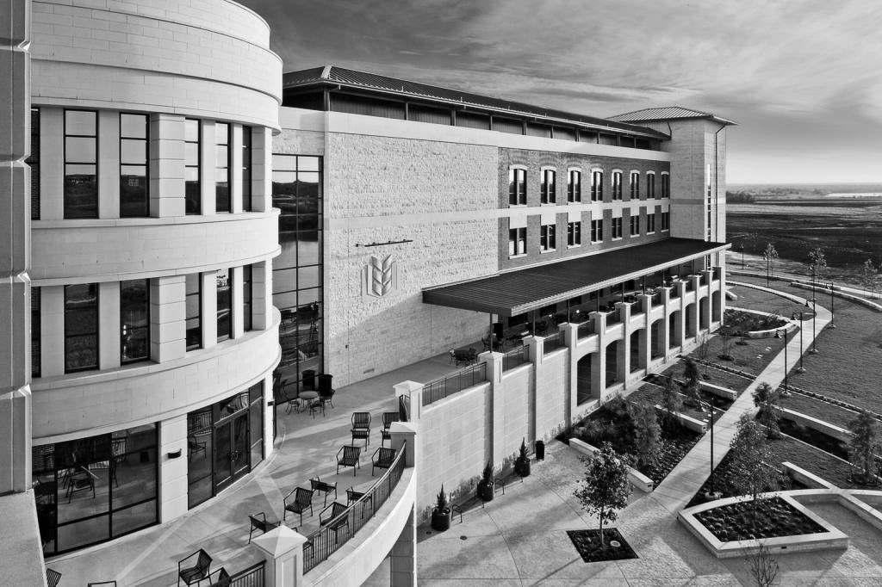
Mind Your Health
Co-hosting along side BHPO and other organizations
Where: Jester Auditorium A121
Time: 6:00 PM - 8:00 P.M.
Attire: Member Shirts
https://docs.google.com/…/1Av89dCizfotKwkGxOEDQcz…/viewform…
** MUST RSVP on the link to get a t-shirt or enter a raffle for gift cards**
**First 100 will recieve a t-shirt**
Free food, prizes and professional speakers.
Covering topics such as abuse, learning disorders, trauma, and more to help raise mental health awareness in the minority communities.

Slide 8
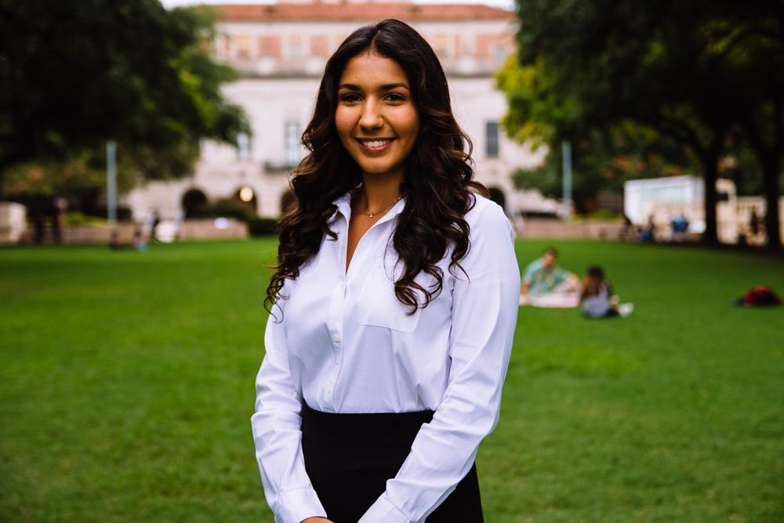
Bianca Garcia
Secretary
Kinesiology Major
3rd Year
Houston, TX
Fun Fact: I have a business minor and you should too!! Message me about applying to McCombs Summer Institute!

Slide 9
ACTIVE MEMBER POINTS
FIVE Volunteer
THREE Social
FIVE Professional
FOUR Fundraising
THREE General Body Meetings
The point sheet is up to date: https://tinyurl.com/yc85l9aq
Let me know if you have any questions!!
biancagarcia207@utexas.edu

Slide 10
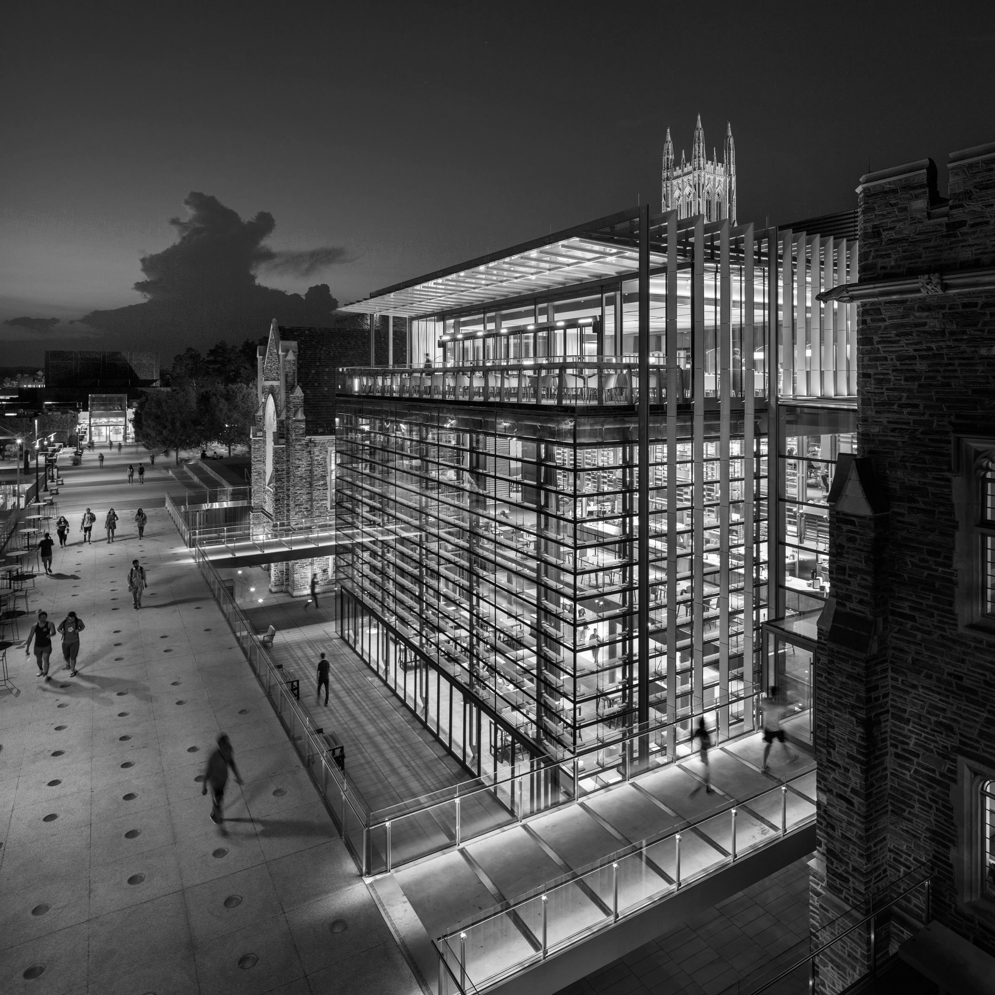
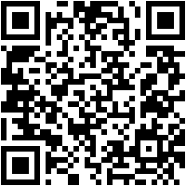
Join the GroupMe!

Slide 11
Important Announcement
Point system
For ALL events involving ride assignments and headcounts, cancellation notice needs to be given 48 hours in advance with valid reasoning to officer hosting event.
** If no notification is received & you are not present at the event, points that would have been earned will be deducted from that respective category of points (volunteering, fundraising, etc.)**

Slide 12
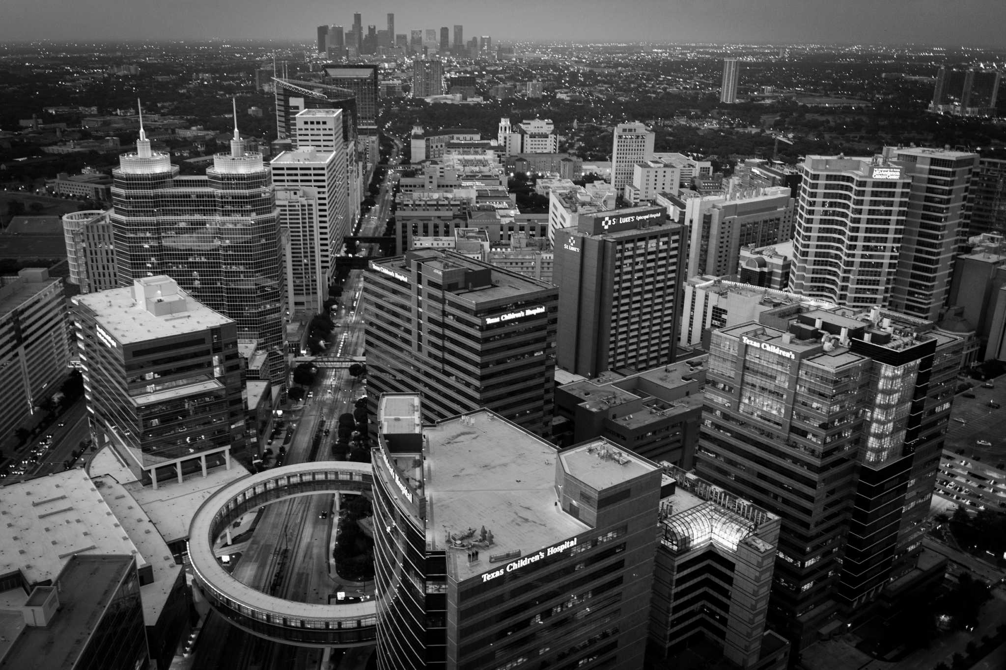
Member of the Month of October:
Christopher Rogel
Thank you so much for you hard work and involvement in HHPO!

Slide 13
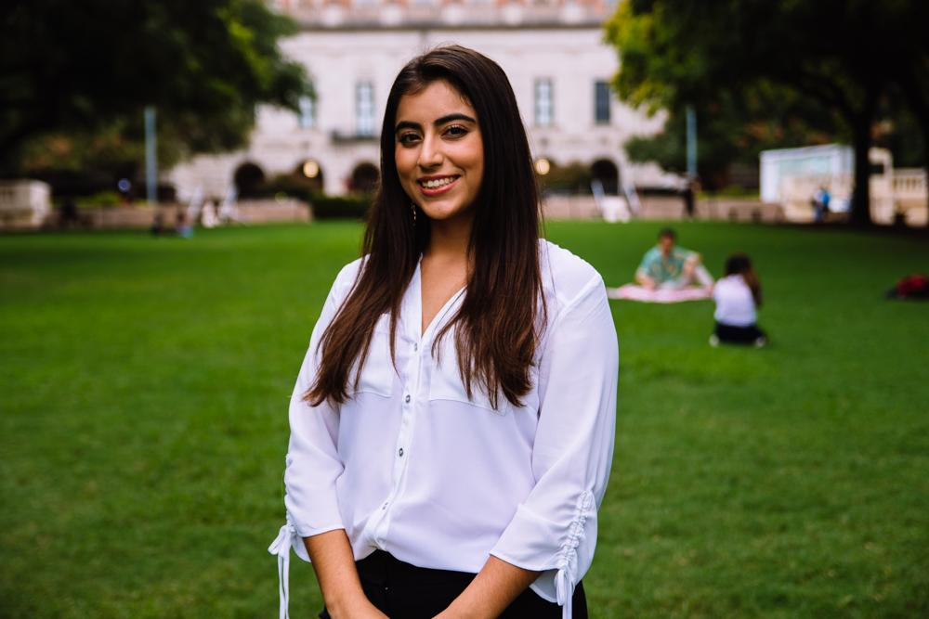
Suzett Fernandez
Financial Director
Human Development and Family Sciences Major
3rd Year
Eagle Pass, TX
I love to dance

Slide 14
DUES
$55 Returning Members
$65 New Members
Includes a Tshirt!
Venmo: @Texas-HHPO
(Please state New/Returner)
Paypal: texashhpo@gmail.com ($2 fee)
Cash or Card
**Email: sfdzz97@gmail.com
- include your name, EID, phone number

Slide 15
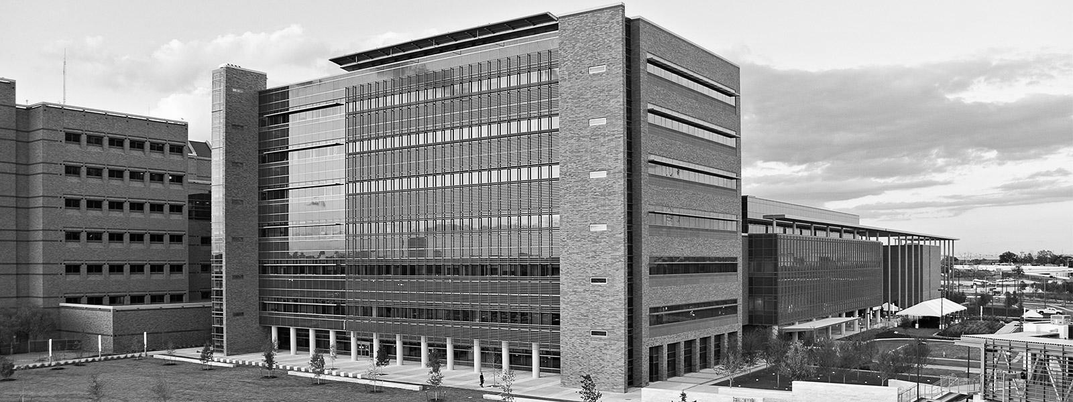
Breakfast Tacos Sale
Come join us and earn a fundraising point!
When: Friday, November 30th
Where: In front of Greg
Time: 8:00am-11:00am

Slide 16
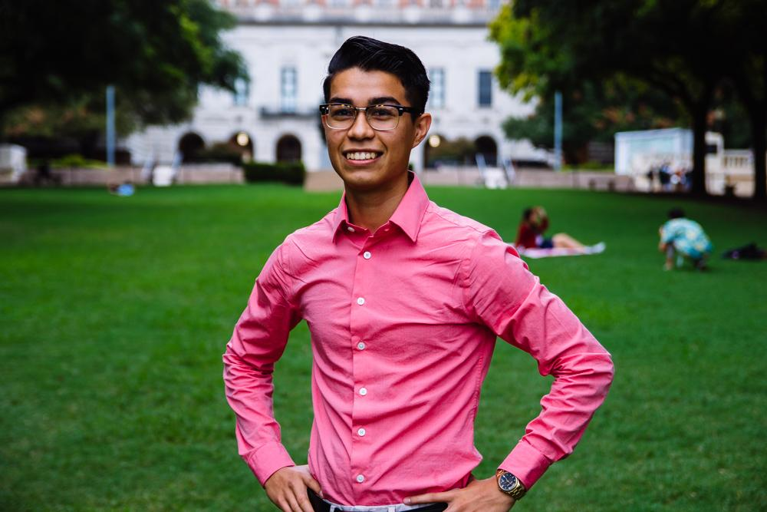
Emmanuel Rayas
Volunteer Director
Biochemistry, BSA
4th Year
San Antonio, TX
I drink on average one coffee and one energy drink per day.

Slide 17

HHPO Project Applications
Deadline: Friday Nov 30th
Health Booklets Project
The inmate population of Texas and correspondents of Inside Books.
https://goo.gl/forms/SCFLDyr4tIngzeoR2
Holistic Treatment Curriculum Committee
The Hispanic immigrant mothers and children housed by Posada Esperanza.
https://goo.gl/forms/oWJ9hnE8YdpmRlyV2

Slide 18
Population Based Volunteering
The Youth
Communities in Schools
The Elderly
Bingo at The Nursing Home
The Homeless
Homecooked Fridays
The Incarcerated
Inside Books
The Public
We Are Blood
The Ecosystem
Texas Athletics

Slide 19
Recurring on your Schedule
Thursday
Inside Books
7-11PM
3121 E 12th St
Austin, TX 78702
insidebooksproject@gmail.com
Friday
Homecooked Fridays
1-3PM & 3-5PM
209 W. 27th St. Austin, TX 78705
Sign-up found on digest.
HHPO Bingo at the Nursing Home
Friday 7-8PM
2806 Real St Austin, TX 7872*
Bus Route 18 on MLK & San Jac
Sunday
Inside Books
5-9PM
3121 E 12th St
Austin, TX 78702
insidebooksproject@gmail.com

Slide 20
Questions & Events
Communities in Schools
Become a mentor for a child enrolled in CIS, a National program aimed to increase the graduation rates of the at-risk youth. Be part of society’s effort to give these kids an equal opportunity.
We Are Blood
Donating blood is at the essence of one human being able to give life to another. Facilitate this act of public health by becoming involved in the process in more ways than one.
Sign-ups are online but i have gone through the process myself to guide you- erayas@utexas.edu

Slide 21
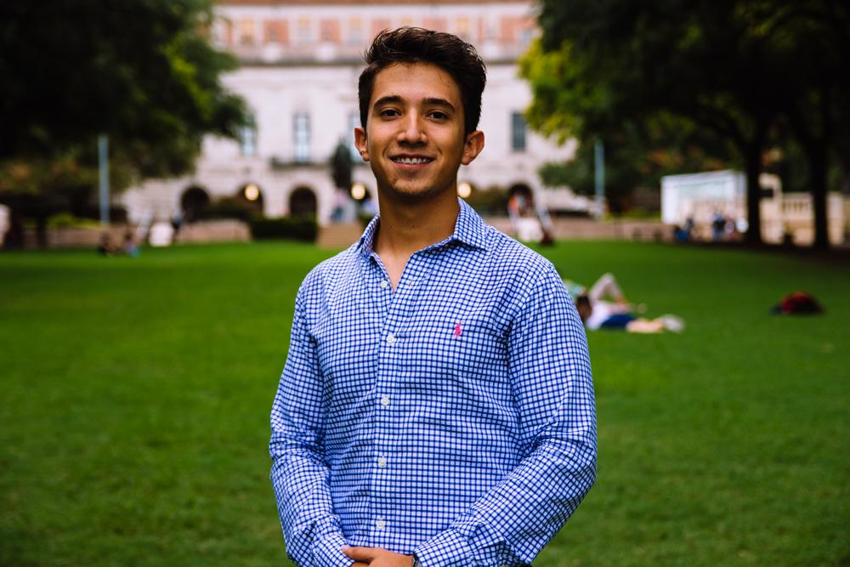
Marcelo Pintos
Social Director
Biochemistry BSA Major
3rd Year
Mcallen, TX
Fun Fact: My first concert ever was Skrillex

Slide 22
Buddy System has kicked off!
All groups have been completed since last week. Let me know if you have not received an email and have signed up!

Slide 23
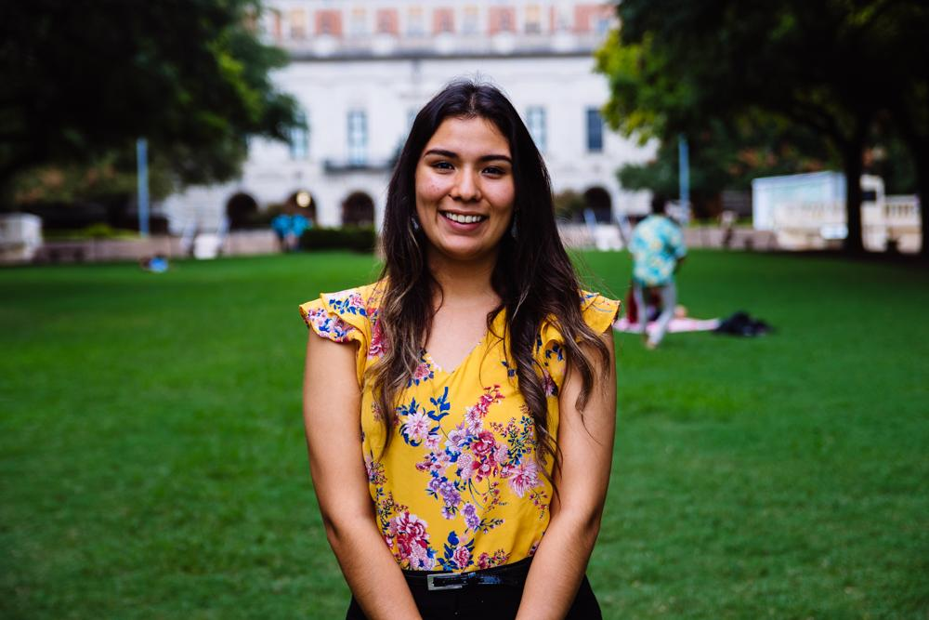
Andrea Martinez
Archives Director
Human Development and Family Sciences Major
3rd Year
Eagle Pass, TX
Fun Fact: My 21st birthday is next weekend yay :)

Slide 24
Send in pictures
for the scrapbook!
Can be selfies, groups, silly pictures, etc.
Want to try and include as many of you as possible!
texashhpo@gmail.com
Subject Line: “Scrapbook Pictures” with your name and EID!
Crafting dates after winter break :)

Slide 25
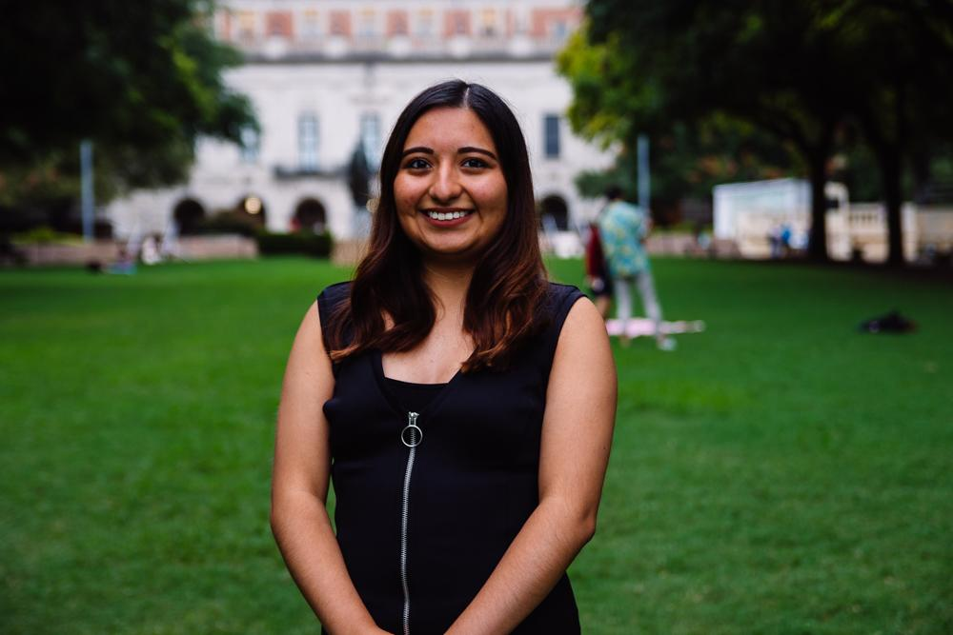
Valeria Sornia
Public Relations Director
Neuroscience Major
3rd Year
Eagle Pass, TX
Fun Fact: I love cheesecake!

Slide 26

Instagram Story Highlights
Missed an event and wondering how it went? Check out our Instagram Story highlights!
Volunteer, Social, Professional, Community, Fundraising!
Upcoming events: Dell Med Mixer and White Elephant Xmas Party!
@texasHHPO

Slide 27
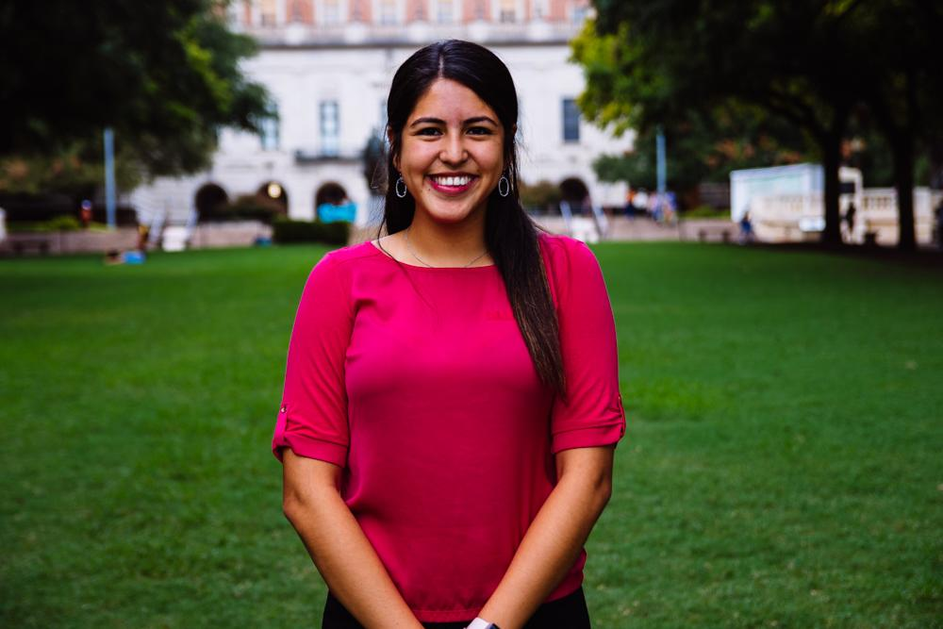
Jessica Medrano
IT Director
Neuroscience Major
3rd Year
Houston, TX
Fun Fact: I have a missing nail :)

Slide 28
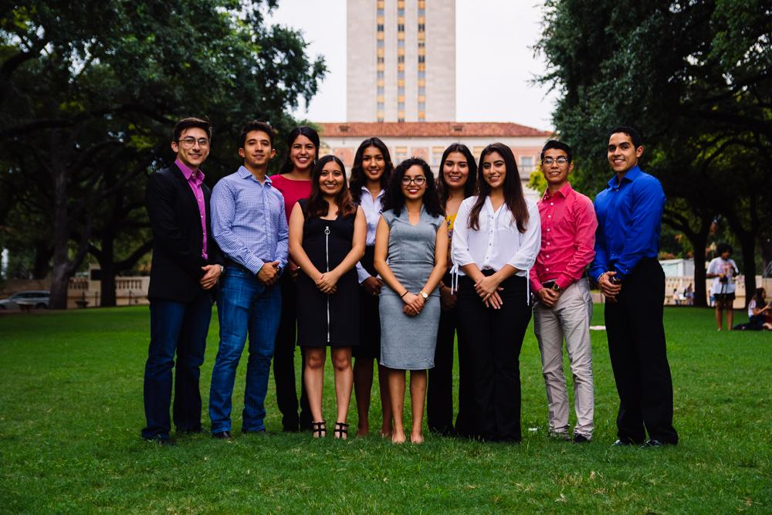
Let us know if you have any questions!!

Slide 29


Thank You for Coming!!
Sign in here:
https://tinyurl.com/y8lss86o
Texashhpo.weebly.com
texashhpo@gmail.com
HHPO (Hispanic Health Professions Organization)
@texashhpo

