Slide 1
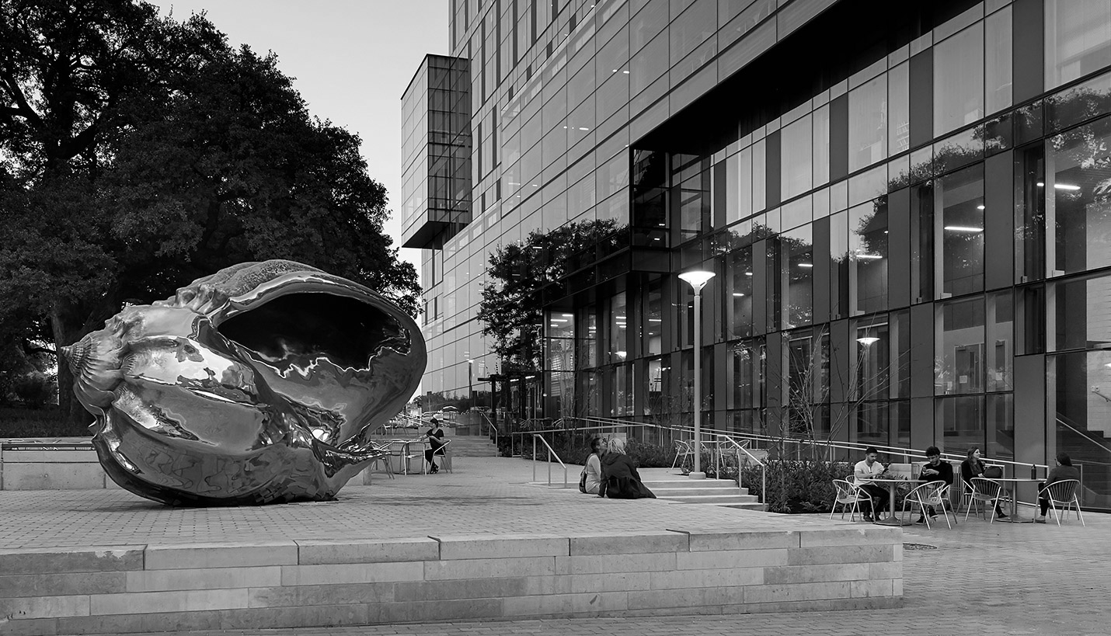
Hispanic Health Professions Organization
4th General Body Meeting
November 6, 2018, 6:45 pm
PAR 201
Sign In Here:

Slide 2
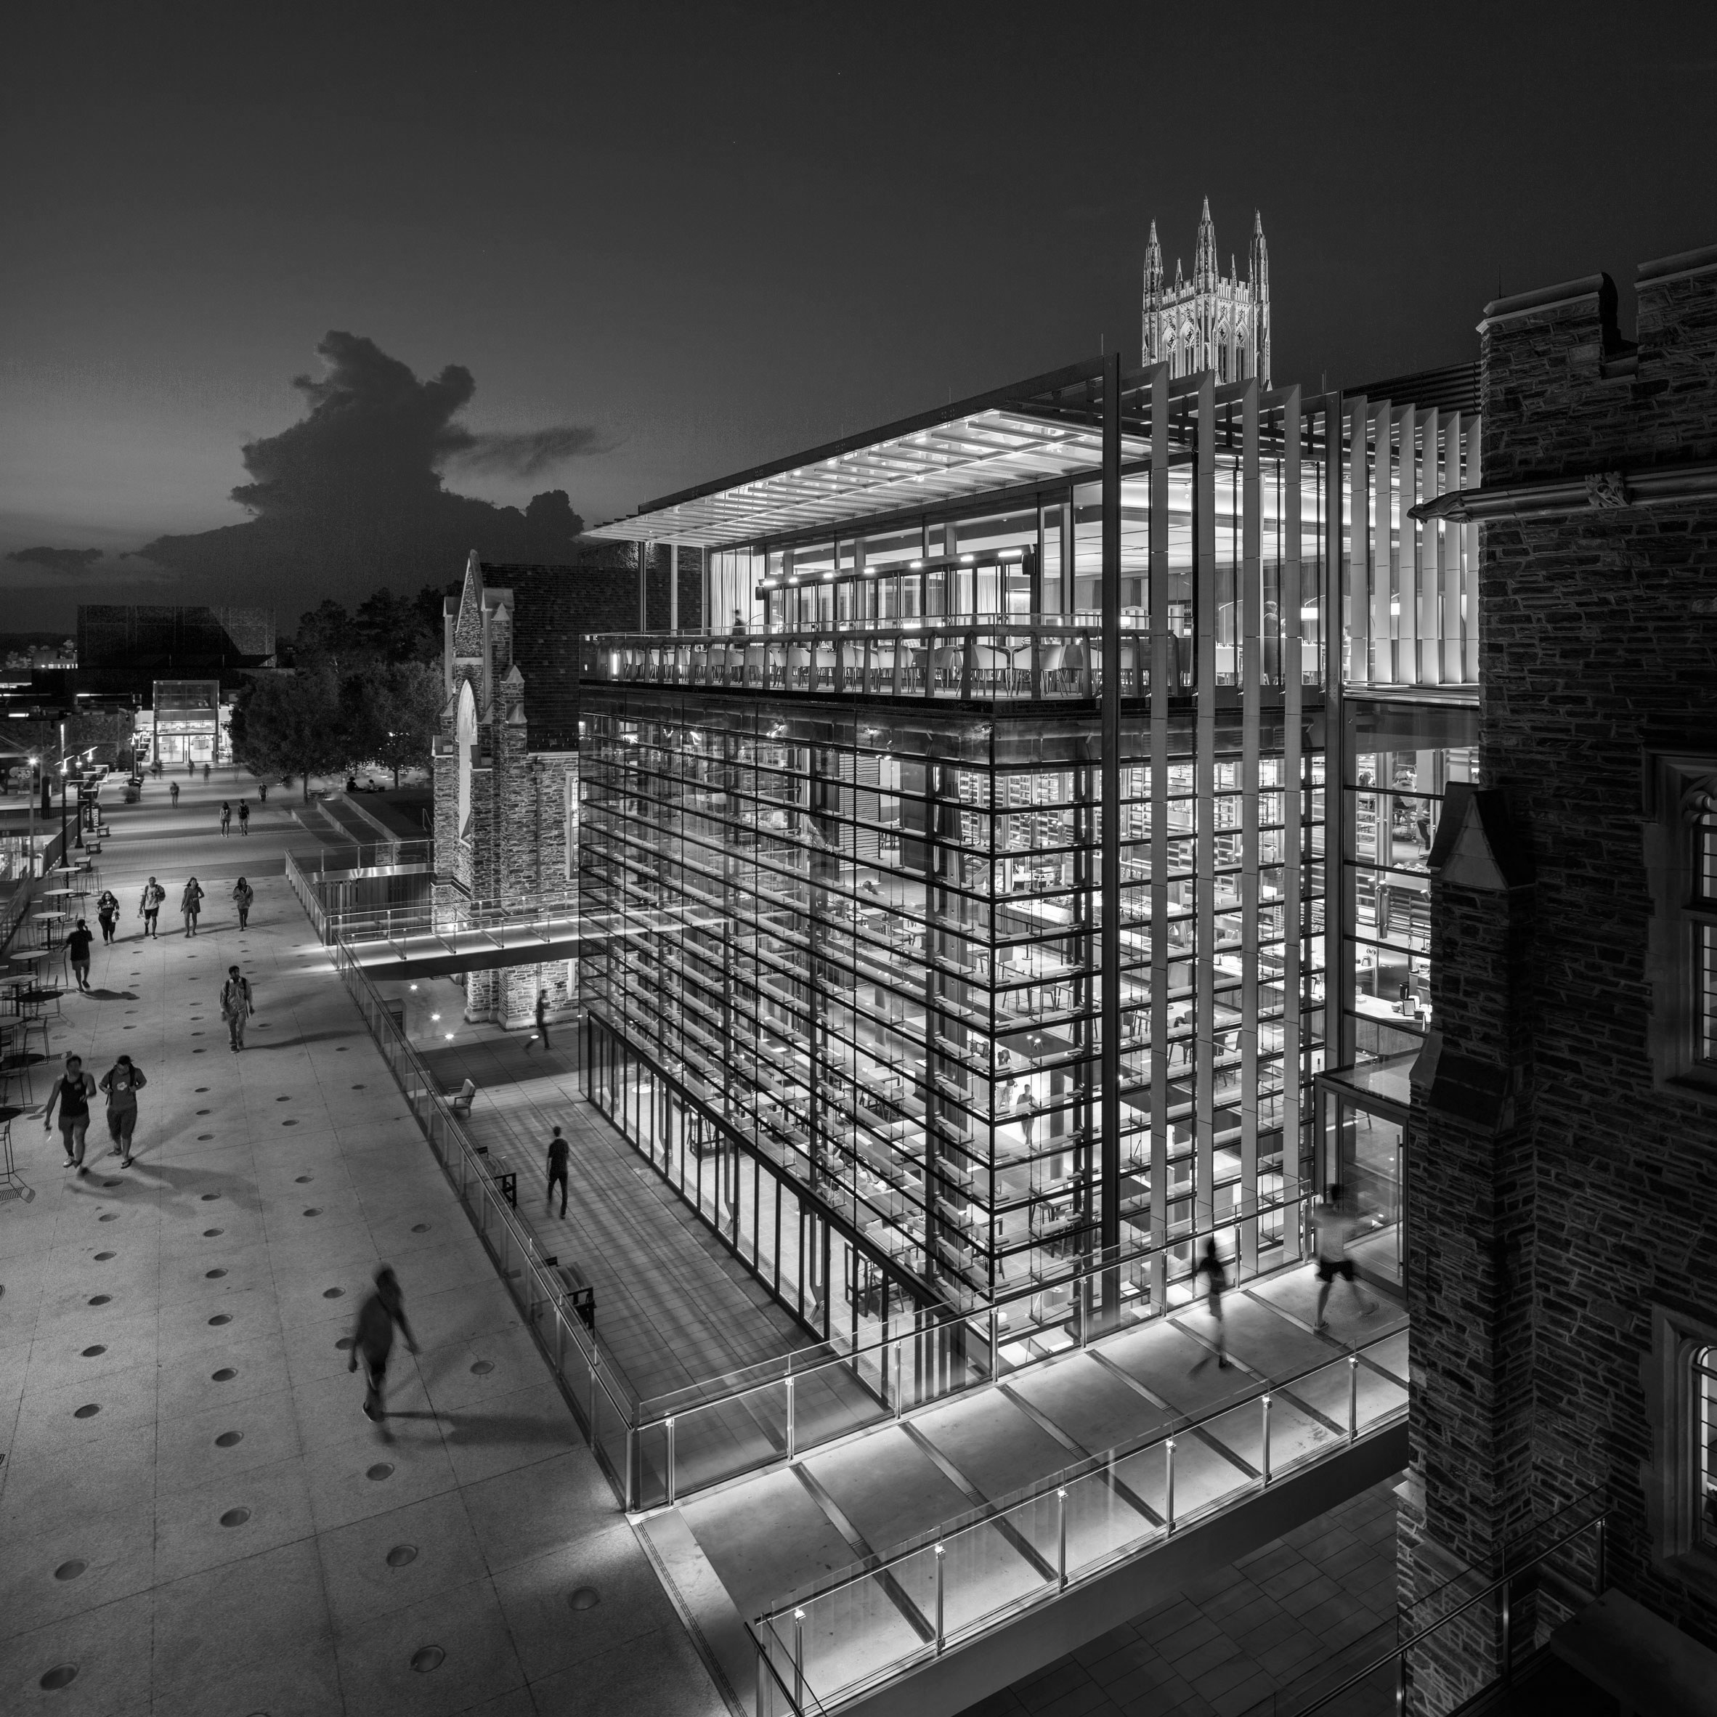
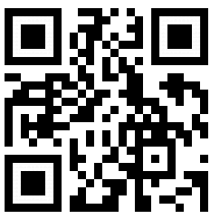
Mid-Semester Assessment

Slide 3
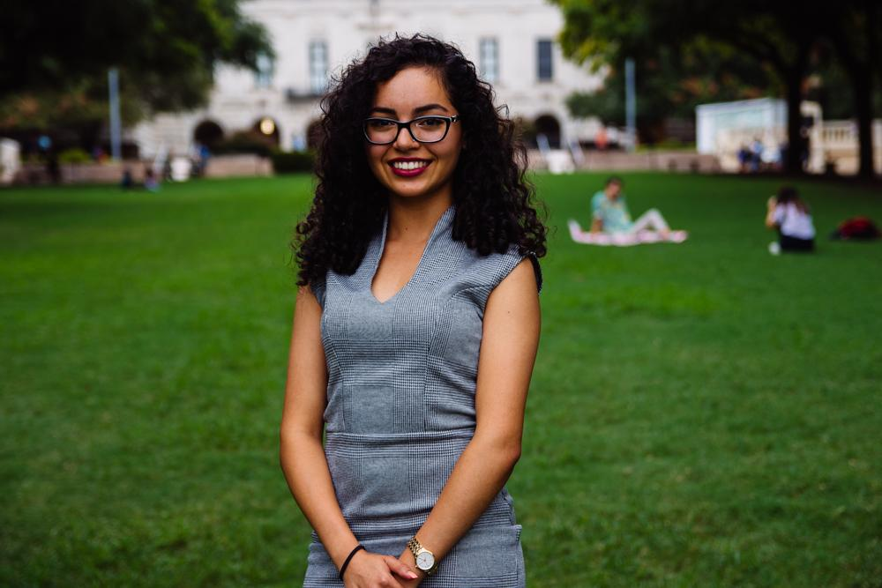
Eva Vaghefi
President
Psychology & Nutrition Double Major
5th Year
Fort Worth, TX
Fun fact: I like eating chips with yogurt :-)

Slide 4
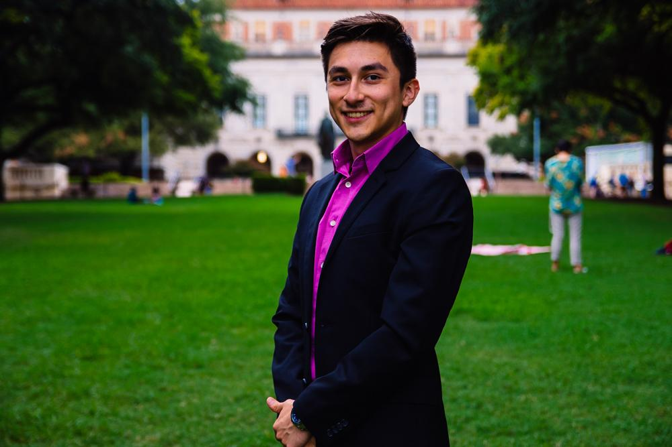
Cesar Gonzalez
VP of Professional Development
Neuroscience Major
Visual Media Minor
3rd Year
Roma, TX
Fun Fact:

Slide 5
How to Work in Healthcare without being a Doctor
Wednesday, November 7
5:30 - 6:30pm / Room: PAI 4.42
Panel discussion with current and former students who have careers in healthcare-related industries. These jobs are targeted for students without any graduate or professional degree after graduating UT.

Slide 6
Medical Laboratory Science Info Session (Post Bach.)
Wednesday, November 7
3:30 - 5pm / Room: POB 2.302
MLS is a great career-field to join with an expanding job market and an average starting pay of $60K. There will be speakers from around the state of Texas talking about what an MLS career-field entails and how to get started.
This is a great job opportunity for students considering a gap year.

Slide 7
Improve Your Professional Literacy
Wednesday, November 14
6 - 7pm / Room: TBA
Email etiquette
Email signature
Resume formatting
Social media behavior
Etc.

Slide 8
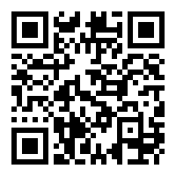
UTHSCSA Med-School Trip
Saturday, November 17
Time TBA
Rides will be provided
Sign up here:

Slide 9
Entrance Exam Preparation
15% discount - prep courses
10% discount one on one tutoring
Our Partner

Slide 10
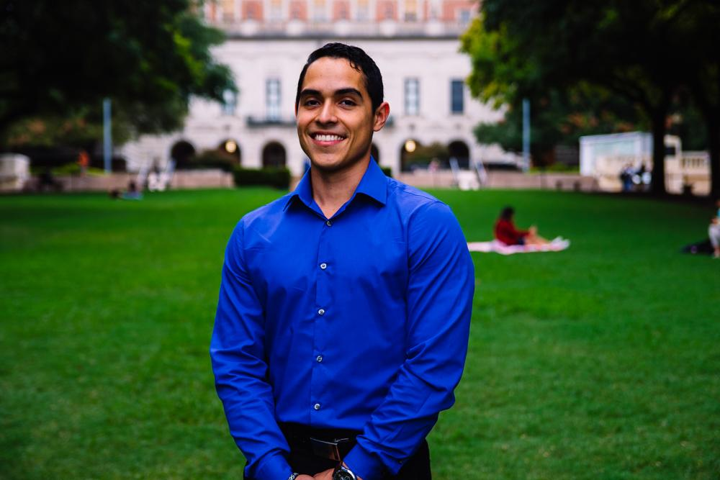
Javier Flores
VP of Community Development
Psychology Major, Pre-PA
3rd Year
Eagle Pass, TX
Fun Fact:

Slide 11
Let’s Talk Diabetes Awareness Week!!

Slide 12
Monday, November 5th
Interactive Tabling
Where: Greg Plaza
When: 6- 7 PM
Snacks: Bars & Waters
Ribbons
Pamphlets
T-shirt giveaway!!

Slide 13
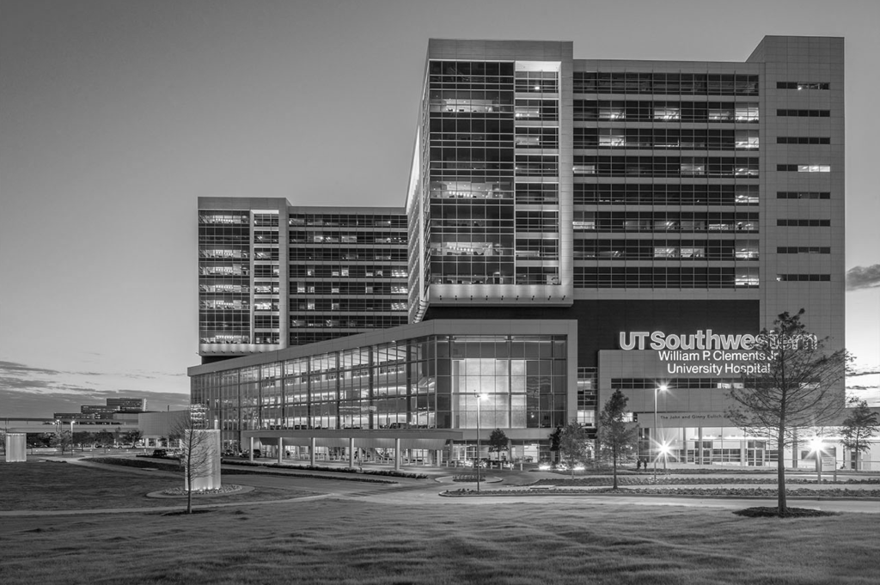
Tuesday, November 6th
Type Texas
Tentative Informational Meeting With A Dietician
Where & When: TBA

Slide 14
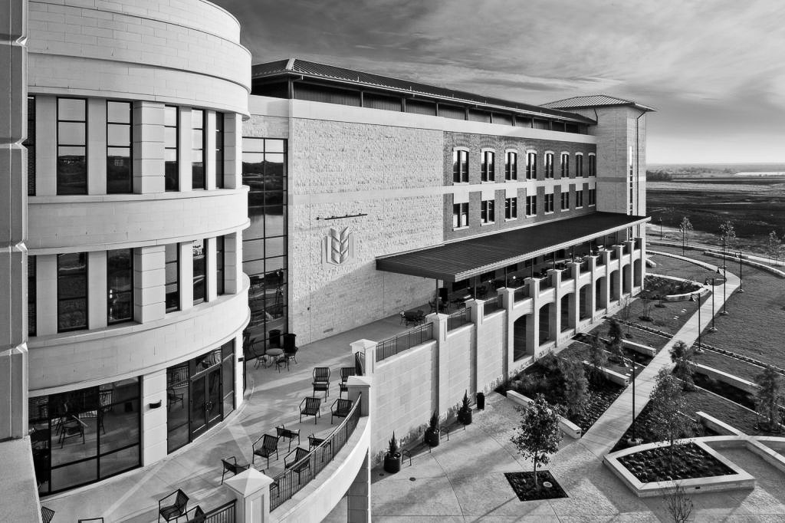
Wednesday, November 7th
Dodgeball Tournament
Where: Whitaker Courts
Time: TBA
$25 total
5 players per team
Collaboration with BHPO, Pre-PA Society, Texas Infinites, Texas Bluebonnets, Texas Latin Dance, Type Texas, Texas Fuego

Slide 15
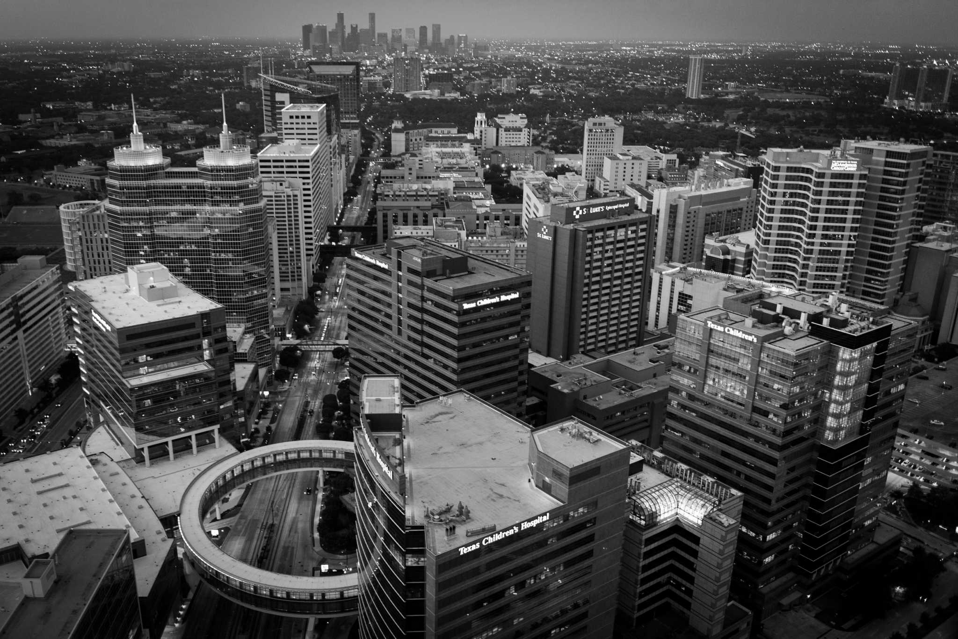
Thursday, November 8th
Texas Latin Dance Collaboration
Where: UNB 3.312 T-house Suite
When: 7-9 pm
Dance Merengue, Bachata, Salsa etc.

Slide 16
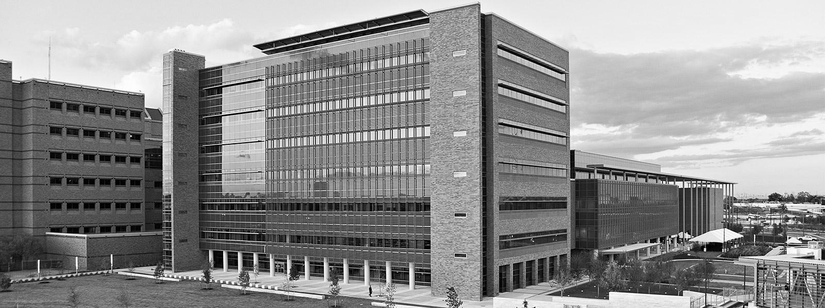
Friday, November 9th
DAW Dinner with Guest Speaker Dr. Solis M.D.
Where: SAC 2.302 Legislative Assembly Room
When: 6-8 pm
Attending Physician: Valerie Chavez M.D.
Physician & Functional Medicine Practitioner

Slide 17
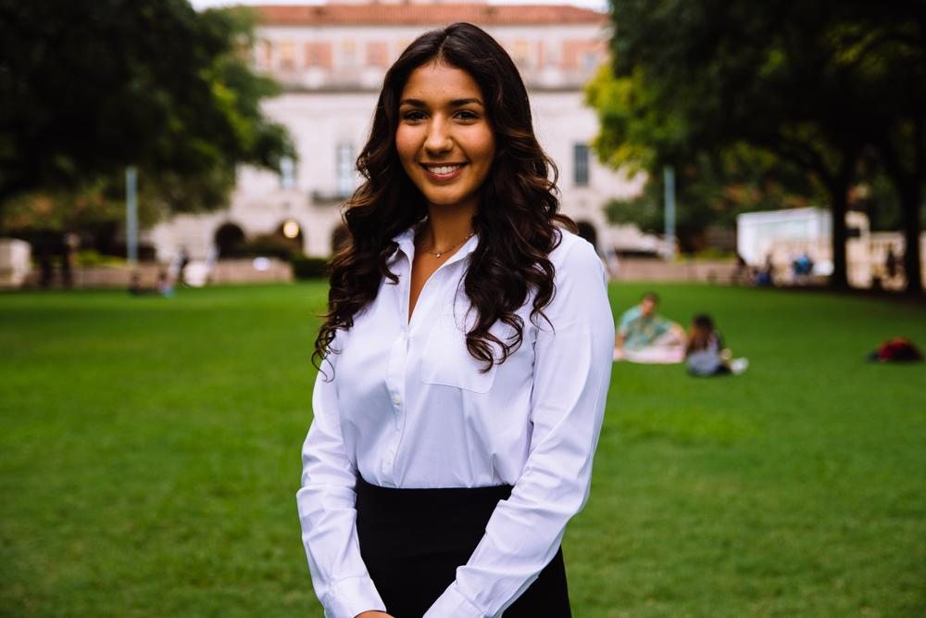
Bianca Garcia
Secretary
Kinesiology Major
3rd Year
Houston, TX
Fun Fact: I’m going to Los Angeles, California with my family for my 21st Birthday in January!!

Slide 18
ACTIVE MEMBER POINTS
FIVE Volunteer
THREE Social
FIVE Professional
FOUR Fundraising
THREE General Body Meetings
The point sheet is up to date: https://tinyurl.com/yc85l9aq
Let me know if you have any questions!!
biancagarcia207@utexas.edu

Slide 19
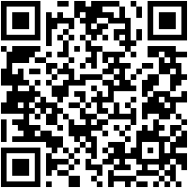
Join the GroupMe!

Slide 20
Important Announcement
Point system
For ALL future events, cancellation notice needs to be given 48 hours in advance with valid reasoning to officer hosting event.
** If no notification is received & you are not present at the event, points that would have been earned will be deducted from that respective category of points (volunteering, fundraising, etc.)**

Slide 21
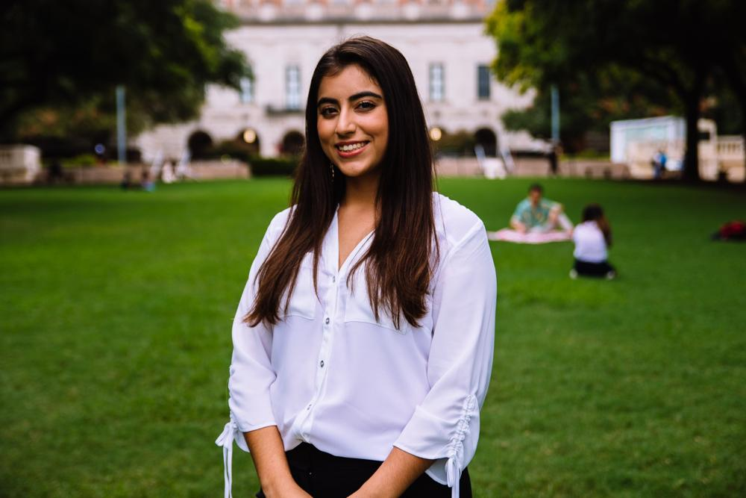
Suzett Fernandez
Financial Director
Human Development and Family Sciences Major
3rd Year
Eagle Pass, TX
I love to dance

Slide 22
DUES
$55 Returning Members
$65 New Members
Includes a Tshirt!
Venmo: @Texas-HHPO
(Please state New/Returner)
Paypal: texashhpo@gmail.com ($2 fee)
Cash or Card
**Email: sfdzz97@gmail.com
- include your name, EID, phone number

Slide 23
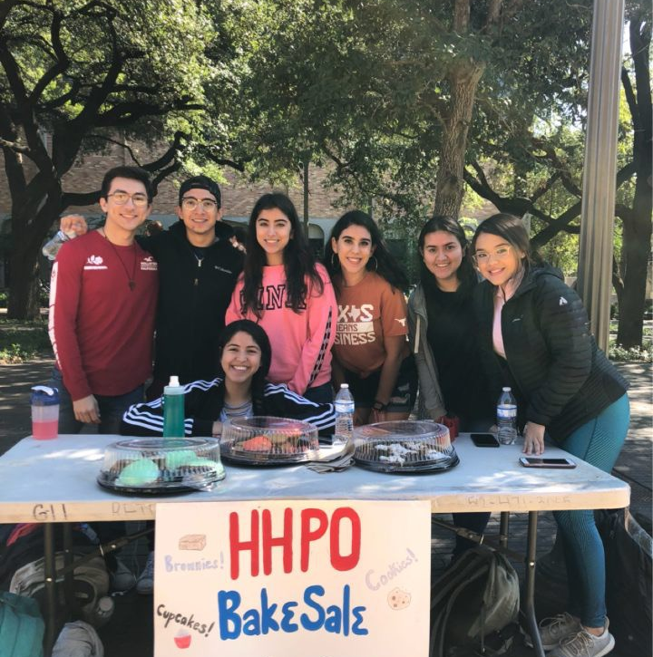
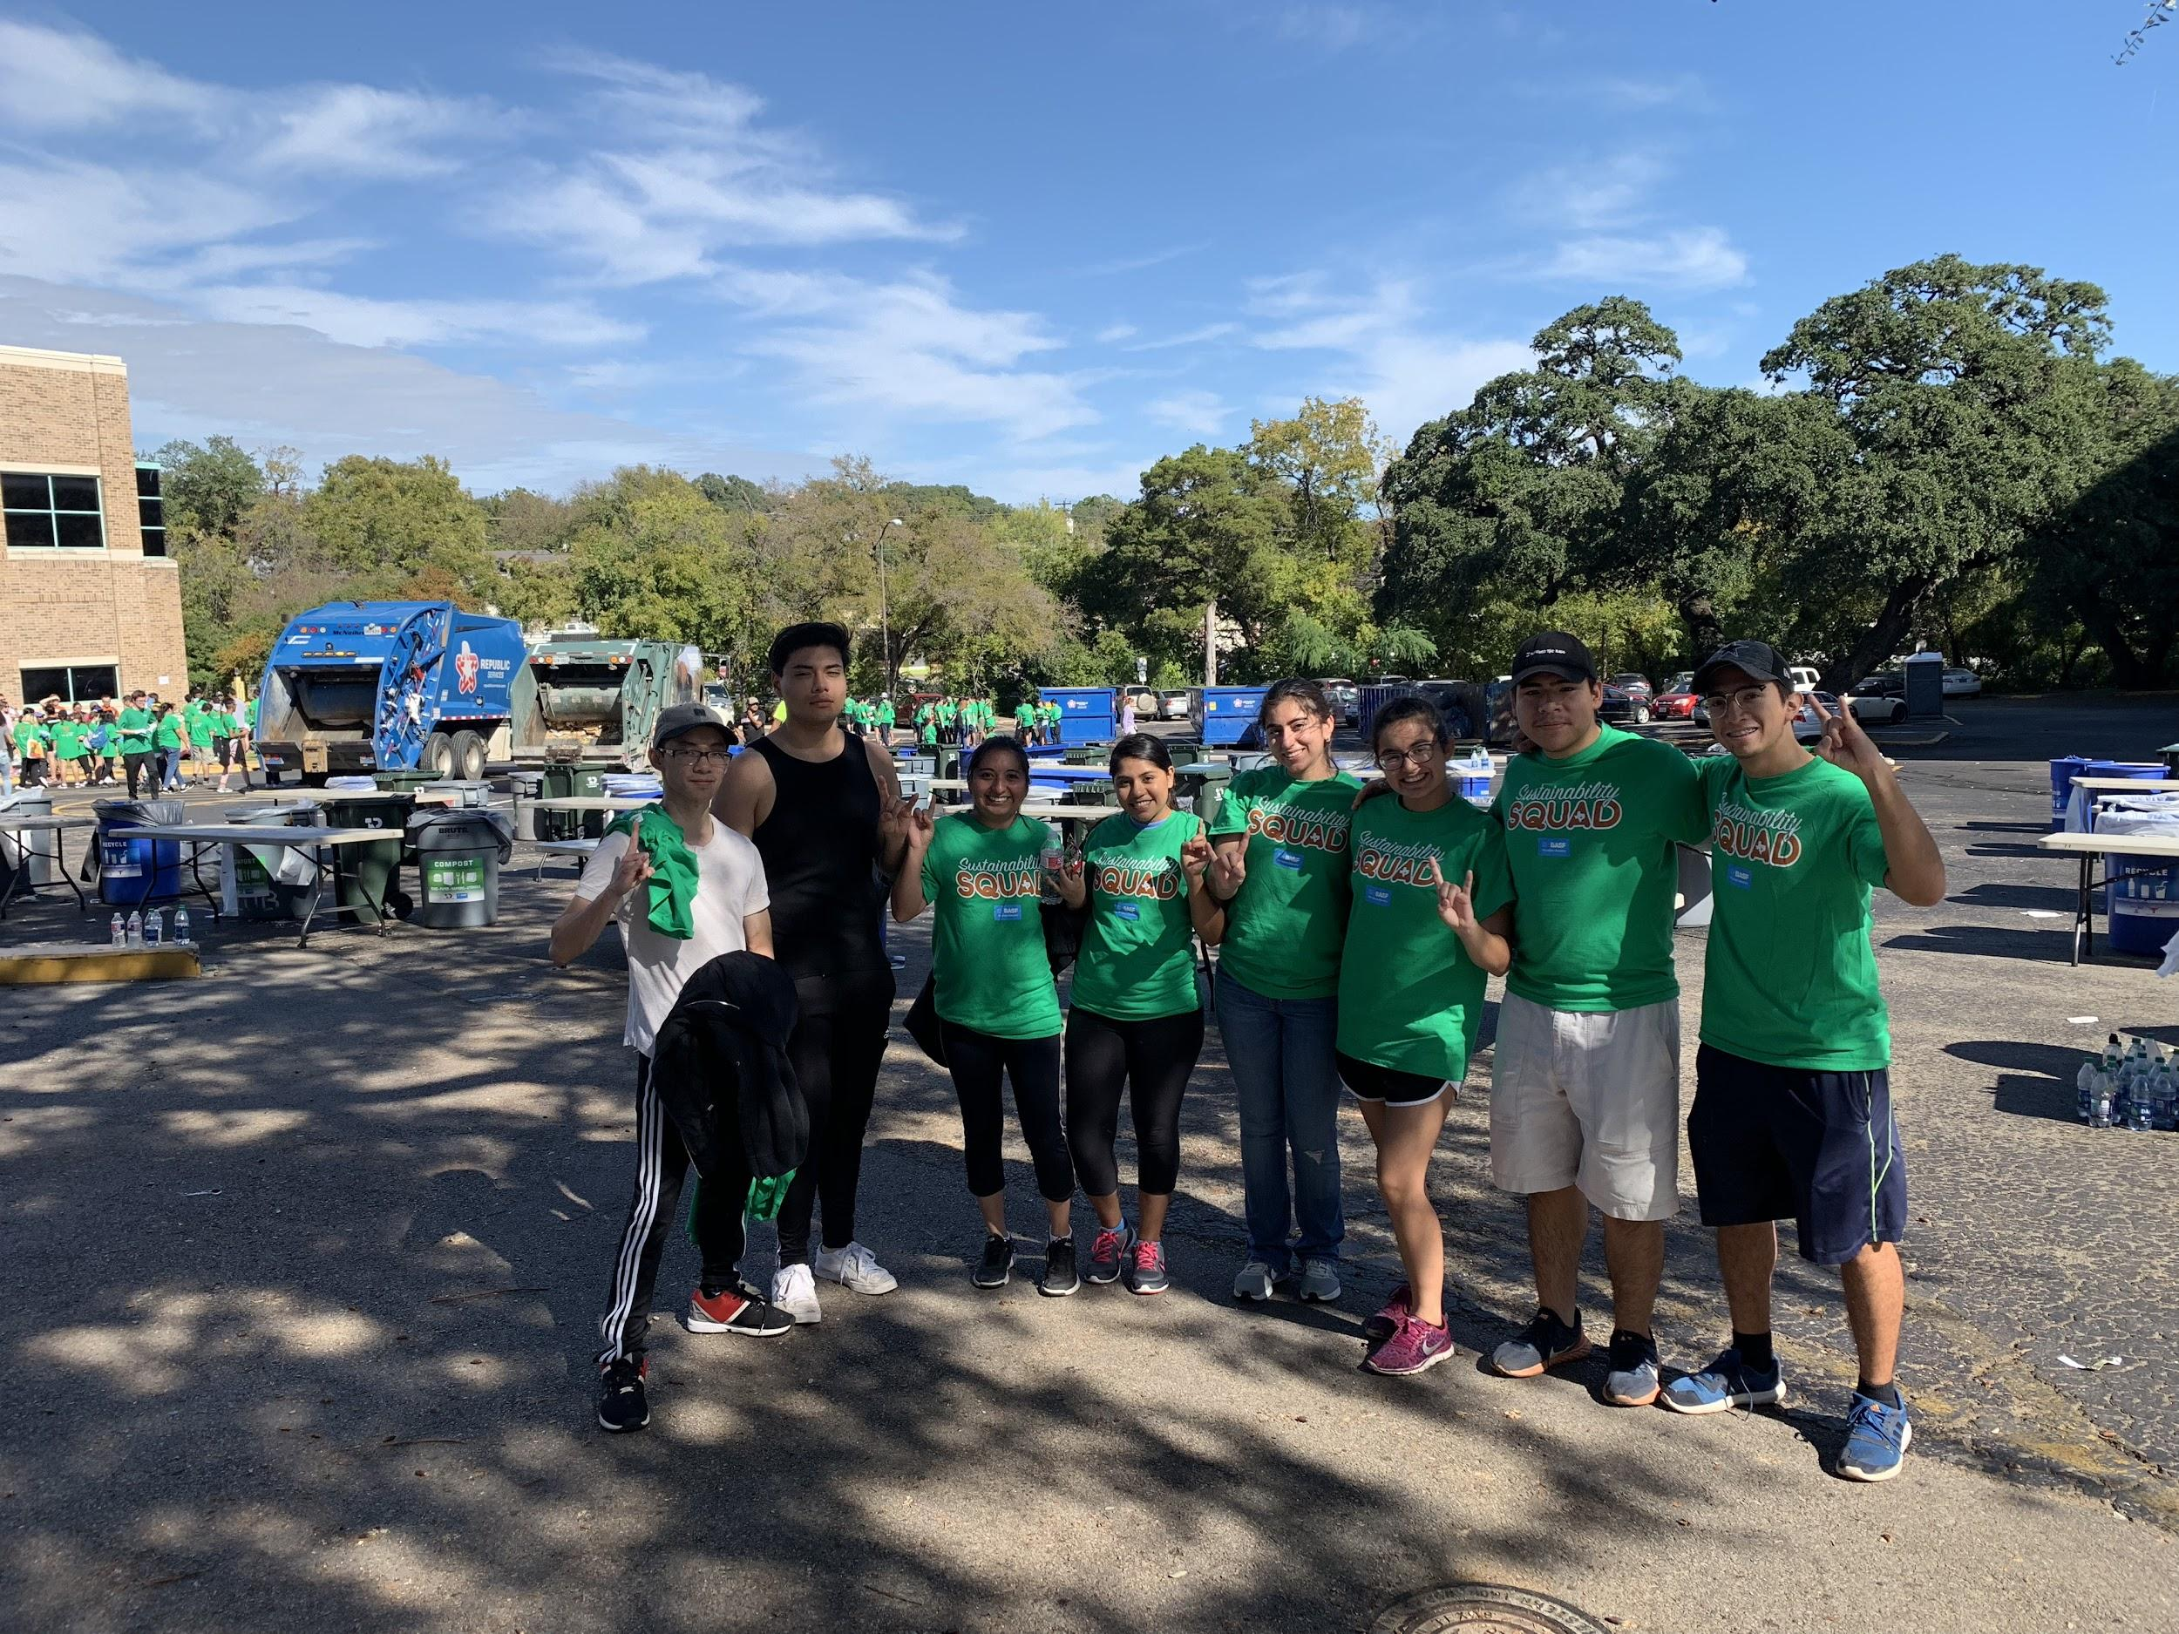
Thank you all for coming out and helping HHPO Fundraise!

Slide 24
Texas Athletics Sustainability
Do you want to earn both a fundraising and volunteer point?
WHAT: We will be sorting waste produced during the game into proper streams.
PLEASE wear comfortable clothes and closed-toed shoes and be prepared to get dirty.
WHEN: November 18th
TIME: 10:15-1:30pm
WHERE: LOT 53 (2699 Speedway, Austin, TX 78712)
LINK TO SIGN UP: https://docs.google.com/forms/d/19RCtyVA7_gJDmhQ8lDH_pD0N38oxBOywTzeXWPddDfE

Slide 25
Leadership Opportunity
The Leadership and Ethics Institute
Position: facilitators on the Student Leadership Team
Application found on Hornslink
Due: November 8th
Texas Leadership Summit
Leadership Education And Progress
Project LEAD
Workshops on Demand
Burnt Orange Leadership Development

Slide 26
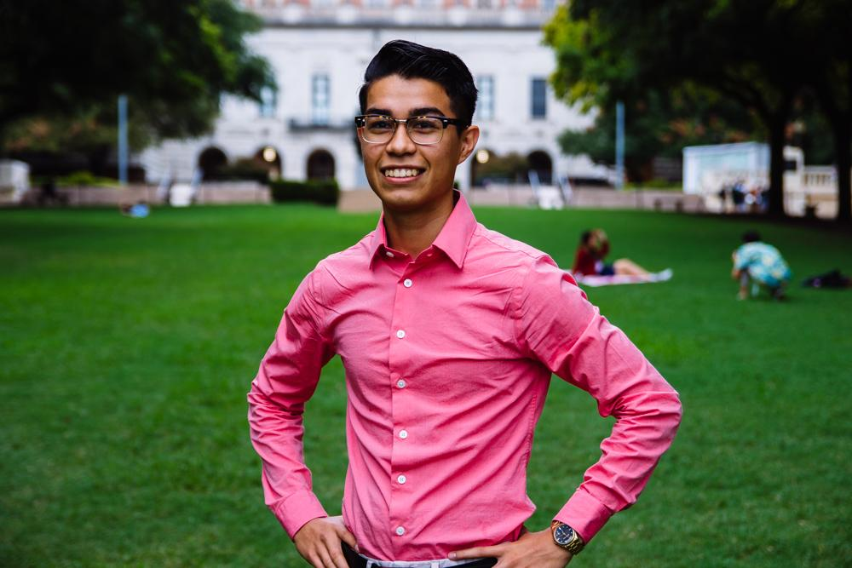
Emmanuel Rayas
Volunteer Director
Biochemistry, BSA
4th Year
San Antonio, TX
The Mountain Dews from from the vending machine at the CLA are expired but I keep buying them.

Slide 27
“What starts here changes the World”
Health Booklets Project
The inmate population of Texas and correspondents of Inside Books.
https://goo.gl/forms/SCFLDyr4tIngzeoR2
Holistic Treatment Curriculum Committee
The Hispanic immigrant mothers and children housed by Posada Esperanza.
https://goo.gl/forms/oWJ9hnE8YdpmRlyV2

Slide 28
Population Based Volunteering
The Youth
Communities in Schools
The Elderly
Bingo at The Nursing Home
The Homeless
Homecooked Fridays
The Incarcerated
Inside Books
The Public
We Are Blood
The Ecosystem
Texas Athletics

Slide 29
Recurring on your Schedule
Thursday
Inside Books
7-11PM
3121 E 12th St
Austin, TX 78702
insidebooksproject@gmail.com
Friday
Homecooked Fridays
1-3PM & 3-5PM
209 W. 27th St. Austin, TX 78705
Sign-up found on digest.
HHPO Bingo at the Nursing Home
7-8PM
2806 Real St Austin, TX 7872*
Bus Route 18 on MLK & San Jac
Sunday
Inside Books
5-9PM
3121 E 12th St
Austin, TX 78702
insidebooksproject@gmail.com

Slide 30
Two New Recurring Events
Communities in Schools
Become a mentor for a child enrolled in CIS, a National program aimed to increase the graduation rates of the at-risk youth. Be part of society’s effort to give these kids an equal opportunity.
We Are Blood
Donating blood is at the essence of one human being able to give life to another. Facilitate this act of public health by becoming involved in the process in more ways than one.
Sign-ups are online but i have gone through the process myself to guide you- erayas@utexas.edu

Slide 31
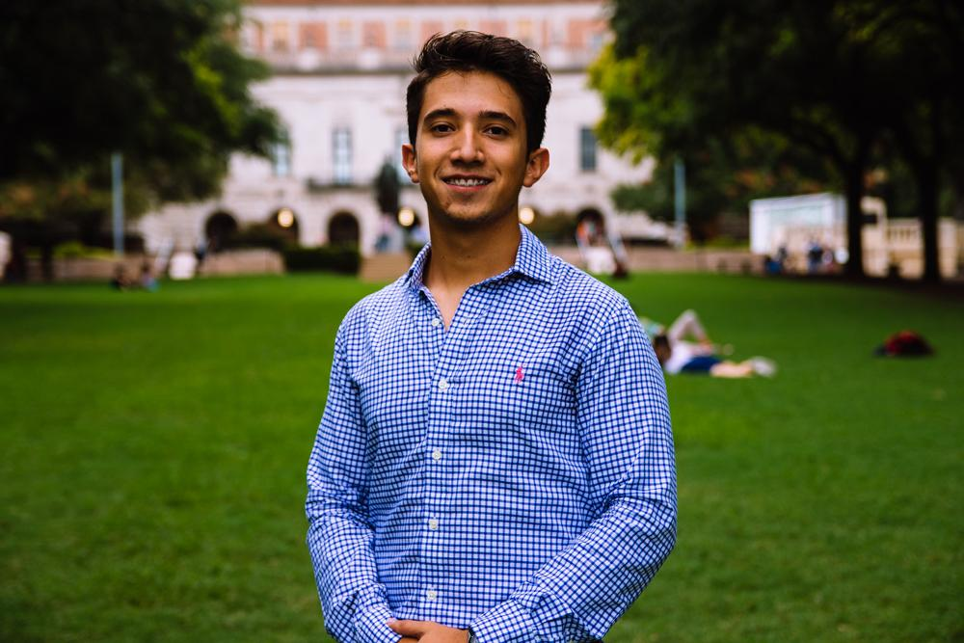
Marcelo Pintos
Social Director
Biochemistry BSA Major
3rd Year
Mcallen, TX
Fun Fact: My first concert ever was Skrillex

Slide 32
Buddy System has kicked off!
All groups have been completed since last week. Let me know if you have not received an email and have signed up!

Slide 33
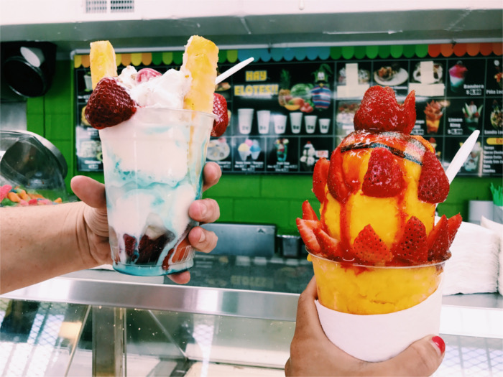
Texas Fuego Mixer
What do you Meme? Party
Hay Elotes + game night - Nov. 15th

Slide 34
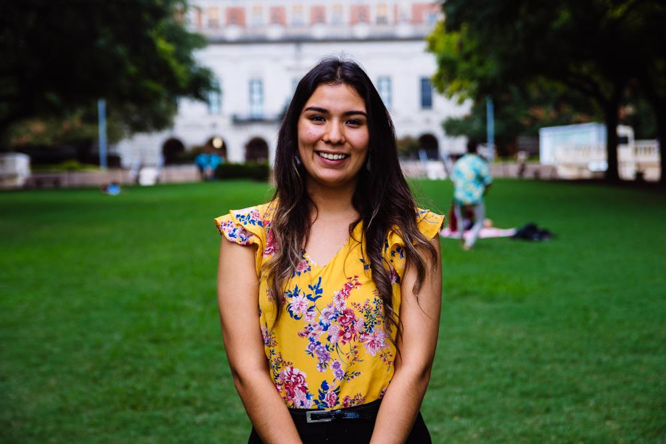
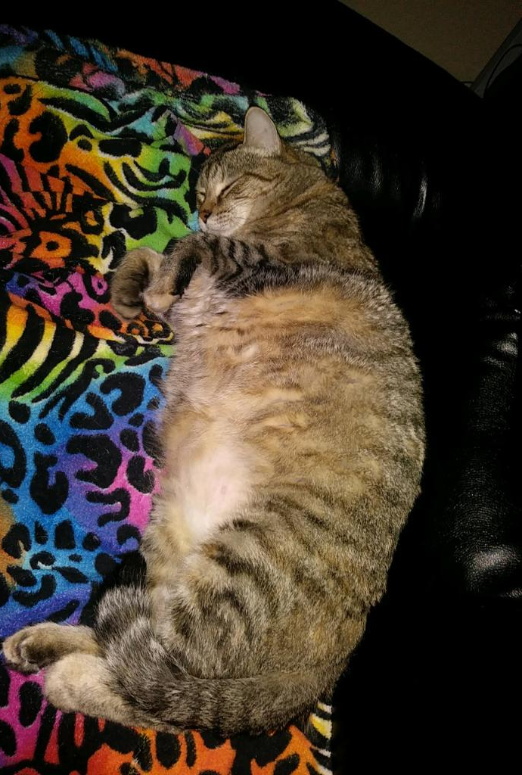
Andrea Martinez
Archives Director
Human Development and Family Sciences Major
3rd Year
Eagle Pass, TX
Fun Fact: I miss my cat, Stinky. She’s very fluffy & hug-able.

Slide 35
Professional Headshots
Get yours in less than 15 minutes that can be used on LinkedIn, social media, applications, etc!
Make an appointment here:
https://calendly.com/headshotphotos/hhpoarchives
$5 for members $10 for non-members
Payment required before appointment & must notify Andrea!

Slide 36
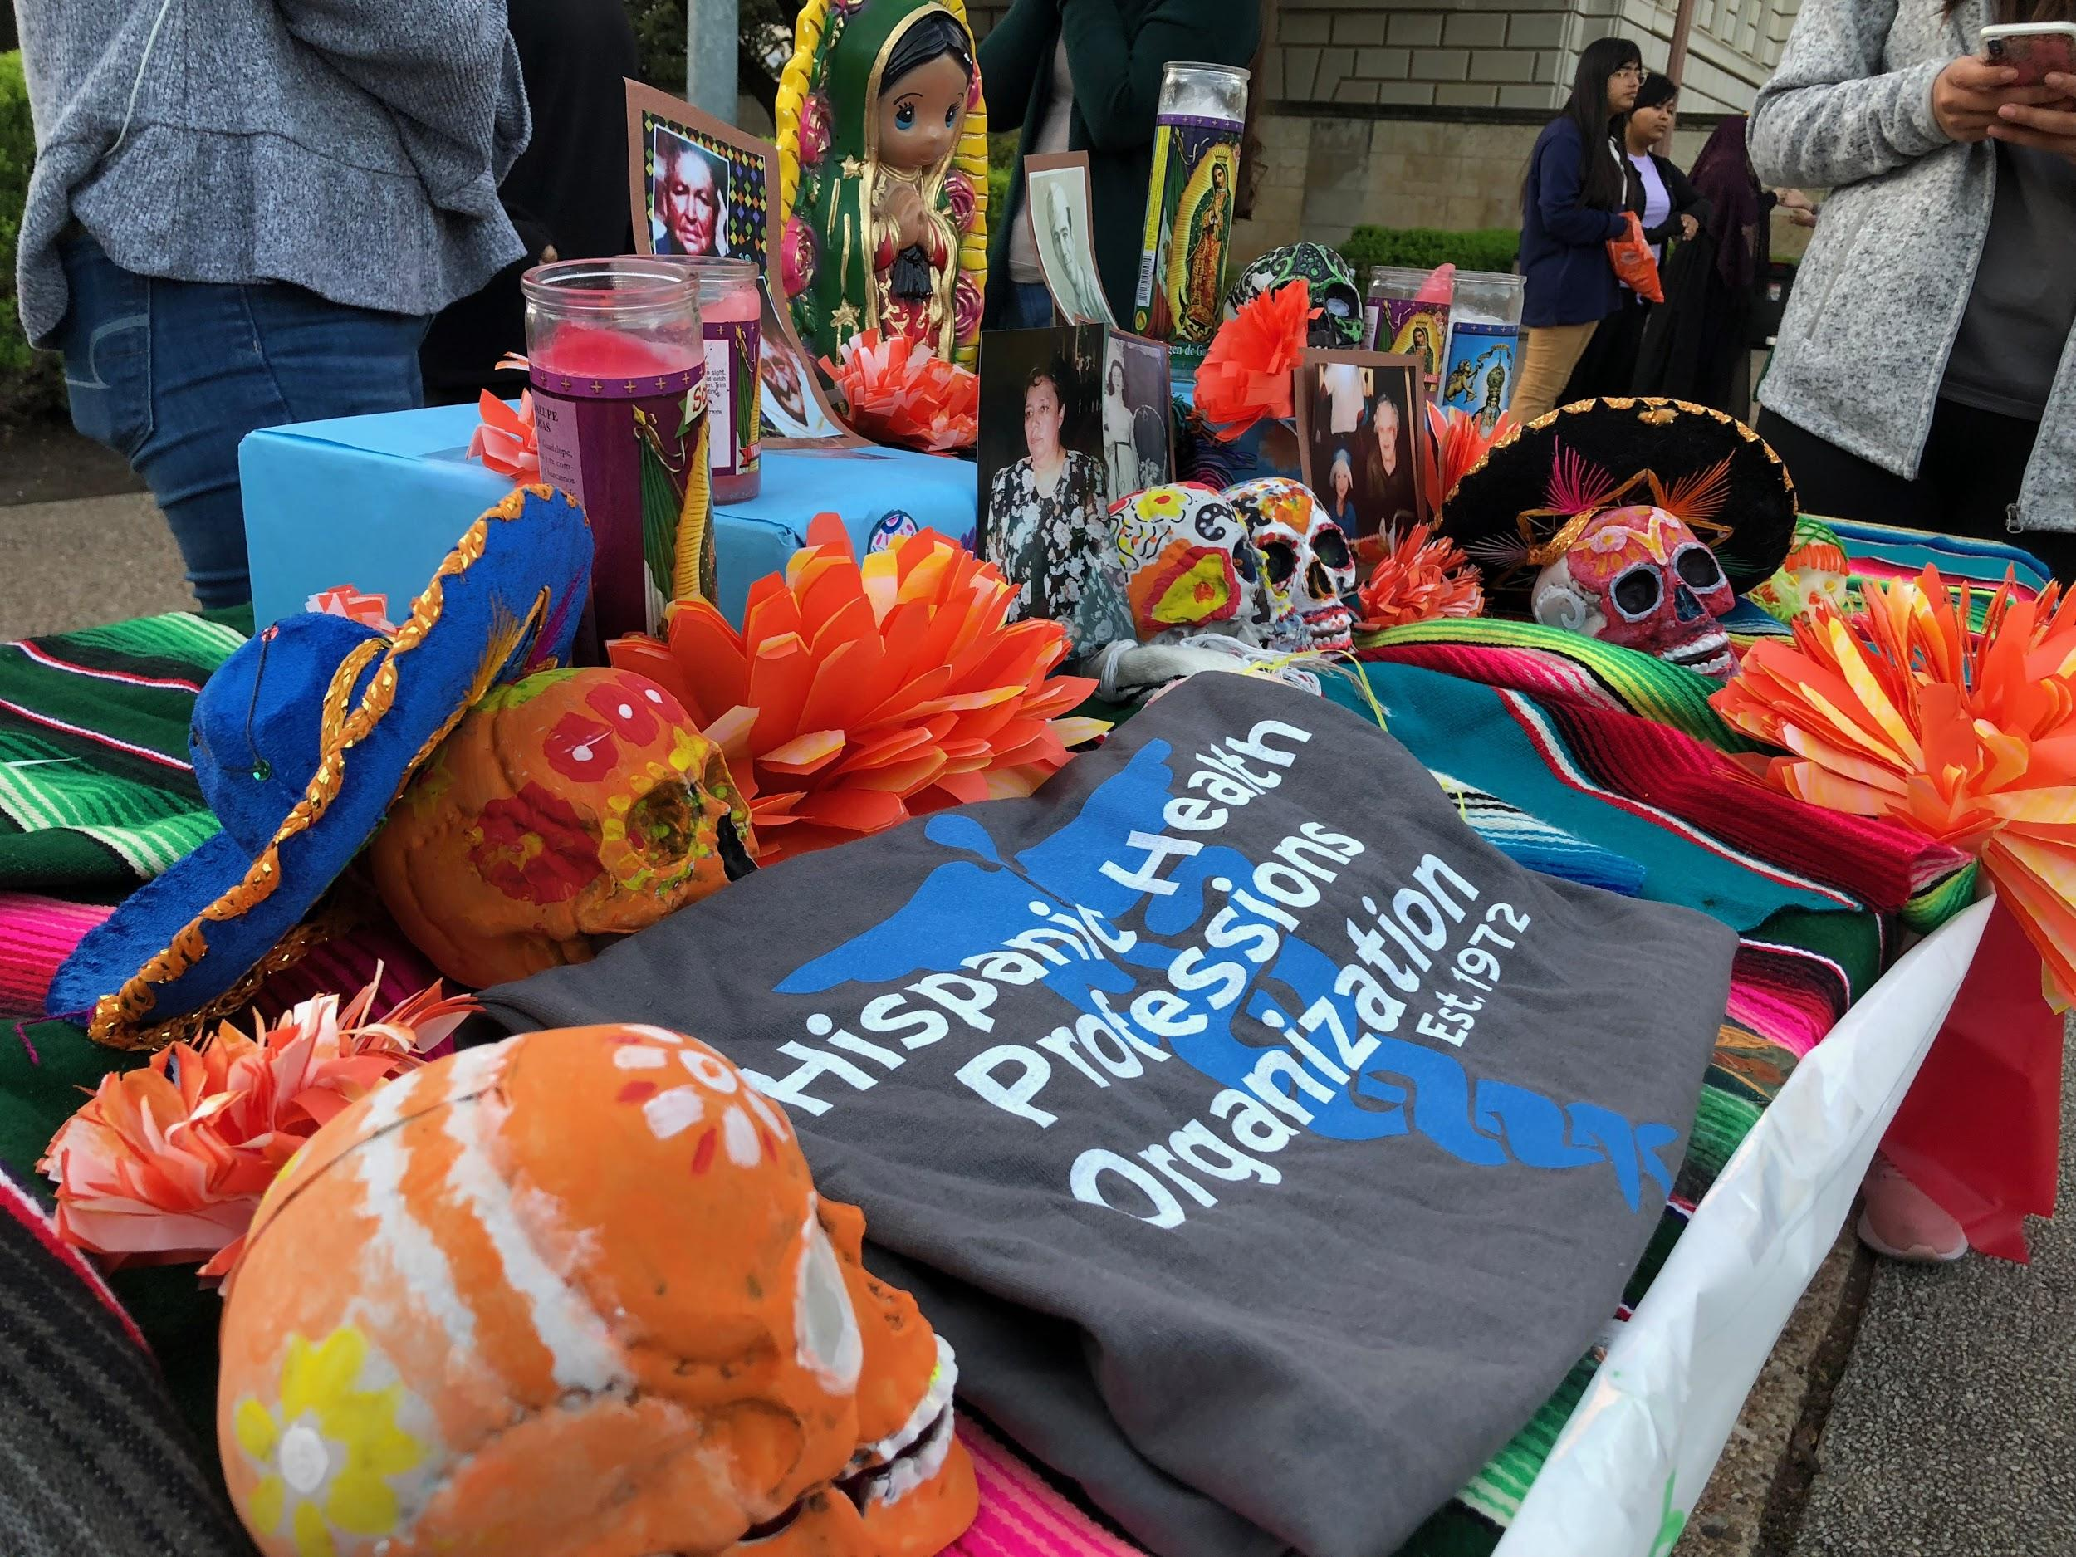
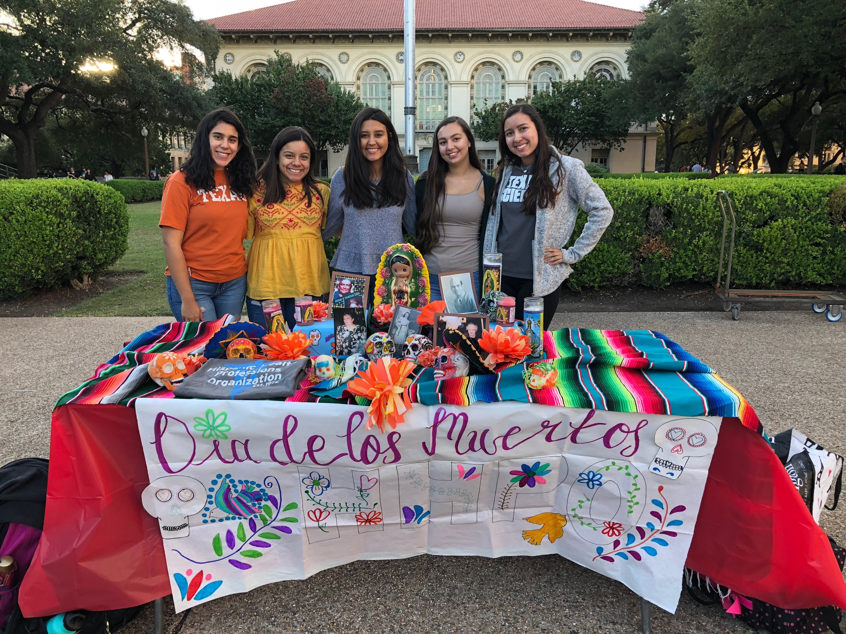
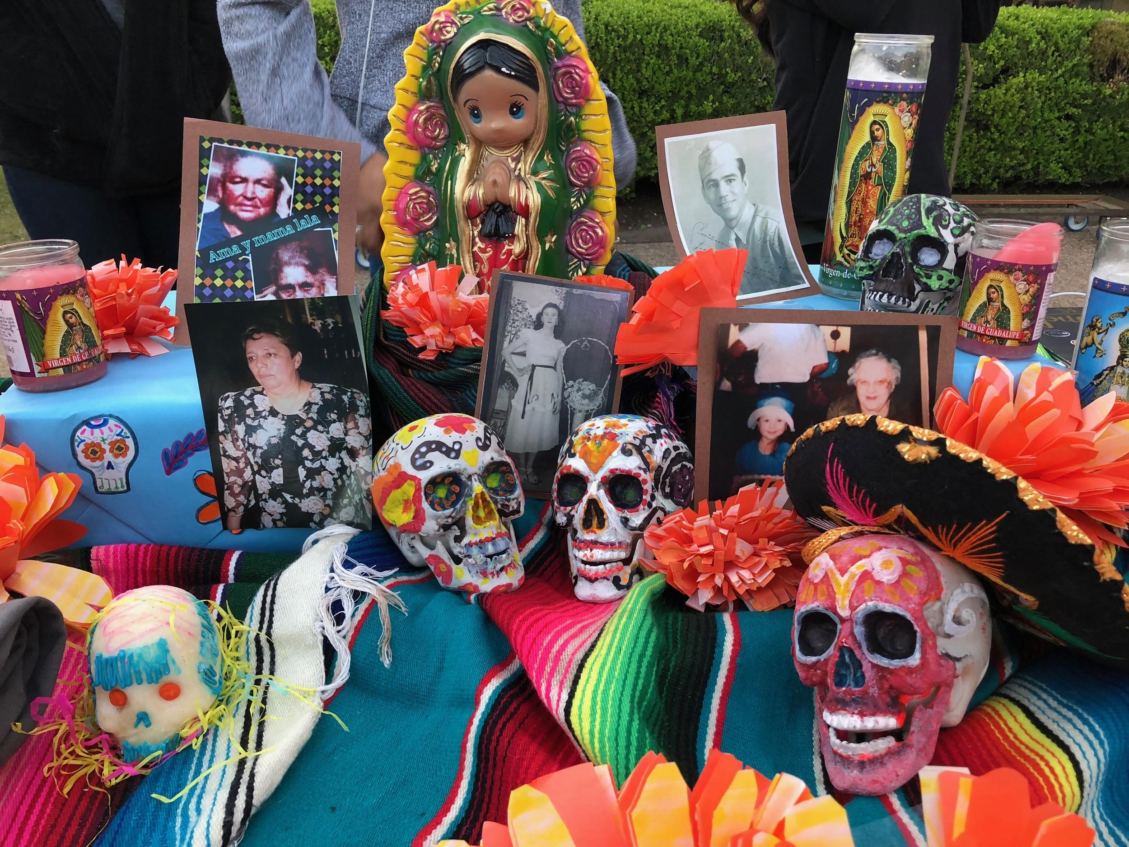
DIA DE LOS MUERTOS
ALTAR CONTEST
We didn’t win, but our altar looked great! Thank you to the committee for helping make this possible!

Slide 37
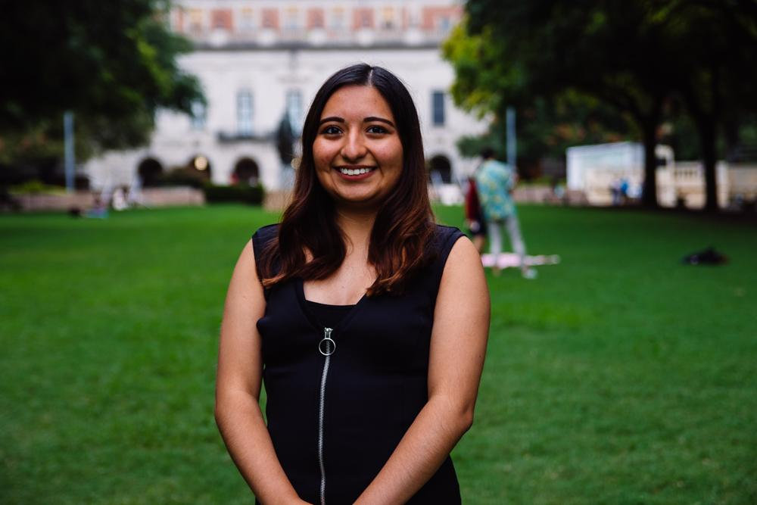
Valeria Sornia
Public Relations Director
Neuroscience Major
3rd Year
Eagle Pass, TX
I turned 21 on Monday!!

Slide 38
Instagram Story Highlights
Missed an event and wondering how it went? Check out our Instagram Story highlights!
Volunteer, Social, Professional, Community, Fundraising!
Upcoming events: DAW Week and MED SCHOOL TRIP!
@texasHHPO

Slide 39
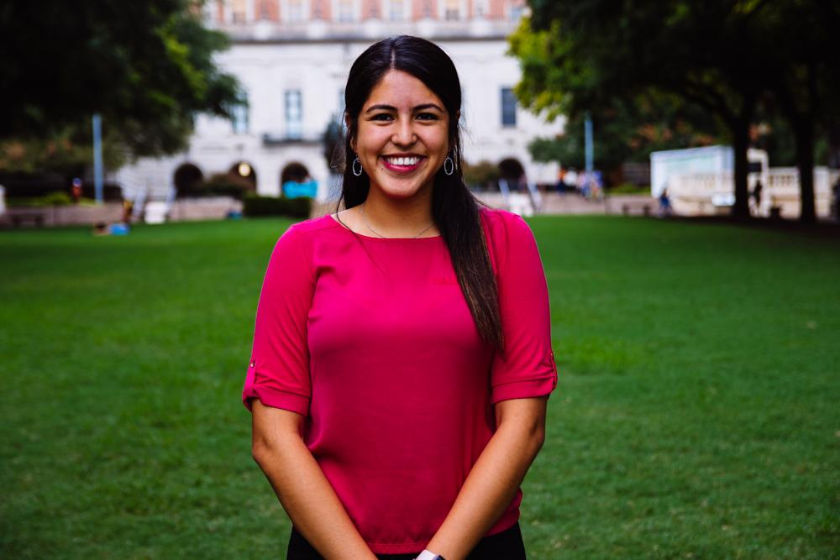
Jessica Medrano
IT Director
Neuroscience Major
3rd Year
Houston, TX
Fun Fact: I use to play the oboe in 6th grade lol

Slide 40
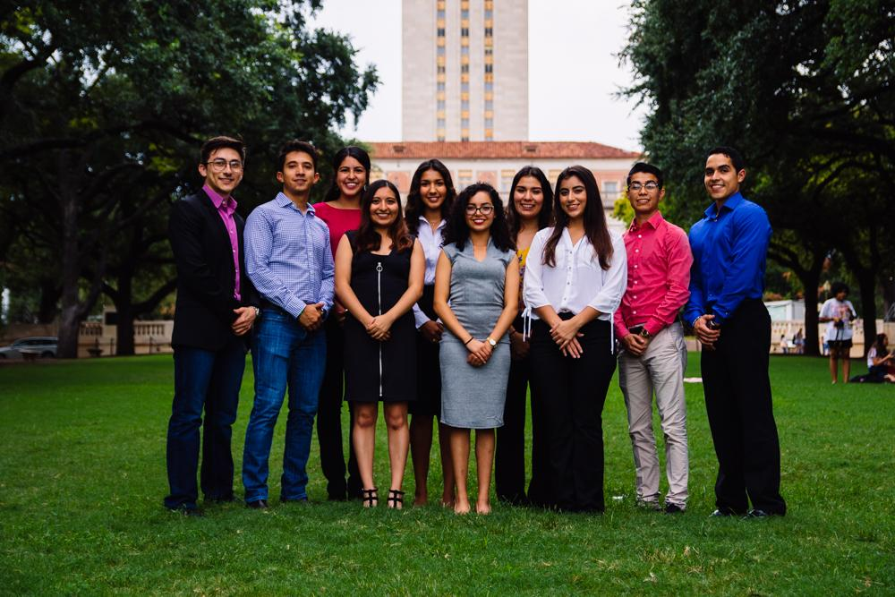
Let us know if you have any questions!!

Slide 41
Thank You for Coming!!
Sign in here:
5th General Body Meeting:
November 27, 2018
PAR 201 6:45
Texashhpo.weebly.com
texashhpo@gmail.com
HHPO (Hispanic Health Professions Organization)
@texashhpo

