Slide 1
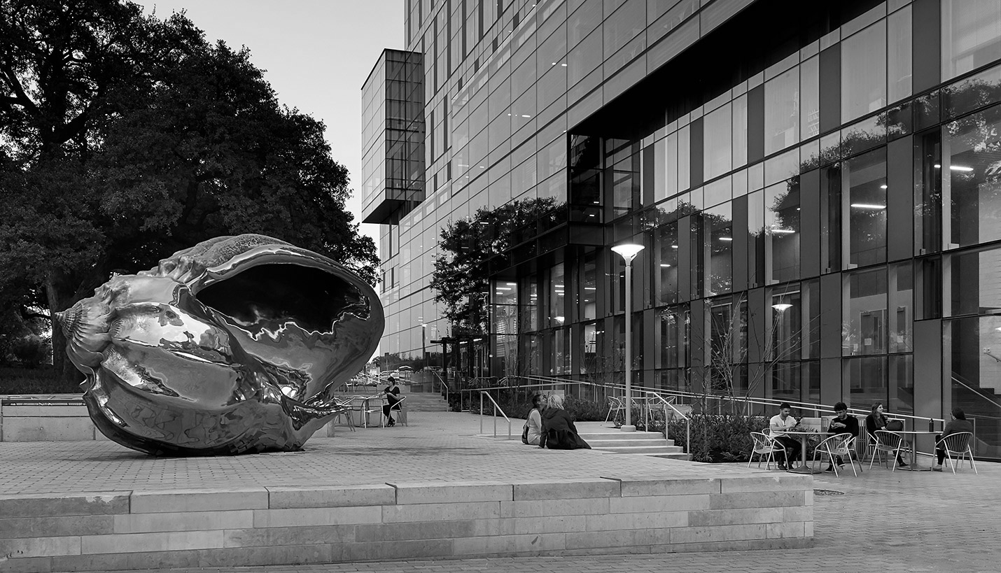
Hispanic Health Professions Organization
3rd General Body Meeting
October 23, 2018, 6:45 pm
PAR 201
Sign In Here:
https://tinyurl.com/y9gl53ar

Slide 2
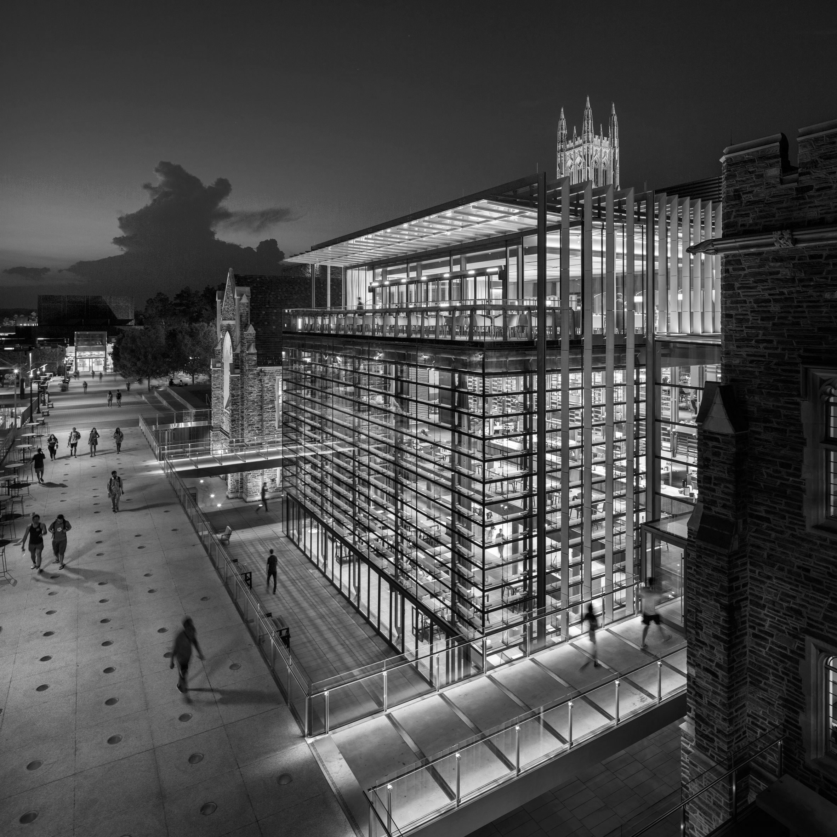
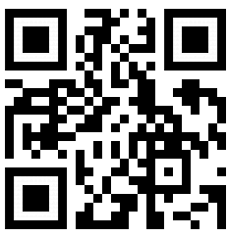
Mid-Semester Survey

Slide 3
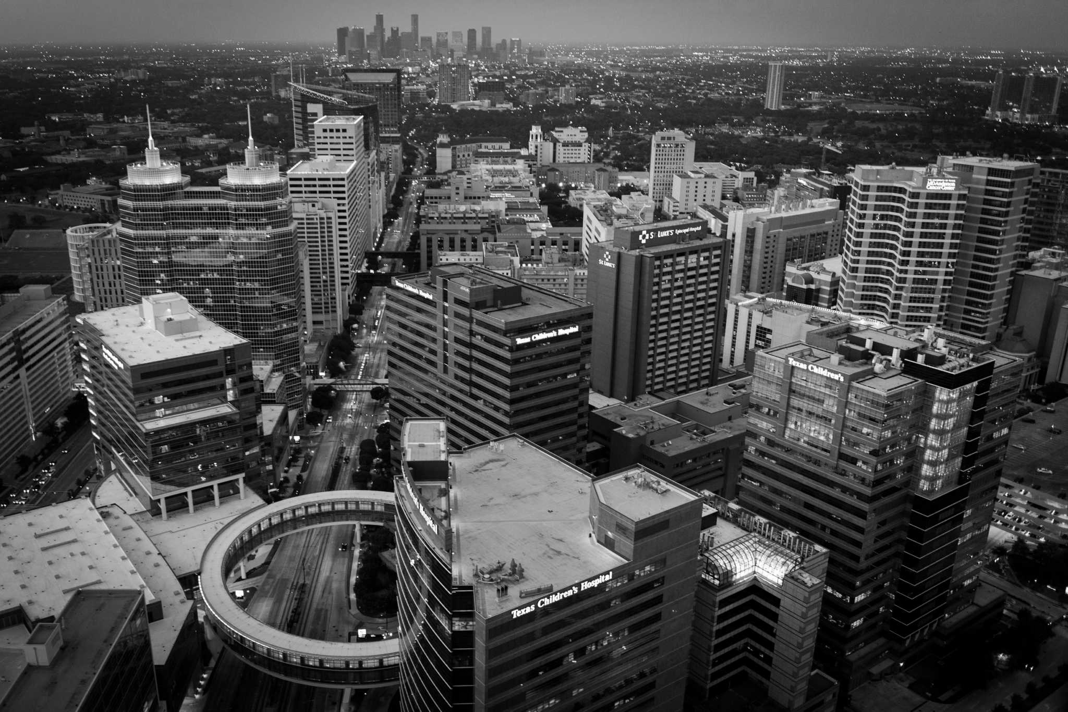
Icebreaker
Handshake

Slide 4
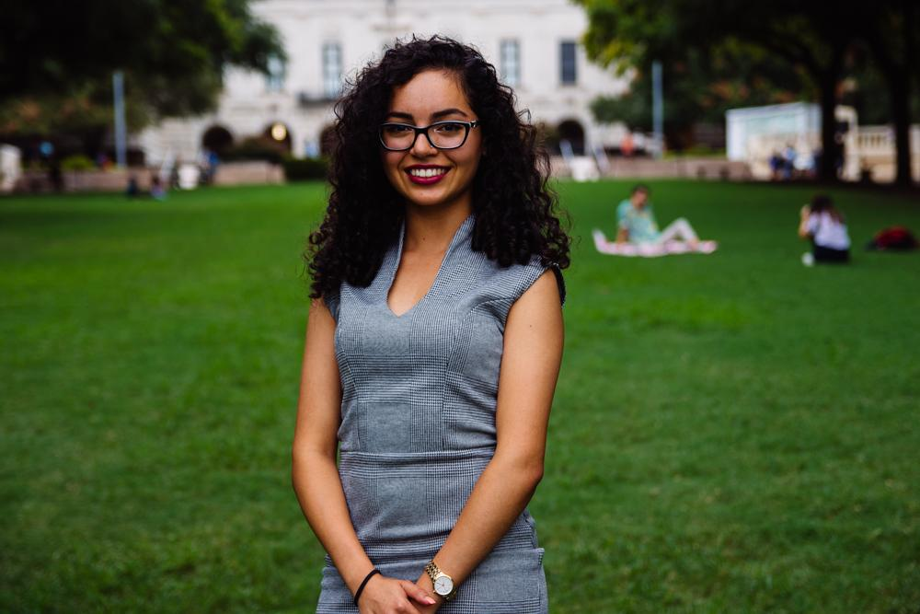
Eva Vaghefi
President
Psychology & Nutrition Double Major
5th Year
Fort Worth, TX
Fun fact:

Slide 5
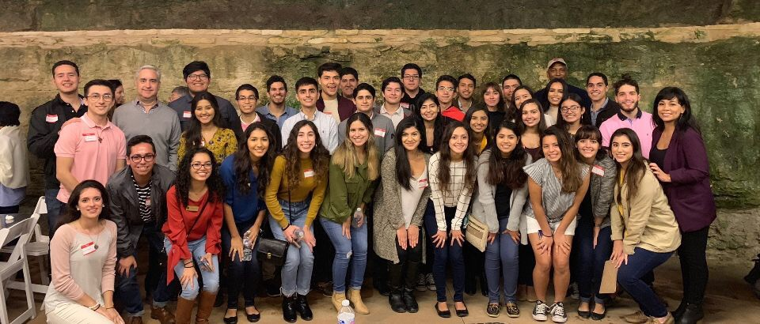
Thank you to everyone who came to BBQ with the Docs!
Notes:
https://bit.ly/2EPs4DM

Slide 6
T-shirt Pick up
Dates & Times:
TH 10/24 11-3 PM PCL Writing Center
M 10/29 9-11 AM PCL Writing Center
F 11/1 12-2 PM PCL Writing Center
T 11/6 5-8 PM PCL Writing Center

Slide 7
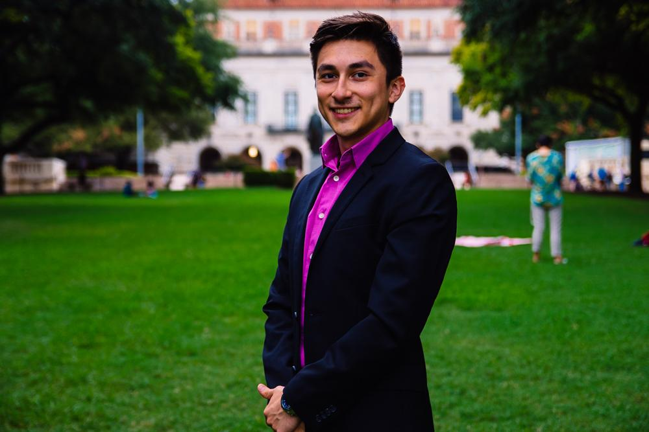
Cesar Gonzalez
VP of Professional Development
Neuroscience Major
Visual Media Minor
3rd Year
Roma, TX
Fun Fact: I can imitate Pinocchio from Shrek

Slide 8
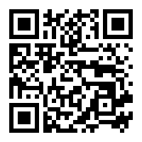
Healthier Texas Summit
October 25th - 26th
Health professionals
Exposure to different
health disparities within
the community

Slide 9
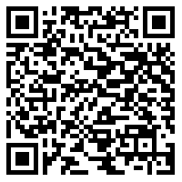
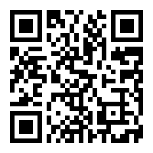
2018 AAMC Minority Student Medical Career Fair
Saturday, November 3 Register Here
Health Professionals
MCAT
Panel Discussions
Admissions
Hands On Activities

Slide 10
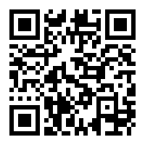
UTHSCSA Med-School Trip
Friday, November 17
Time TBA
Rides will be provided
Sign up here:

Slide 11
Entrance Exam Preparation
15% discount - prep courses
10% discount one on one tutoring
Our Partner

Slide 12
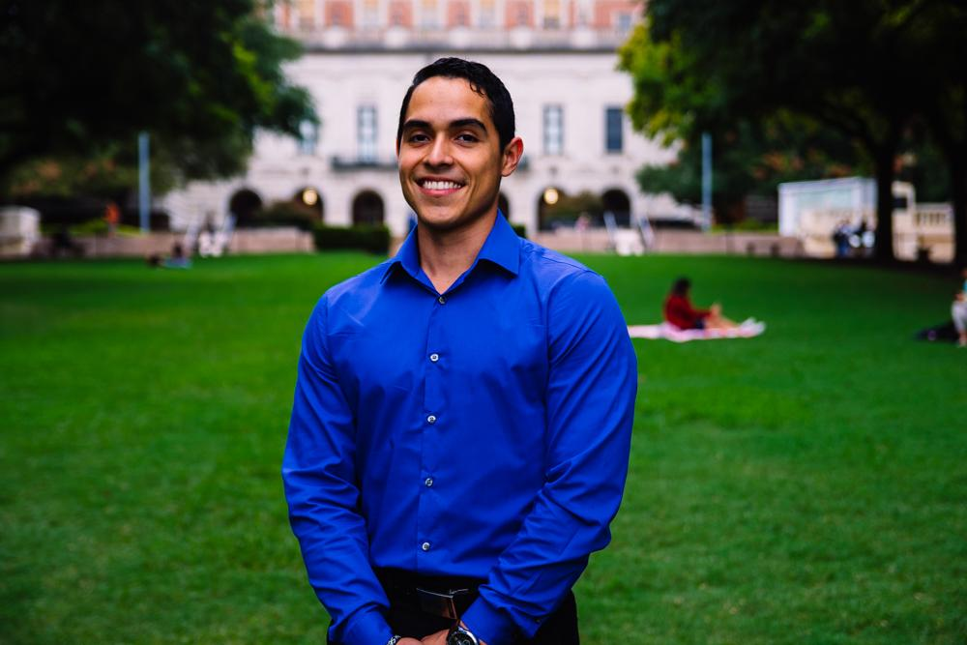
Javier Flores
VP of Community Development
Psychology Major, Pre-PA
3rd Year
Eagle Pass, TX
Fun Fact:

Slide 13
Let’s Talk Diabetes Awareness Week!!

Slide 14
Monday, November 5th
Interactive Tabling
Where: Greg Plaza
When: 6- 7 PM
Snacks: Bars & Waters
Ribbons
Pamphlets
T-shirt giveaway!!

Slide 15
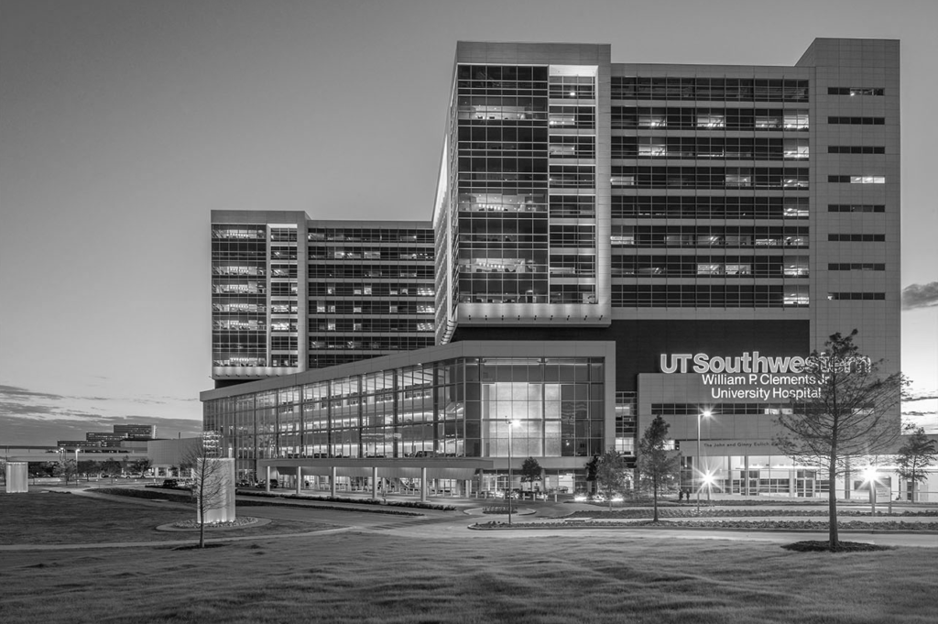
Tuesday, November 6th
Type Texas
Tentative Informational Meeting With A Dietician
Where & When: TBA

Slide 16
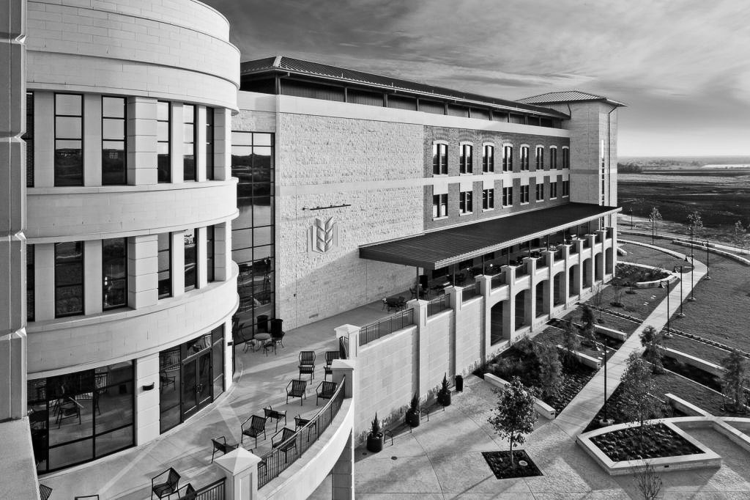
Wednesday, November 7th
Dodgeball Tournament
Where: Whitaker Courts
Time: TBA
$25 total
5 players per team
Collaboration with BHPO, Pre-PA Society, Texas Infinites, Texas Bluebonnets, Texas Latin Dance, Type Texas, Texas Fuego

Slide 17
Thursday, November 8th
Texas Latin Dance Collaboration
Where: UNB 3.312 T-house Suite
When: 7-9 pm
Dance Merengue, Bachata, Salsa etc.

Slide 18
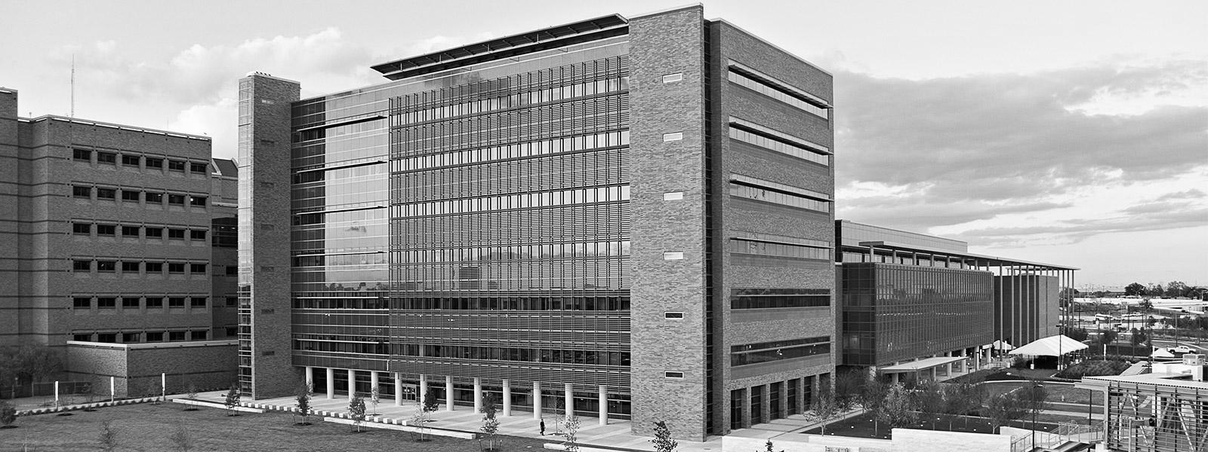
Friday, November 9th
DAW Dinner with Guest Speaker Dr. Solis M.D.
Where: SAC 2.302 Legislative Assembly Room
When: 6-8 pm
Attending Physician: Valerie Chavez M.D.
Physician & Functional Medicine Practitioner

Slide 19
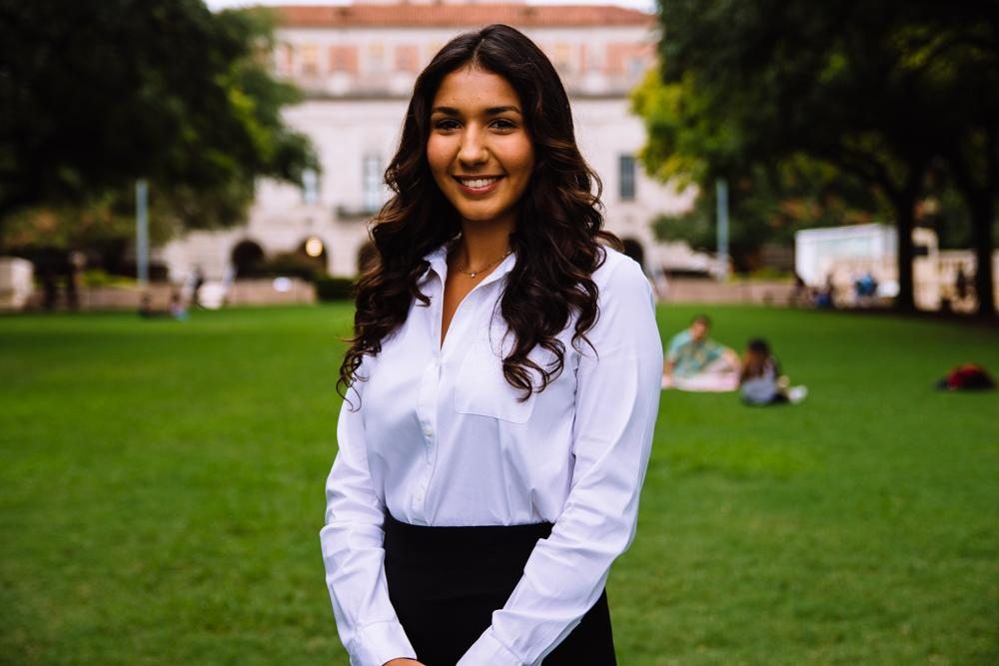
Bianca Garcia
Secretary
Kinesiology Major
3rd Year
Houston, TX
Fun Fact: I am going to Spain this Winter for a shadowing internship!! Message me if you’re interested in learning about it!

Slide 20
ACTIVE MEMBER POINTS
FIVE Volunteer
THREE Social
FIVE Professional
FOUR Fundraising
THREE General Body Meetings
The point sheet is up to date: https://tinyurl.com/yc85l9aq
Let me know if you have any questions!!
biancagarcia207@utexas.edu

Slide 21
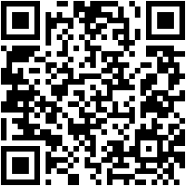
Join the GroupMe!

Slide 22
Important Announcement
Point system
For ALL future events, cancellation notice needs to be given 48 hours in advance with valid reasoning to officer hosting event.
** If no notification is received & you are not present at the event, points that would have been earned will be deducted from that respective category of points (volunteering, fundraising, etc.)**

Slide 23
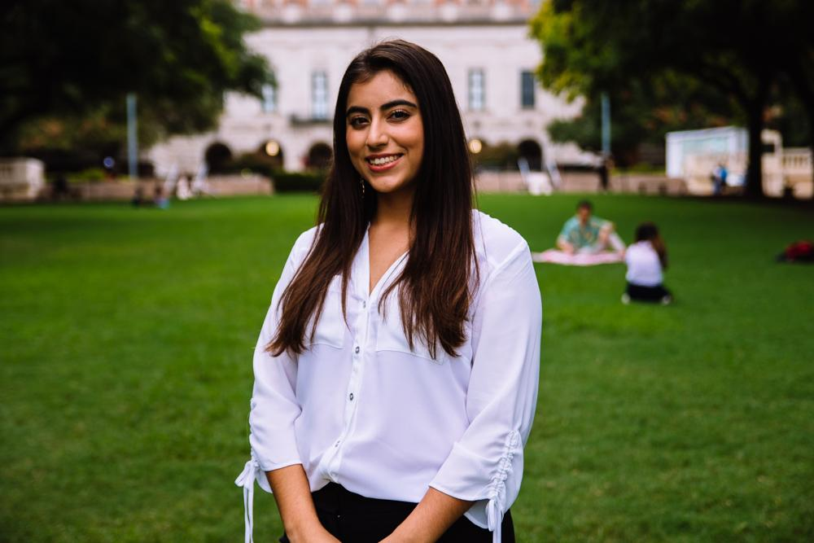
Suzett Fernandez
Financial Director
Human Development and Family Sciences Major
3rd Year
Eagle Pass, TX
I am going to PERU in the winter!

Slide 24
DUES
$45 Returning Members
$55 New Members
Includes a Tshirt!
Venmo: @Texas-HHPO
(Please state New/Returner)
Paypal: texashhpo@gmail.com ($2 fee)
Cash or Card
**Email: sfdzz97@gmail.com
- include your name, EID, phone number
** Increases by $10 after 3rd GBM**

Slide 25
Halloween Bake Sale
Do you want to earn both a fundraising and social point?
Baking Day *Social Point*
When: Thursday, October 25th
Tme: 7pm-9pm
Where: 4510 W. Guadalupe St. Apt C223
Bake Sale *Fundraising Point for Buying or Selling*
When: Friday, October 26th
Time: 11am-2pm
Where: Jester

Slide 26
Texas Athletics Sustainability
Do you want to earn both a fundraising and volunteer point?
WHAT: We will be sorting waste produced during the game into proper streams.
PLEASE wear comfortable clothes and closed-toed shoes and be prepared to get dirty.
WHEN: November 4th
TIME: 10:15-1:30pm
WHERE: LOT 53 (2699 Speedway, Austin, TX 78712)
LINK TO SIGN UP: https://docs.google.com/forms/d/1RY8EfDG1Wekdja92hjuXkVsI3AlE5xVqzwkQkn-Vaus

Slide 27
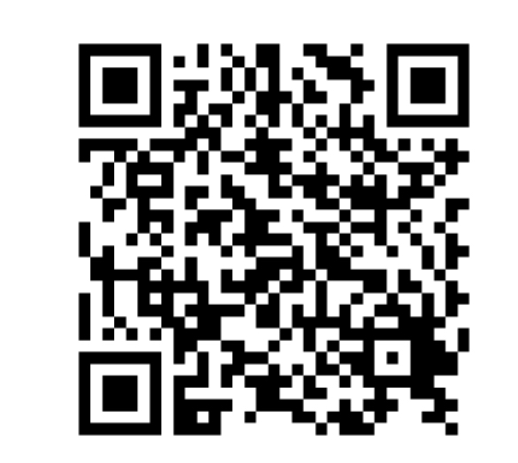
How should you be rewarded?

Slide 28
Leadership Opportunity
The Leadership and Ethics Institute
Position: facilitators on the Student Leadership Team
Application found on Hornslink
Due: November 8th
Texas Leadership Summit
Leadership Education And Progress
Project LEAD
Workshops on Demand
Burnt Orange Leadership Development

Slide 29
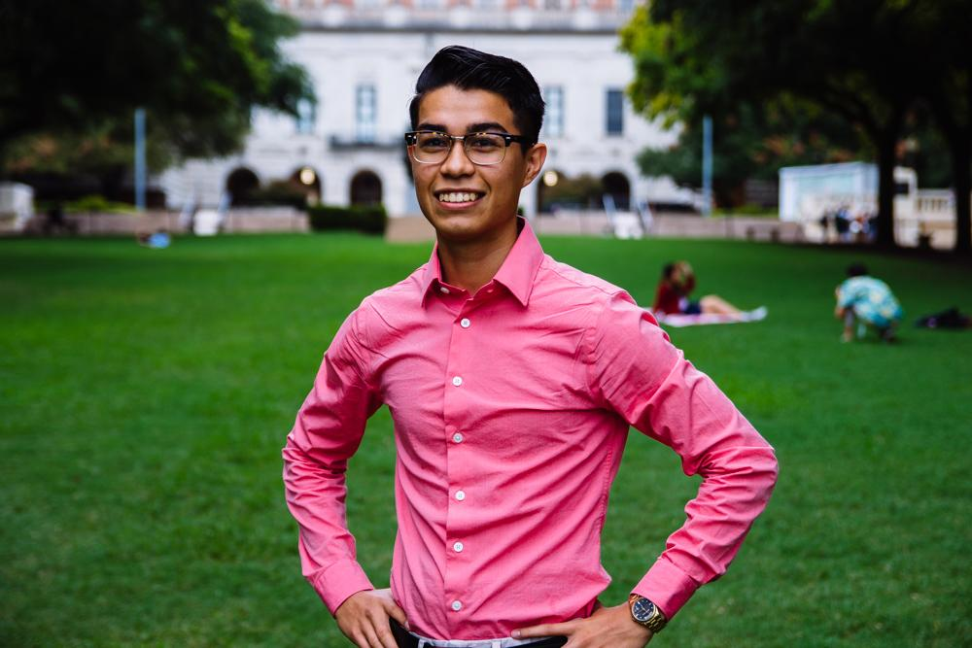
Emmanuel Rayas
Volunteer Director
Biochemistry, BSA
4th Year
San Antonio, TX
The Mountain Dews from from the vending machine at the CLA are expired but I keep buying them.

Slide 30
“What starts here changes the World”
Health Booklets Project
The inmate population of Texas and correspondents of Inside Books.
https://goo.gl/forms/SCFLDyr4tIngzeoR2
Holistic Treatment Curriculum Committee
The Hispanic immigrant mothers and children housed by Posada Esperanza.
https://goo.gl/forms/oWJ9hnE8YdpmRlyV2

Slide 31
Population Based Volunteering
The Youth
Communities in Schools
The Elderly
Bingo at The Nursing Home
The Homeless
Homecooked Fridays
The Incarcerated
Inside Books
The Public
We Are Blood
The Ecosystem
Texas Athletics

Slide 32
Recurring on your Schedule
Thursday
Inside Books
7-11PM
3121 E 12th St
Austin, TX 78702
insidebooksproject@gmail.com
Friday
Homecooked Fridays
1-3PM & 3-5PM
209 W. 27th St. Austin, TX 78705
Sign-up found on digest.
HHPO Bingo at the Nursing Home
7-8PM
2806 Real St Austin, TX 7872*
Bus Route 18 on MLK & San Jac
Sunday
Inside Books
5-9PM
3121 E 12th St
Austin, TX 78702
insidebooksproject@gmail.com

Slide 33
Two New Recurring Events
Communities in Schools
Become a mentor for a child enrolled in CIS, a National program aimed to increase the graduation rates of the at-risk youth. Be part of society’s effort to give these kids an equal opportunity.
We Are Blood
Donating blood is at the essence of one human being able to give life to another. Facilitate this act of public health by becoming involved in the process in more ways than one.
Sign-ups are online but i have gone through the process myself to guide you- erayas@utexas.edu

Slide 34
Next Special-Cause Event
HopeFest 18’
The National Kidney Foundation has personally invited us to volunteer with them and help facilitate their kidney screenings. 10-15 spots were allotted.
Lunch will be provided. Rides will be provided.
Saturday, October 27th
9:30AM-3:00PM
https://goo.gl/forms/0QLy5QskChHeIhOW2

Slide 35
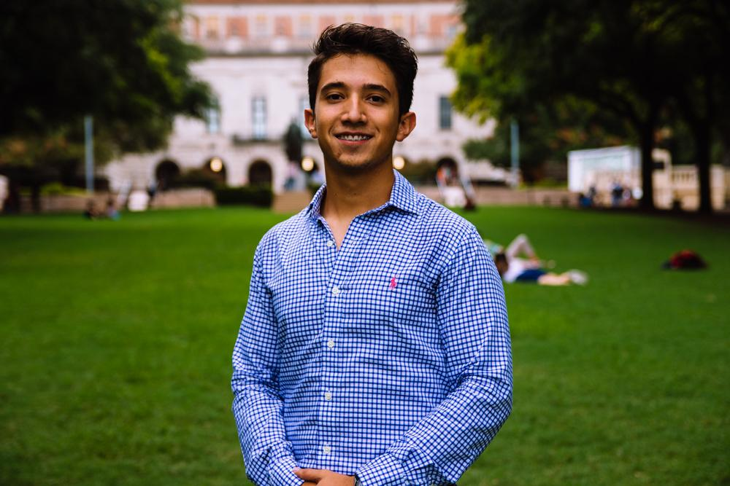
Marcelo Pintos
Social Director
Biochemistry BSA Major
3rd Year
Mcallen, TX
Fun Fact

Slide 36
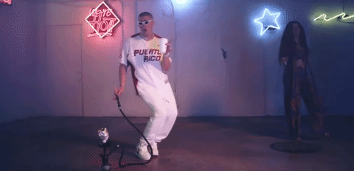
THIS IS HALLOWEEN
Don’t miss HHPO’s Halloween Party When: FRIDAY, Oct. 26th
Where: The Block on 28th rooftop. Time: 9:30 pm
Don’t forget your costumes!

Slide 37
Buddy System has kicked off!
Will be making the rest of the groups this week! Remember to send your availability as soon as you get the email.

Slide 38
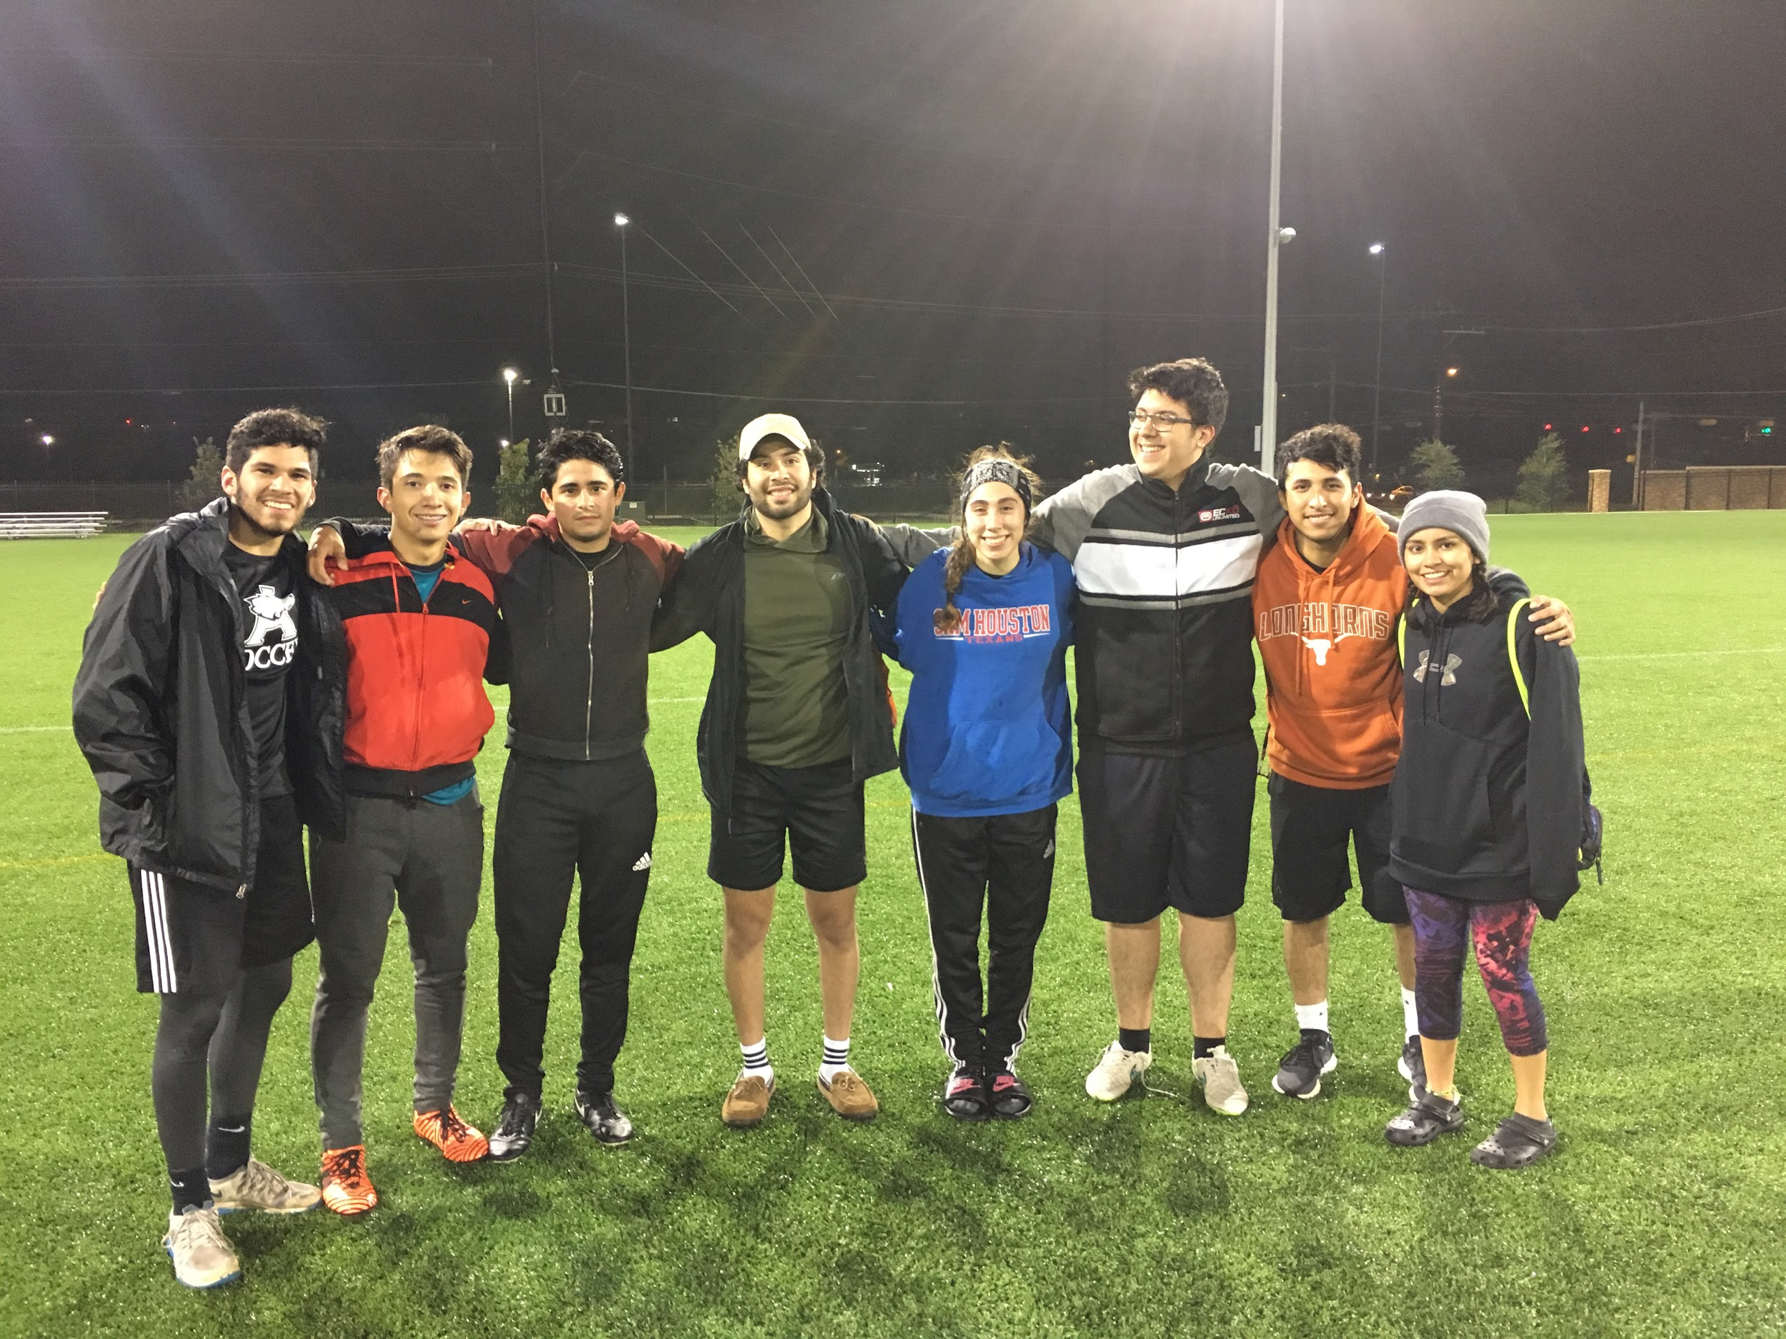
Leaving It All On The Field!!
IM Soccer Team 2k18

Slide 39
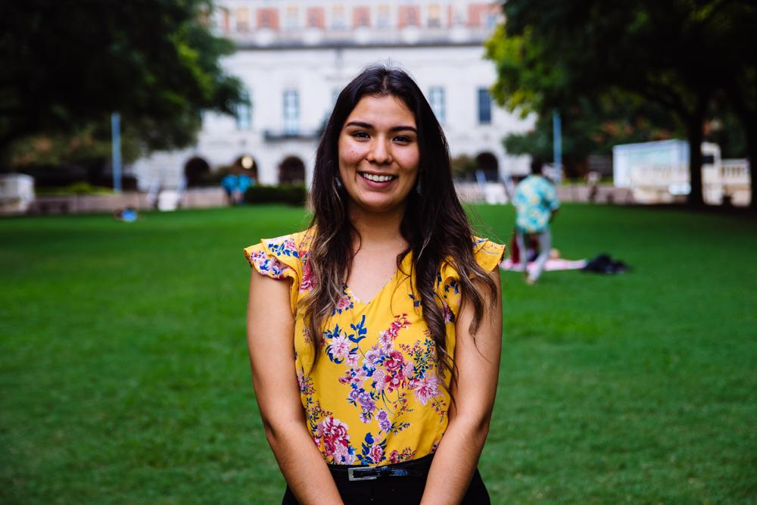
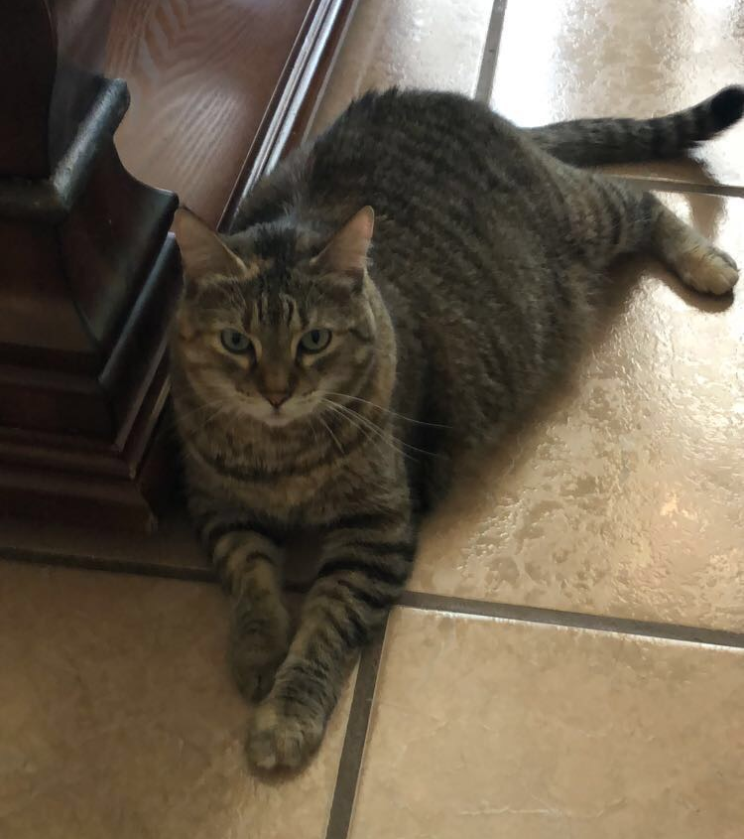
Andrea Martinez
Archives Director
Human Development and Family Sciences Major
3rd Year
Eagle Pass, TX
Fun Fact (or not so Fun Fact): I miss my cat, Stinky :(

Slide 40
Professional Headshots
Get yours in less than 15 minutes that can be used on LinkedIn, social media, applications, etc!
Make an appointment here:
https://calendly.com/headshotphotos/hhpoarchives
$5 for members $10 for non-members
Payment required before appointment & must notify Andrea!

Slide 41
DIA DE LOS MUERTOS
ALTAR CONTEST
When: Thursday, November 1
Where: UT Main Mall
Time: 5:30PM (set-up) - 9:00PM
>>> WINNING ALTAR GETS A $50 CASH PRIZE! <<<
-1 FUNDRAISING POINT FOR ANY DONATIONS!
-1 SOCIAL POINT FOR ATTENDING THE EVENT!
Join the committee to help design/plan the altar!
SIGN UP HERE: https://goo.gl/forms/i2RrkjXpDCXDwnuG3

Slide 42
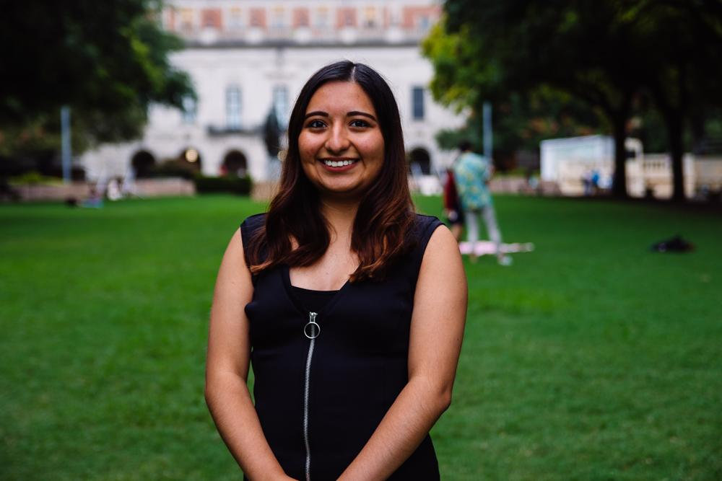
Valeria Sornia
Public Relations Director
Neuroscience Major
3rd Year
Eagle Pass, TX
I love sour candy! (SOUR PATCH KIDS)

Slide 43
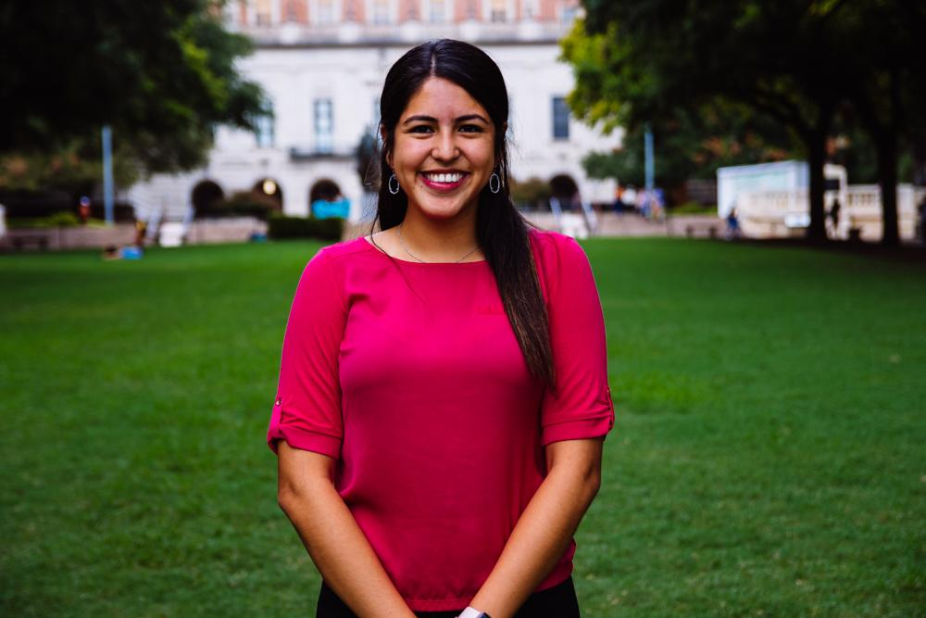
Jessica Medrano
IT Director
Neuroscience Major
3rd Year
Houston, TX
Fun Fact: I have more fuzzy socks than regular socks :)

Slide 44
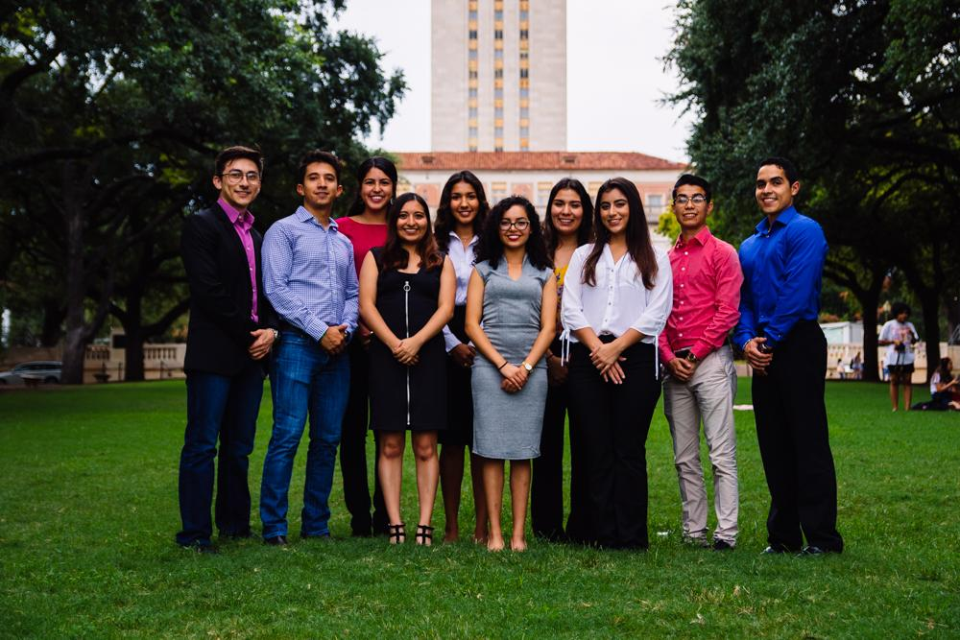
Let us know if you have any questions!!

Slide 45
Thank You for Coming!!
Sign in here:
https://tinyurl.com/y9gl53ar
4th General Body Meeting:
November 6, 2018
PAR 201 6:45
Texashhpo.weebly.com
texashhpo@gmail.com
HHPO (Hispanic Health Professions Organization)
@texashhpo

