Slide 1
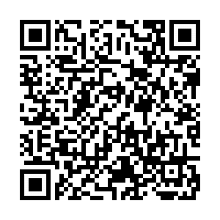
SIGN IN HERE:

Slide 5
We will be tabling at Gone to CNS on Monday, October 15th from 6-8 PM!
Gone to CNS is an opportunity to learn about the organizations that operate under the College of Natural Sciences and all the resources they provide.
We are looking for a handful of members to help out!
If interested fill out the form below:
https://docs.google.com/forms/d/1ouKN2let-xxbp8V71y-urRexzQVEkqRS8MZeY13cTwI/edit

Slide 11
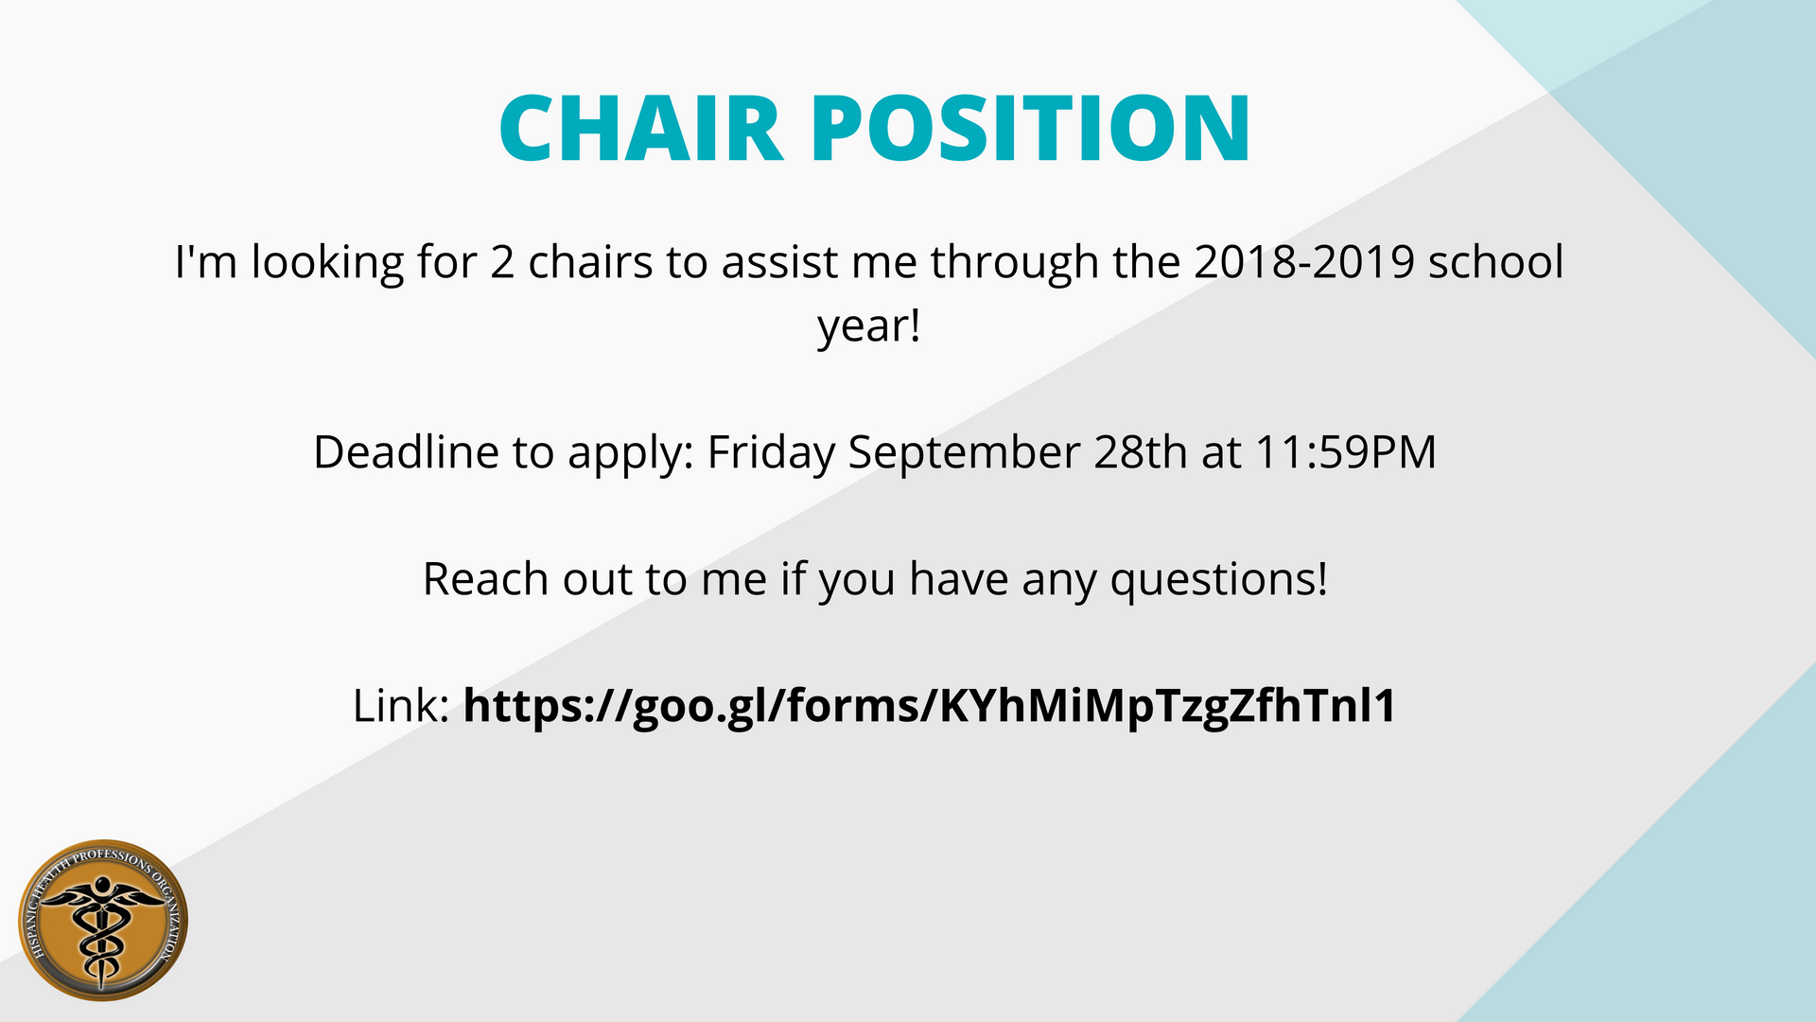
- c.i.g@live.com

Slide 13
Chair Application
Looking for a leadership opportunity?
I am looking for three chairs to assist me throughout the 2018-2019 school year!
Do not miss your chance and apply now!
Deadline is Friday, September 28.
Link found Below:
https://drive.google.com/open?id=1r2rynNN_WNSNy7R2M6tYB1Ak060H0M8UWm9v2r5CQ1E

Slide 21
Chair Position
I am searching for one chair to serve alongside me for the 2018-19 year.
I will delegate tasks to you while allowing you express your independent ideas.

Slide 22
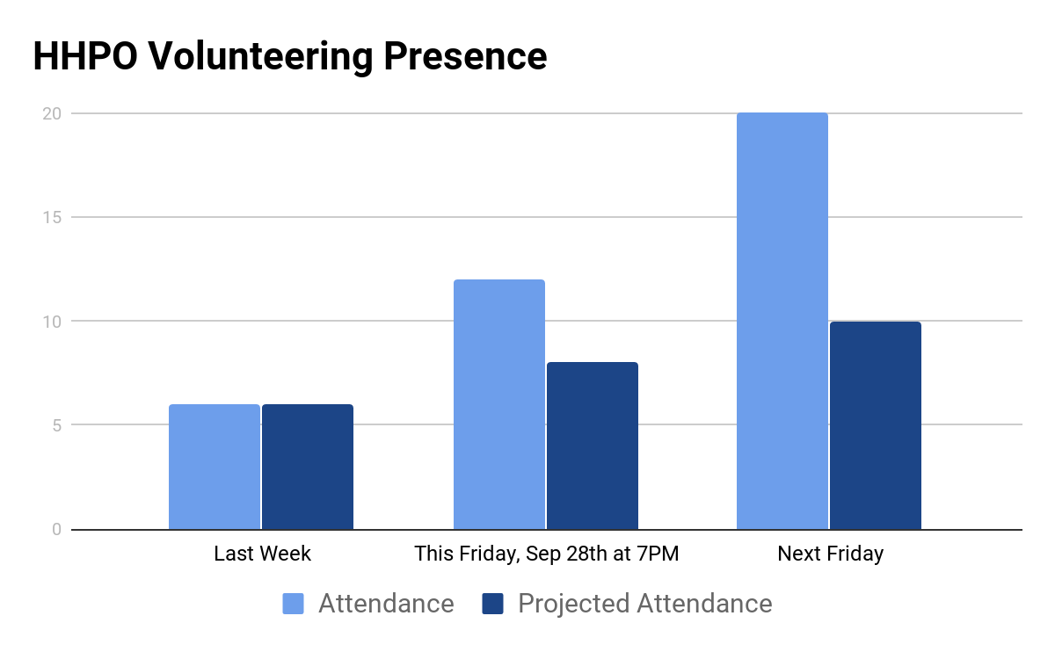
Nursing Home Bingo

Slide 23
Nursing Home Bingo
Sign up Link: https://goo.gl/forms/NU0jJmyCf6vmKU4d2
We take bus route 18 from the corner of MLK and San Jacinto.
Bus ride is only 7 minutes long.
This Friday at 7PM

Slide 24
Recurring Events
Tuesday
Inside Books
-Give the gift of knowledge to inmates across Texas (7-11PM).
Thursday
Inside Books
-Give the gift of knowledge to inmates across Texas (7-11PM).
Friday
Homecooked Fridays
-Cook for the hungry down the street (1-3 and 3-5PM).

Slide 25
Electric Scooter
Come talk to me after the meeting if not about volunteering than about my scooter
-Emmanuel Rayas

Slide 27
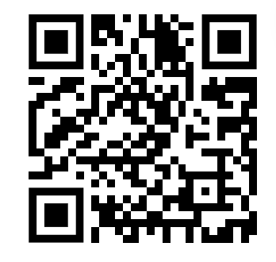
Program is ready.
The purpose is to make you come up with strategies to tackle the famously hard ut stem classes.
Instead of doing mentor applications, I will organize members in groups of classes being taken. Two people from each group will take the lead with a weekly lesson plan I have designed.
https://goo.gl/forms/PgKDnvstdfCqQEIK2

Slide 28
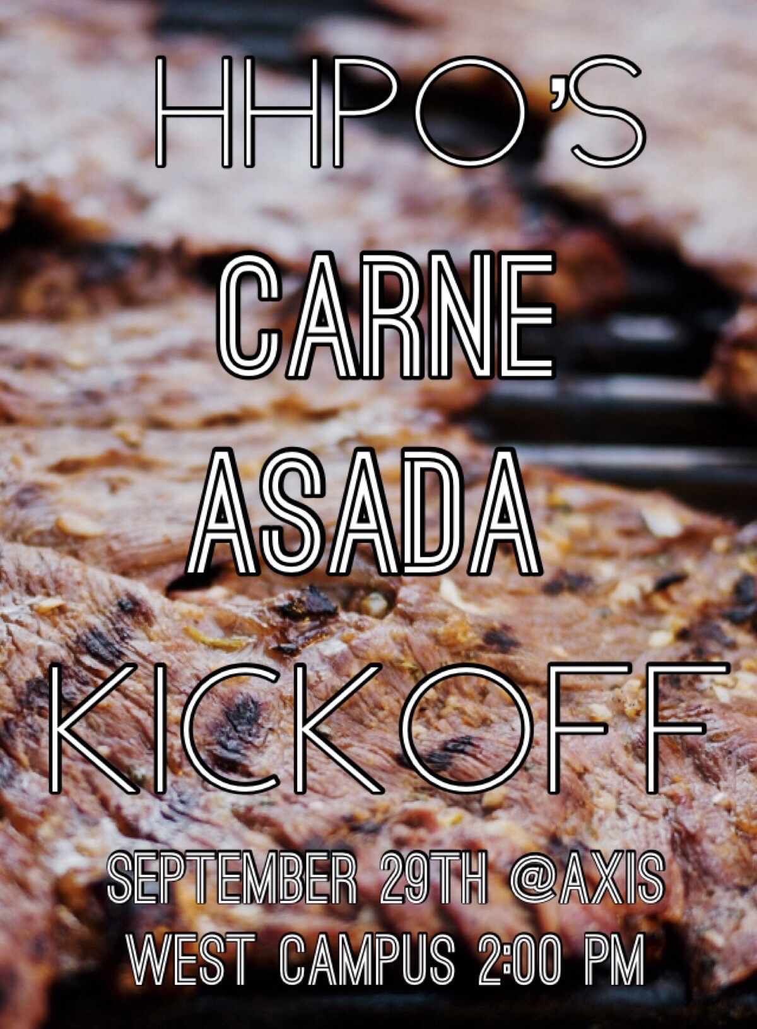
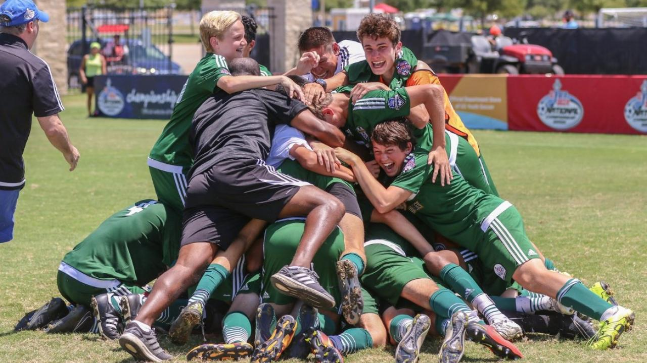
This saturday. RSVP!
Oct 10
We need more girls!

