Slide 1
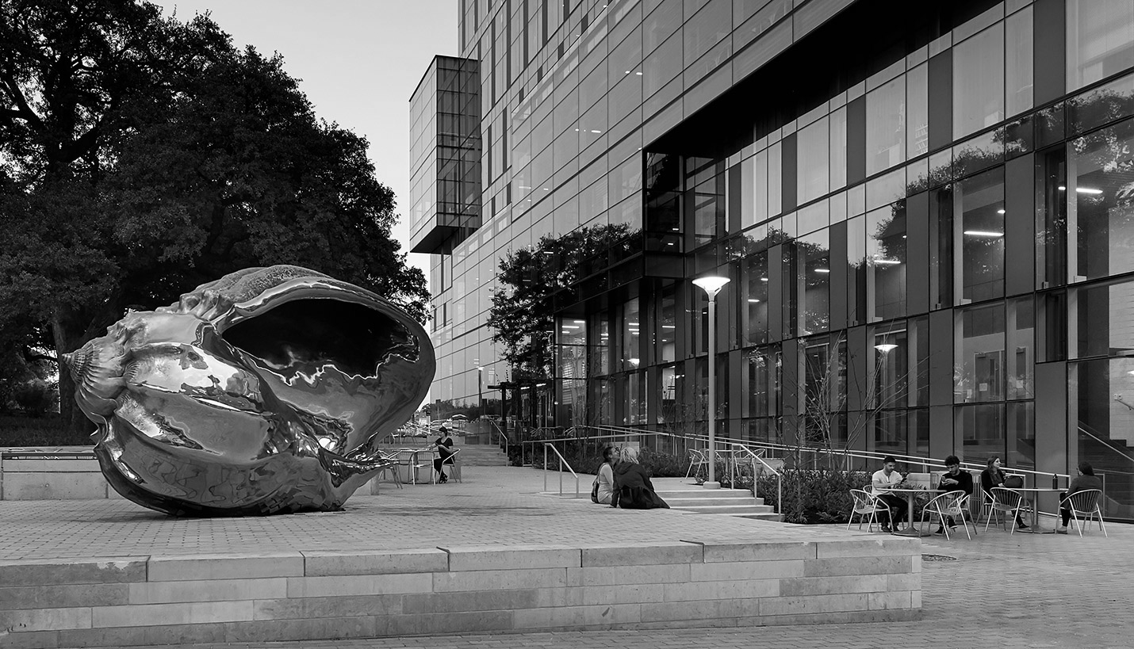

Hispanic Health Professions Organization
Information Body Meeting
March 26th, 6:45 pm
MEZ B0.036
Sign In Here:
https://tinyurl.com/y4t2wxfv

Slide 2
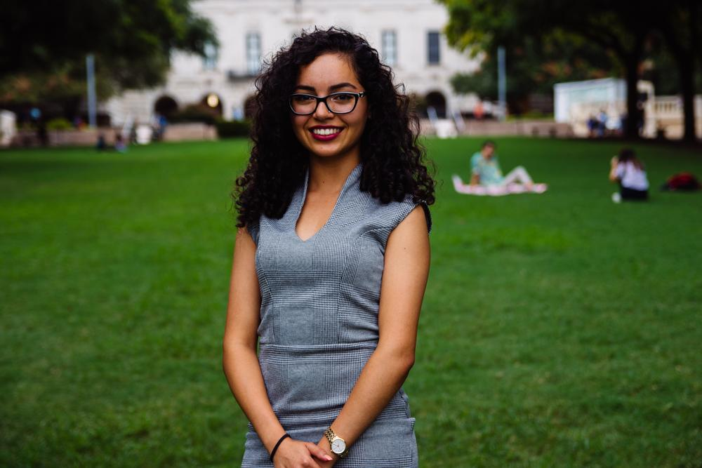
Evangelina Vaghefi
President
Psychology & Nutrition Double Major
5th Year
Fort Worth, TX
I’m swearing off chick-fil A forever...unless

Slide 3

Dell Med Open House
Tentative Date & Time:
Saturday May 4th 8-1:30 PM
Purpose: To orient first-gen, underrepresented students with the medical school application process.
Focal Points:
What to expect from the application process
Funding the MCAT + prep materials
Post-matriculation funding
Being a competitive applicant
Tips for traditional/multiple mini interviews (MMI)
Notes:
The Pre Med Open House was created by the Mentorship & Pipeline Committee of Dell Med's Making Equity Standard in Healthcare (MESH) student org. The purpose of this program is to orient students (predominantly first-generation, underrepresented, and/or those with low access to resources) to the medical school application process. The workshop is med student-run and utilizes round robin stations to tackle different aspects of the application cycle. These stations include information on what a typical and atypical application timeline looks like, funding the MCAT and prep materials, post-matriculation funding, what makes a competitive applicant, and traditional/multiple mini interviews (MMI) tips. A light breakfast will be served as well!
I will be in touch with more specifics soon, including an exact schedule of the program. But they usually run from 9 am to 12:30ish pm on Saturday morning (we're looking at 05/04 for yours).

Slide 4
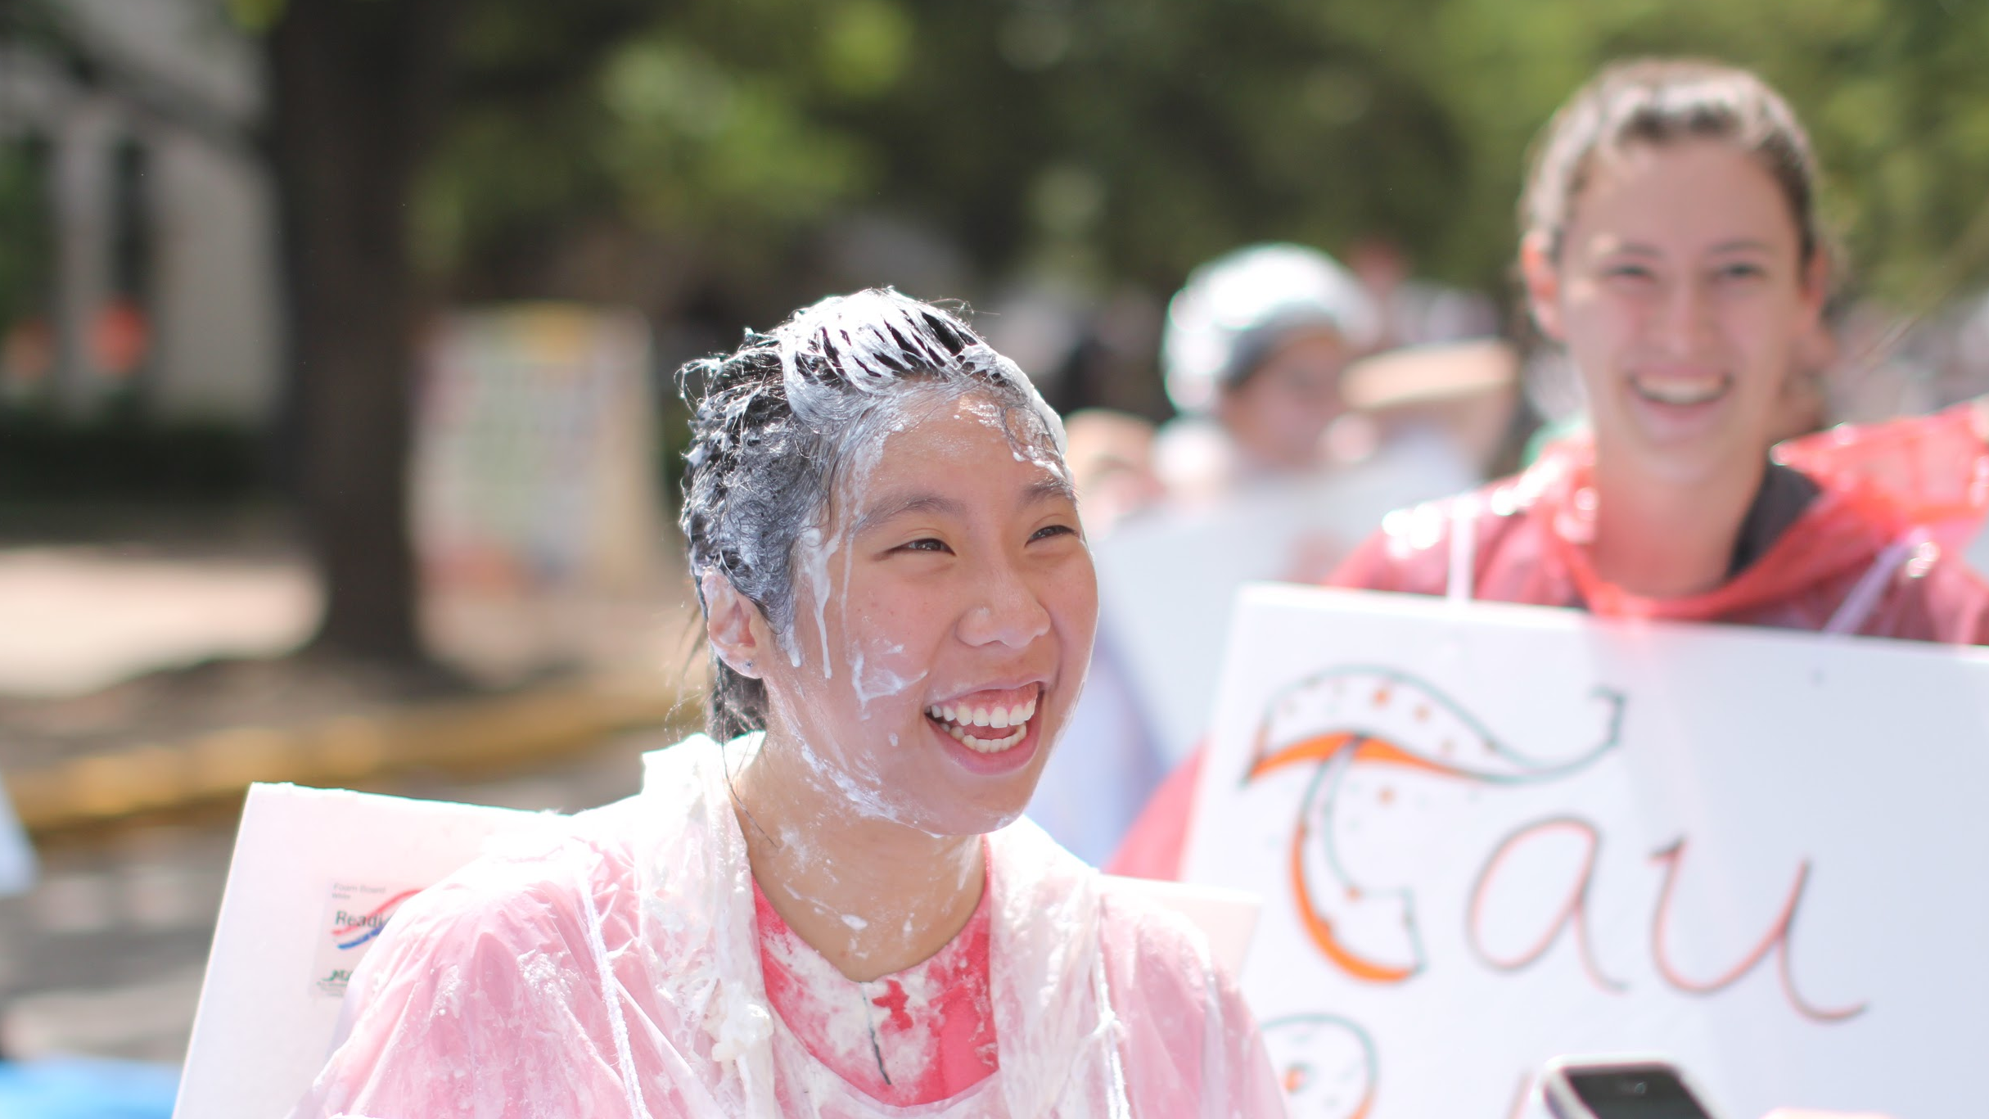
Pie A President 2019!
Pie ME in the face on Tuesday, April 2th from 2-4 PM @ Greg Plaza!
Benefiting Children’s Surgical Global Outreach
FREE surgeries for children in Guatemala
Pies are $3 each or 2 for $5
A chance to win $100 for our org!
Raffles for individual prizes:
  Kendra Scott, Alamo Drafthouse tix, etc!
Notes:
Replace [TIME] with the time you are being pied. If you aren’t sure about your time shoot pieapresident@texasaed.org a message!
*Orgs in each category of members (1-50, 51- 100, 101 - 151, 151+) with the largest number of pies will be awarded $100 CASH!
Raffles include gift cards to restaurants and places like amazon. Kendra scott jewelry is also in the raffle!

Slide 5

Aspire Banquet
CONGRATULATIONS TO MANNY FOR WINNING AN AWARD FOR LEADERSHIP AND SERVICE!!!
(From CNS)

Slide 6
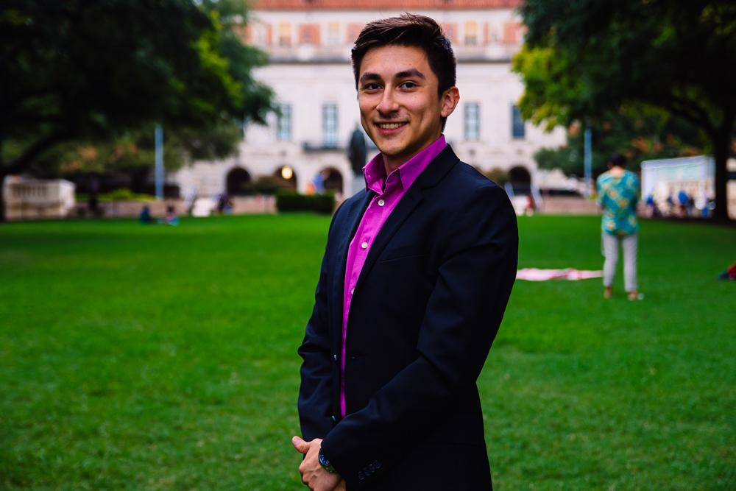
Cesar Gonzalez
VP of Professional Development
Neuroscience Major
Visual Media Minor
3rd Year
Roma, TX
I tried my first 5 hr energy today, i’m a caffeine junkie now

Slide 7
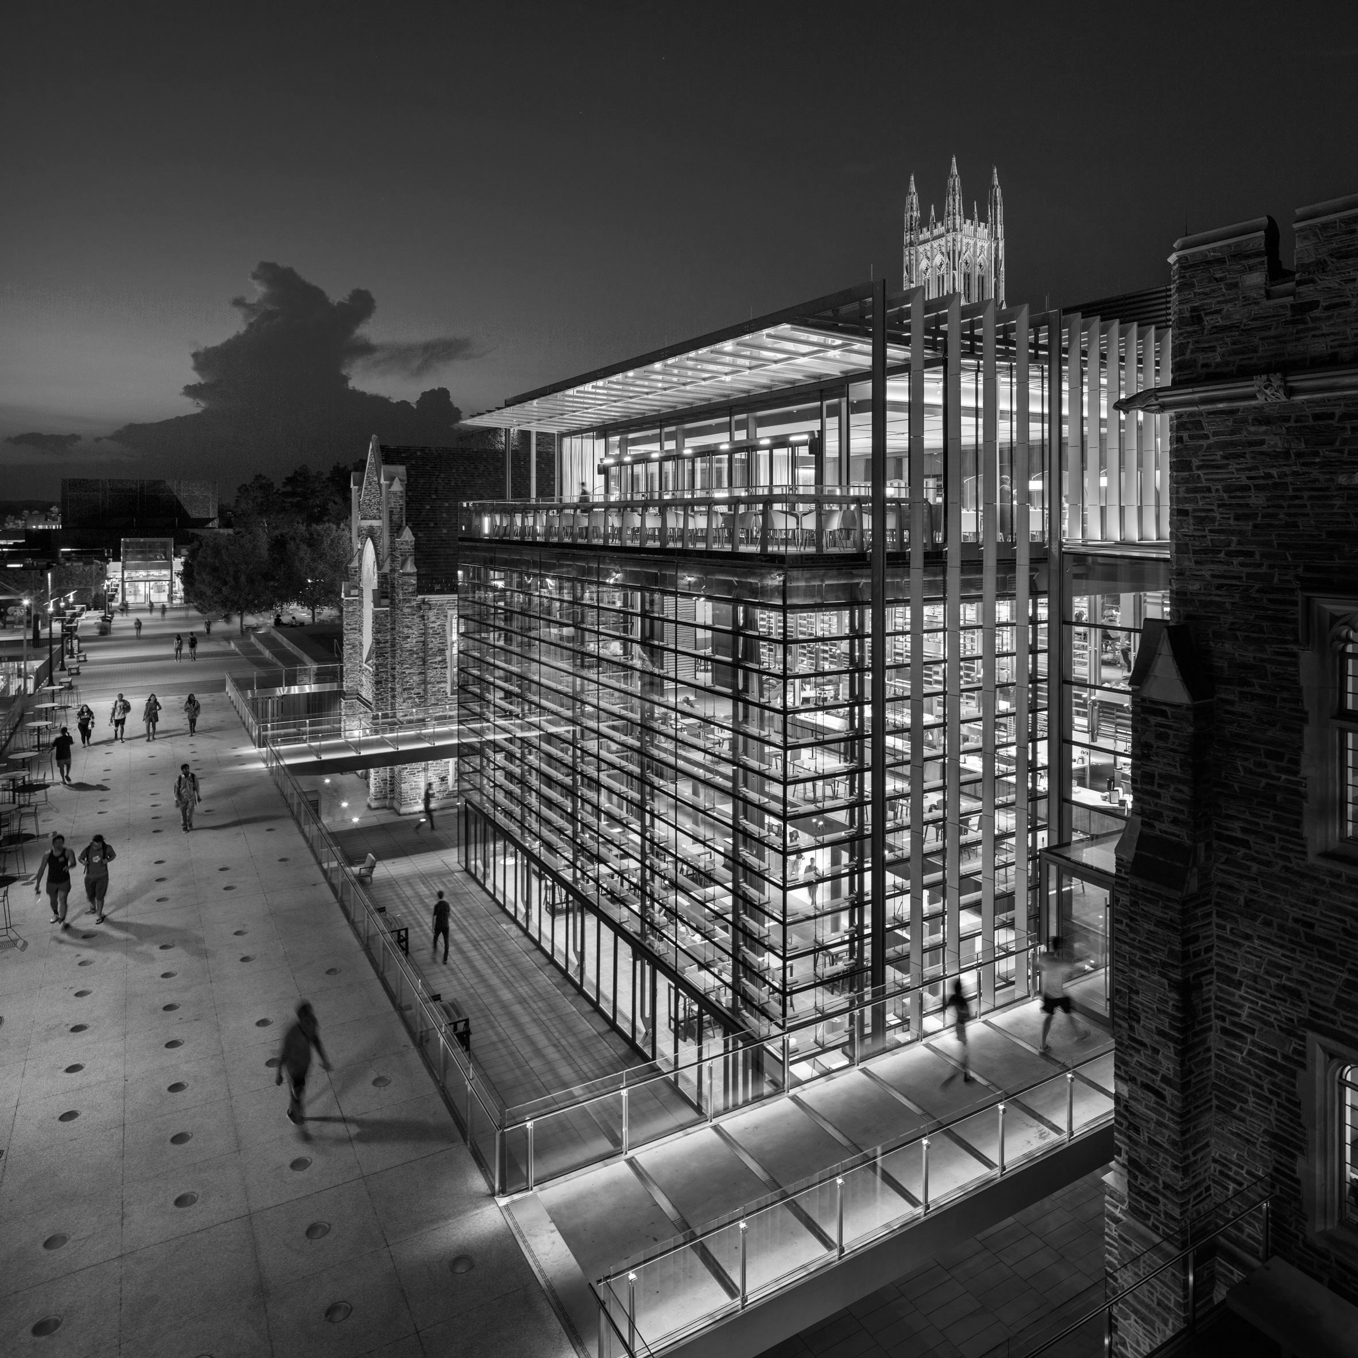

UT Health - Long School of Medicine
Saturday, March 30th / 9:45 am - 2:00 pm
Rides will be provided

Slide 8



Entrance Exam Preparation
15% discount - prep courses
10% discount one on one tutoring
Our Partner

Slide 9
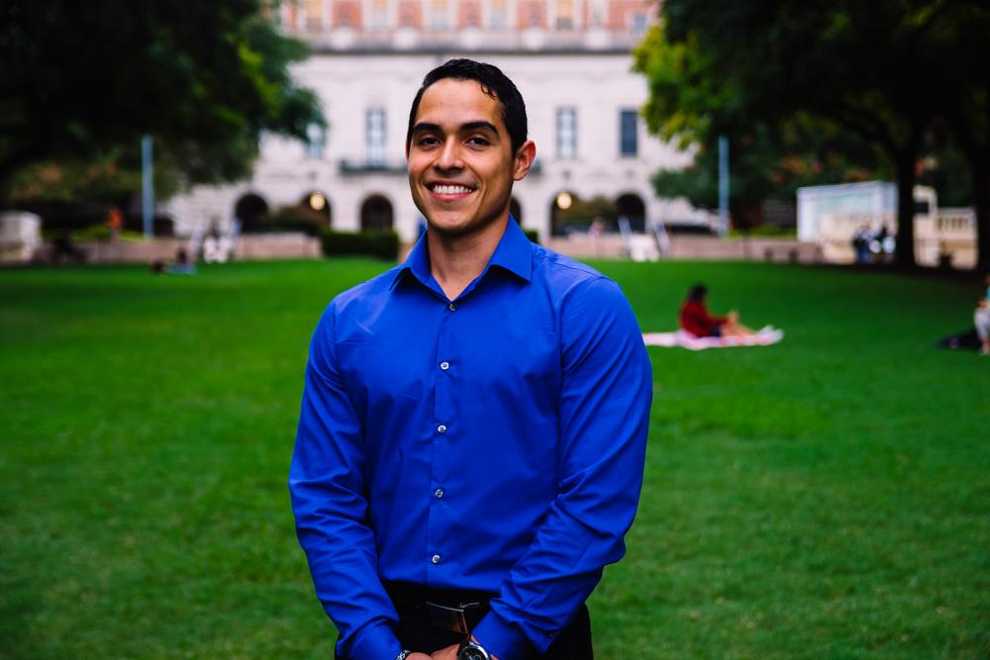
Javier Flores
VP of Community Development
Psychology Major, Pre-PA
3rd Year
Eagle Pass, TX
Fun Fact: I have a bad sweet tooth.

Slide 10


Cesar E. Chavez Blood Drive
Was a success!

Slide 11
Cesar E. Chavez Legacy Dinner
Hosted by Mexican American Culture Commitee
Date: Wednesday March 26th, 2019
Location: Shirley Bird Perry Ballroom (Texas Union)
Time: 6:00PM-9:00 PM
Keynote Speaker: Andres Chavez
https://tinyurl.com/y44zja6k

Slide 13
Survival of the Fittest
Date: Saturday, April 27th
Time: 10:00AM-12:00PM
Location: Whitaker Fields
First Place team will get prizes! Still TTBD
Then after.. WE FEAST AT PLUCKERS

Slide 14
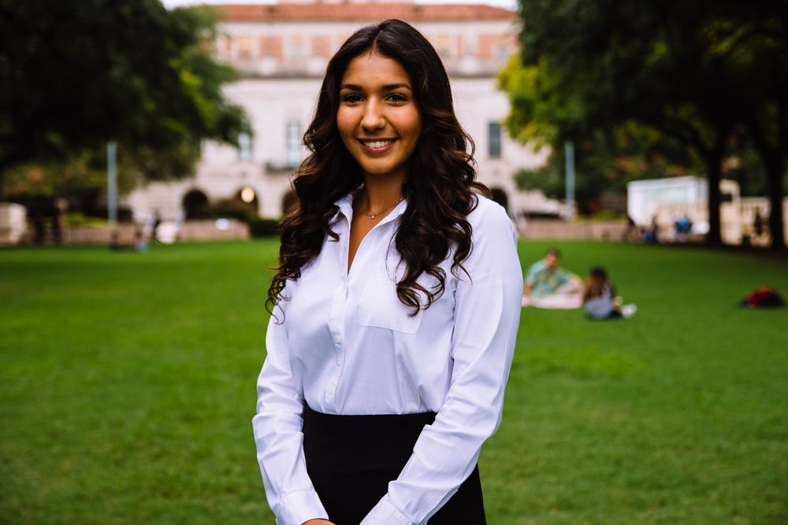
Bianca Garcia
Secretary
Kinesiology Major
3rd Year
Houston, TX
Fun Fact: Fresa’s is my go to restaurant in Austin!

Slide 15
ACTIVE MEMBER POINTS
FIVE Volunteer
THREE Social
THREE Professional
THREE Fundraising
THREE General Body Meetings
The point sheet is up to date: https://tinyurl.com/yxecb6f7
Let me know if you have any questions!!
biancagarcia207@utexas.edu

Slide 16
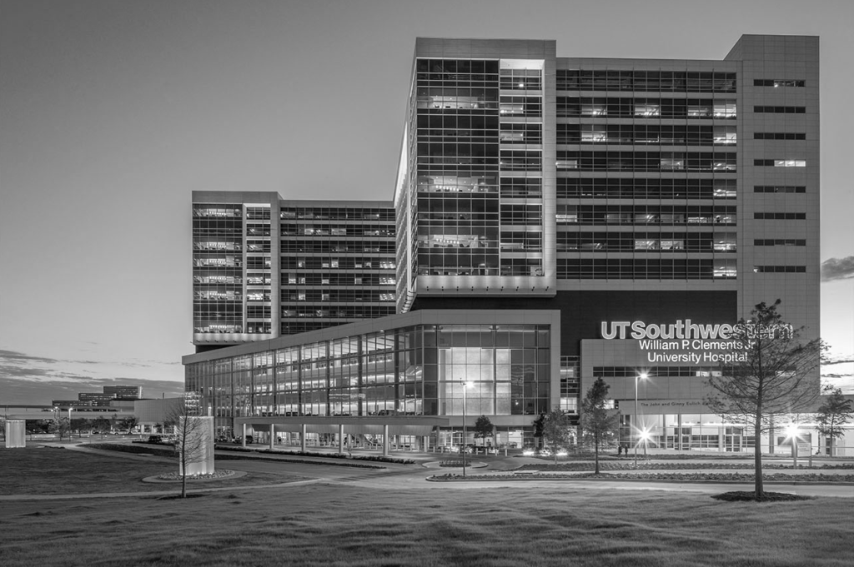
For ALL events involving head counts and ride confirmations, cancellation notice needs to be given 48 hours in advance with valid reasoning to officer hosting event.
** If no notification is received & you are not present at the event, points that would have been earned will be deducted from that respective category of points (volunteering, fundraising, etc.)**
Notes:
This includes

Slide 17
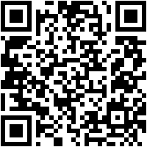
Join the GroupMe!

Slide 18
Google Calendar Link
Stay up to date!
https://tinyurl.com/yxs4qpkq

Slide 19
Families have been made!! You should hear from your officers this week!
Interested in joining? https://tinyurl.com/y44zja6k

Slide 20
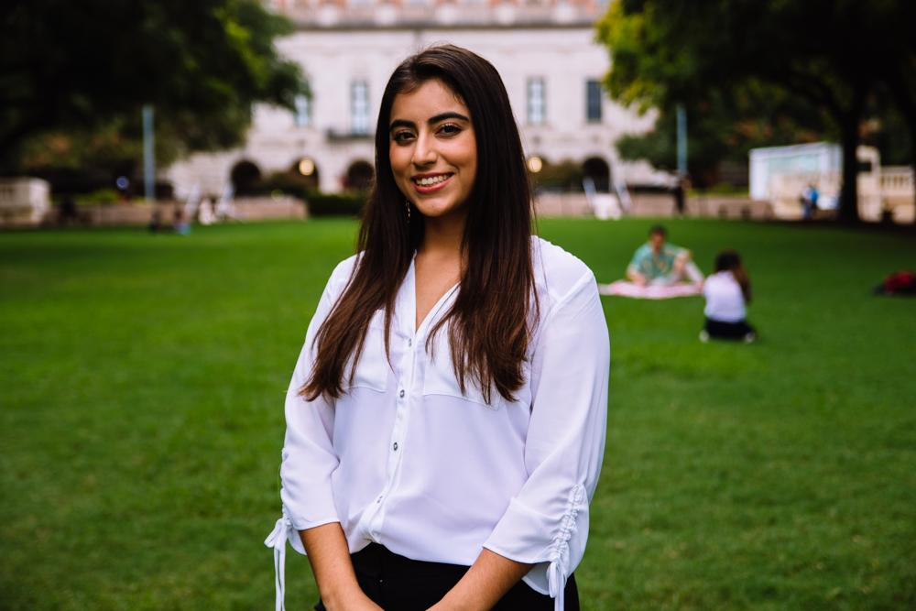
Suzett Fernandez
Financial Director
Human Development and Family Sciences Major
3rd Year
Eagle Pass, TX
I could have 888 (Vietnamese food) any day, every day

Slide 21
DUES
$ 30 Returning Members
$35 New Members
Includes a Tshirt!
Venmo: @Texas-HHPO
(Please state New/Returner)
Paypal: texashhpo@gmail.com ($2 fee)
Cash or Card
**Email: sfdzz97@gmail.com
- include your name, EID, phone number
** Increases by $10 after 3rd GBM**

Slide 22
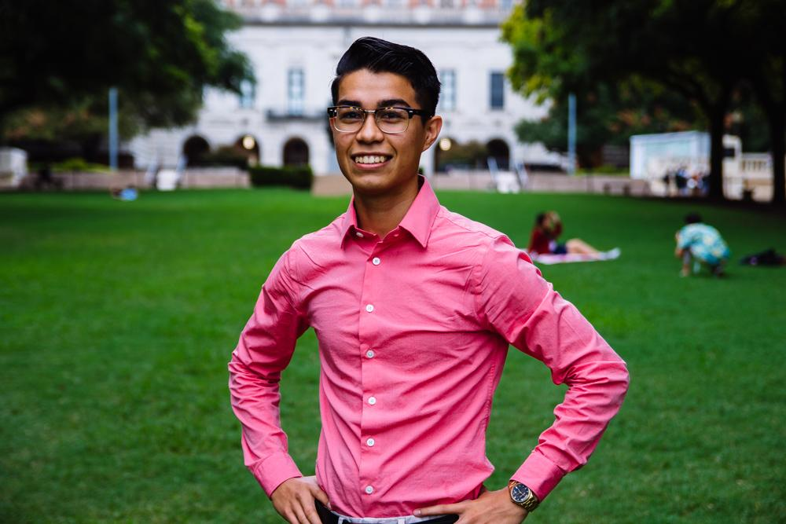
Emmanuel Rayas
Volunteer Director
Biochemistry, BSA
4th Year
San Antonio, TX
I won the Aspire Leadership and Service Award yesterday and I am really proud of it!!

Slide 23
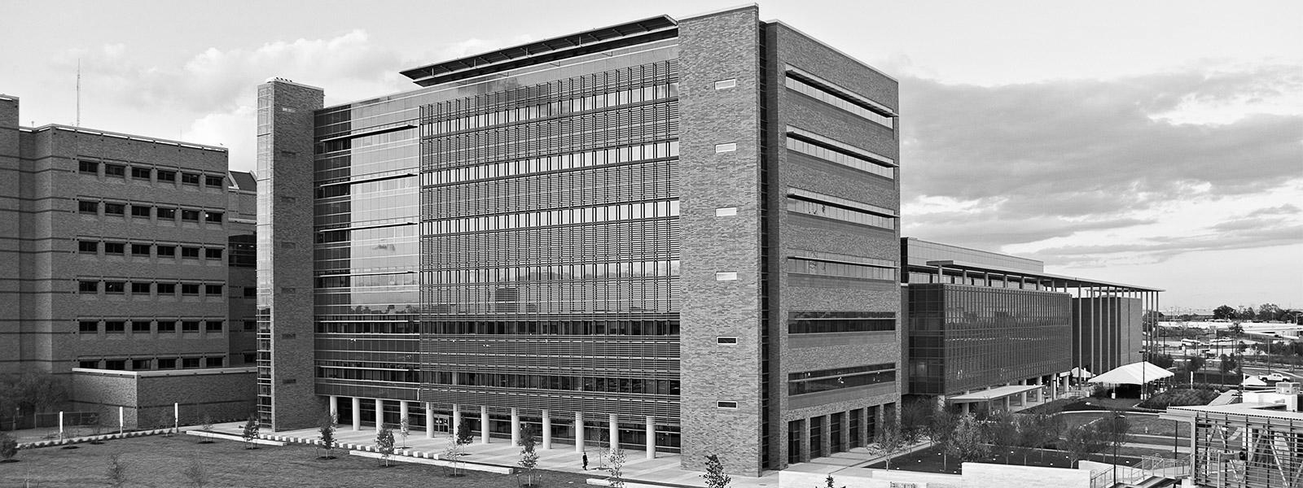
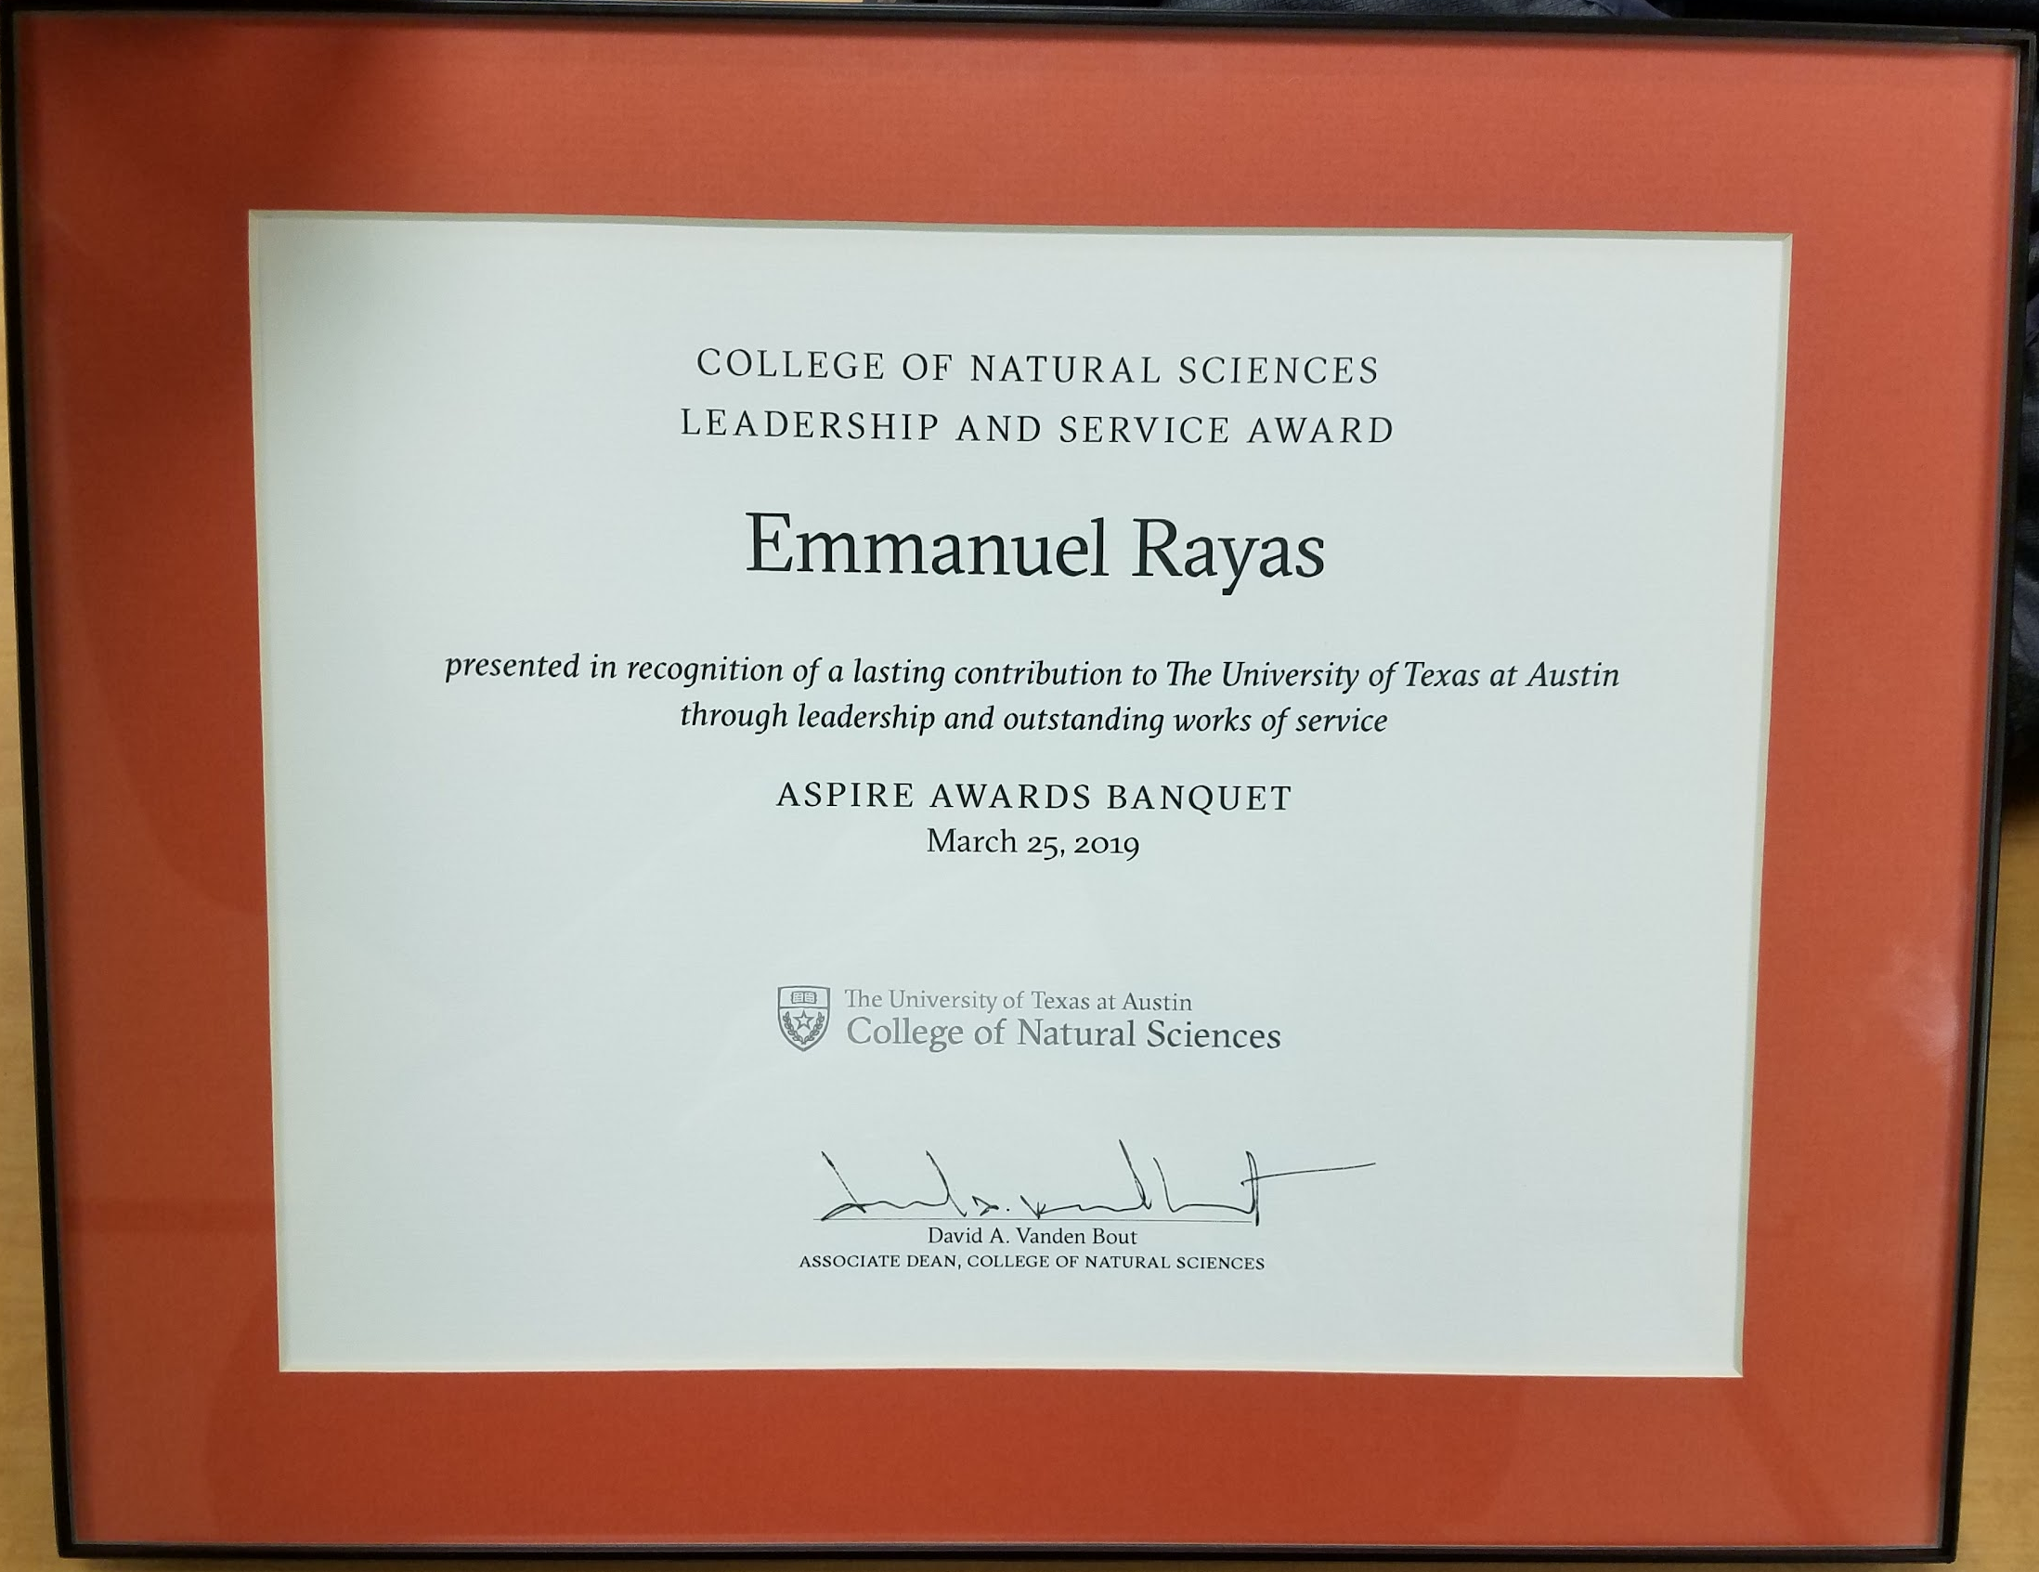
Notes:
Sign up link: https://goo.gl/forms/lxvrn03VPdcSoklr1
Shifts:
9:30 - 12:30
11:30-3:30
2:30-5:30

Slide 24

Nursing Home-Bingo
Friday
Mar 29, 7:00p
Take the bus together
(6:45p)
Or you can drive
Info
Bus stop 18 on
Trinity and MLK
2806 Real St
Austin, TX 78722

Slide 25

Volunteer Programs Survey
New Events
Psychiatric
Patients
Community
Gardens
Environmental
Movements
Group-Me
Volunteer
Together
With fellow
HHPO’ers
Who like the
same events.

Slide 26
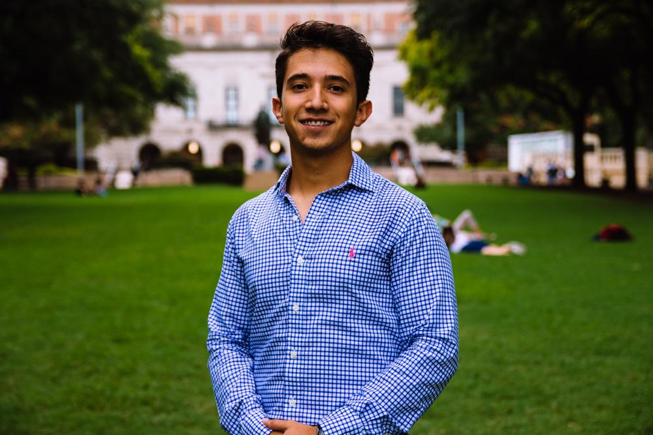
Marcelo Pintos
Social Director
Biochemistry BSA Major
3rd Year
Mcallen, TX / Reynosa MX
I went to three different states in Mexico during spring-break :o

Slide 27

HHPO’s Boat Party
Date: May 10th 4:00pm-10:00pm
Last day of school!
$20 for members and $30 for non-members
Please venmo @Texas-HHPO
And send screenshot of your payment to pmarcelo518@gmail.com
nndjd
Notes:
This includes

Slide 28
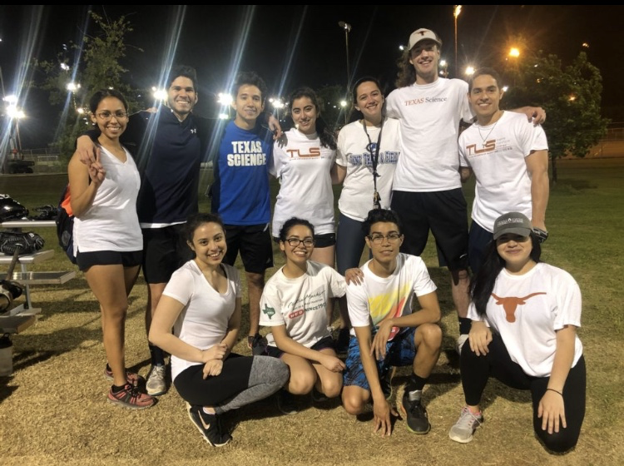
Softball Team
Poll

Slide 29
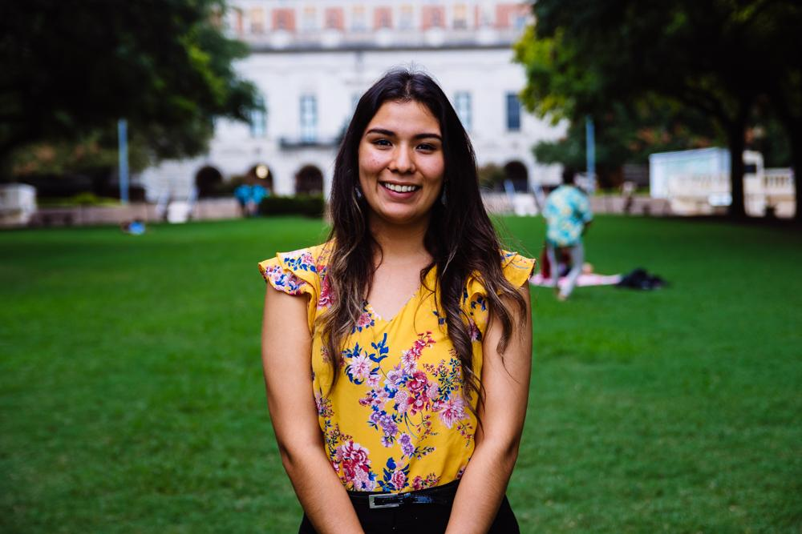
Andrea Martinez
Archives Director
Human Development and Family Sciences Major
3rd Year
Eagle Pass, TX
Fun fact: 7 more weeks til the semester ends!! :)

Slide 30

Scrapbooking Social
Sunday 4/31 @ 6pm in the SAC activity room -
Sign up here for live updates via GroupMe:

Slide 31
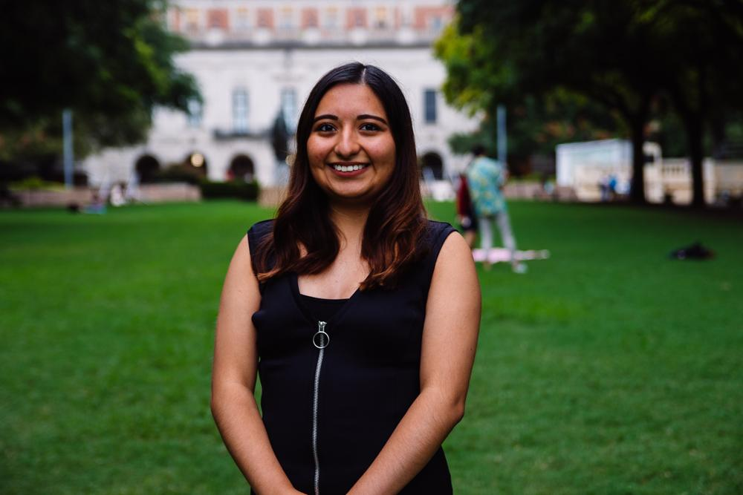
Valeria Sornia
Public Relations Director
Neuroscience Major
3rd Year
Eagle Pass, TX
I finally saw A Star Is Born, and I cried :(

Slide 32
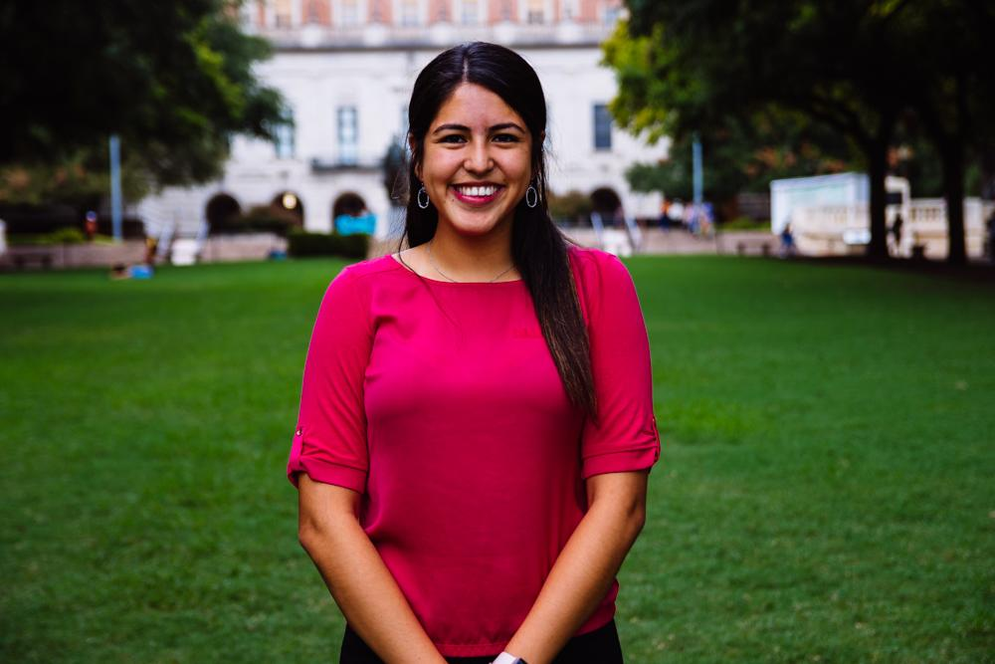
Jessica Medrano
IT Director
Neuroscience Major
3rd Year
Houston, TX
Fun fact: I get to go see Bad Bunny on Thursday and my 21st birthday is on Saturday!! #212121

Slide 33
Nominations
Each position will be given 2-3 minutes
VP and Presidential positions are limited to previous officers
Any individual can be nominated for more than one position
I will stop taking nominations by e-mail after 11:59 PM tonight

Slide 34


Thank You for Coming!!
Sign in here:
https://tinyurl.com/y4t2wxfv
3rd General Body Meeting:
2 April 2019
6:45 pm
Website: Texashhpo.weebly.com
Email: texashhpo@gmail.com
HHPO (Hispanic Health Professions Organization)
@texashhpo

