Slide 1
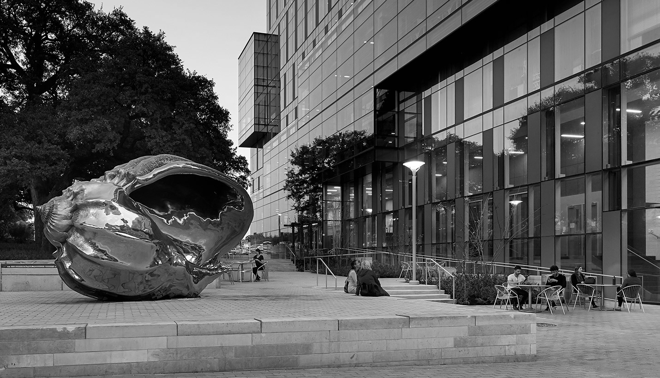
Hispanic Health Professions Organization
Information Body Meeting
February 19th, 2018, 6:45 pm
MEZ B0.036
Sign In Here:
https://tinyurl.com/y4999k68

Slide 2
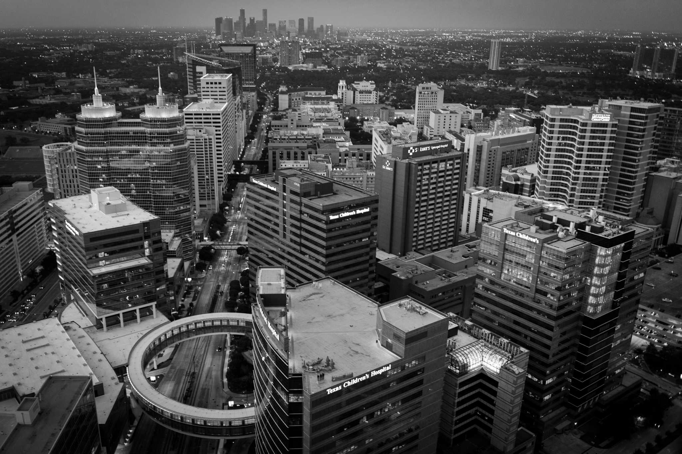
Icebreaker
Families!!
Notes:
Groups:
1 - Eva & Jessica
2 - Cesar & Andrea
3 - Javi & Valeria
4 - Suzett & Chelo
5 - Manny & Bianca

Slide 3
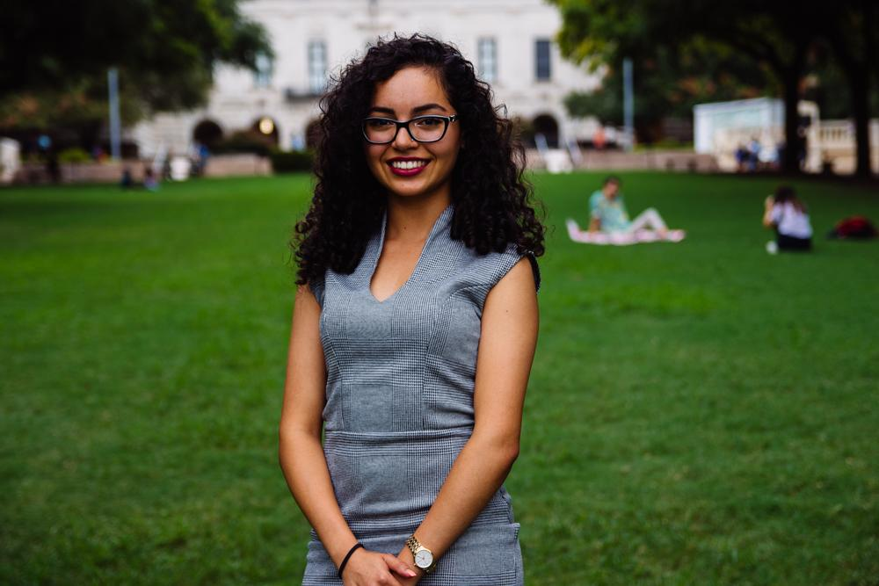
Evangelina Vaghefi
President
Psychology & Nutrition Double Major
5th Year
Fort Worth, TX
I tried pole vaulting out in the 8th grade...never quite got it down.

Slide 4
T-shirts

Slide 5
Aspire Banquet
Monday March 25th @ 6 PM
SAC Ballroom
The annual Aspire Awards Banquet celebrates African-American and Hispanic students who have excelled in the sciences. During this event, two peer-nominated awards will be given in: Leadership and Service.
Leadership and Service Award: Recipients have exhibited strong skills in leading and motivating others and have made a lasting contribution, through outstanding works of voluntary service, to The University of Texas and the surrounding communities.
Inspire Award: Recipients have proven inspirational by virtue of their courage and integrity and have acted as outstanding examples for others in the College of Natural Sciences community.
Awards are nomination based, so if you would like to nominate a fellow CNS student do so here by Wednesday February 27th.
RSVP before March 15th!
https://utexasscience.wufoo.com/forms/z1dzpkgi06l9xd2/

Slide 6
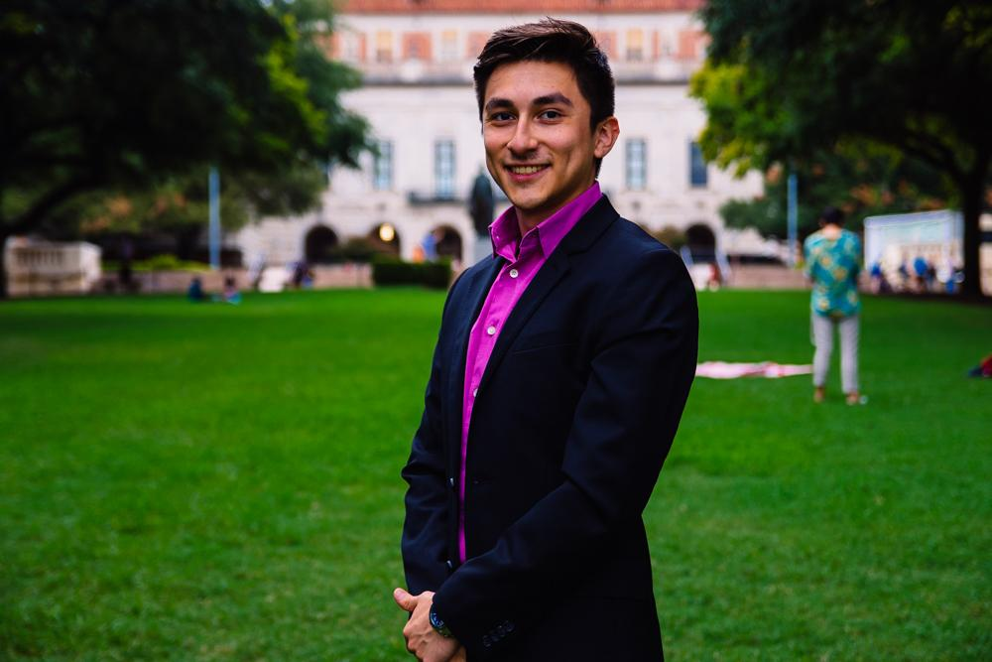
Cesar Gonzalez
VP of Professional Development
Neuroscience Major
Visual Media Minor
3rd Year
Roma, TX
I tumbled 4 times down dean keeton off a lime, ALMOST DIED

Slide 7
Professional Event
You’ll talk about approaches, practice handshakes and go over the best and easiest ways to connect so you are ready to put your best foot forward at the HP Fair.

Slide 8
Professional Workshop
Discussion Panel with the board
02/25/19 - 7pm - EPS 4.104
Topics such as gap years
Careers outside professionals schools
Time management in college
Keeping a healthy mindset

Slide 9
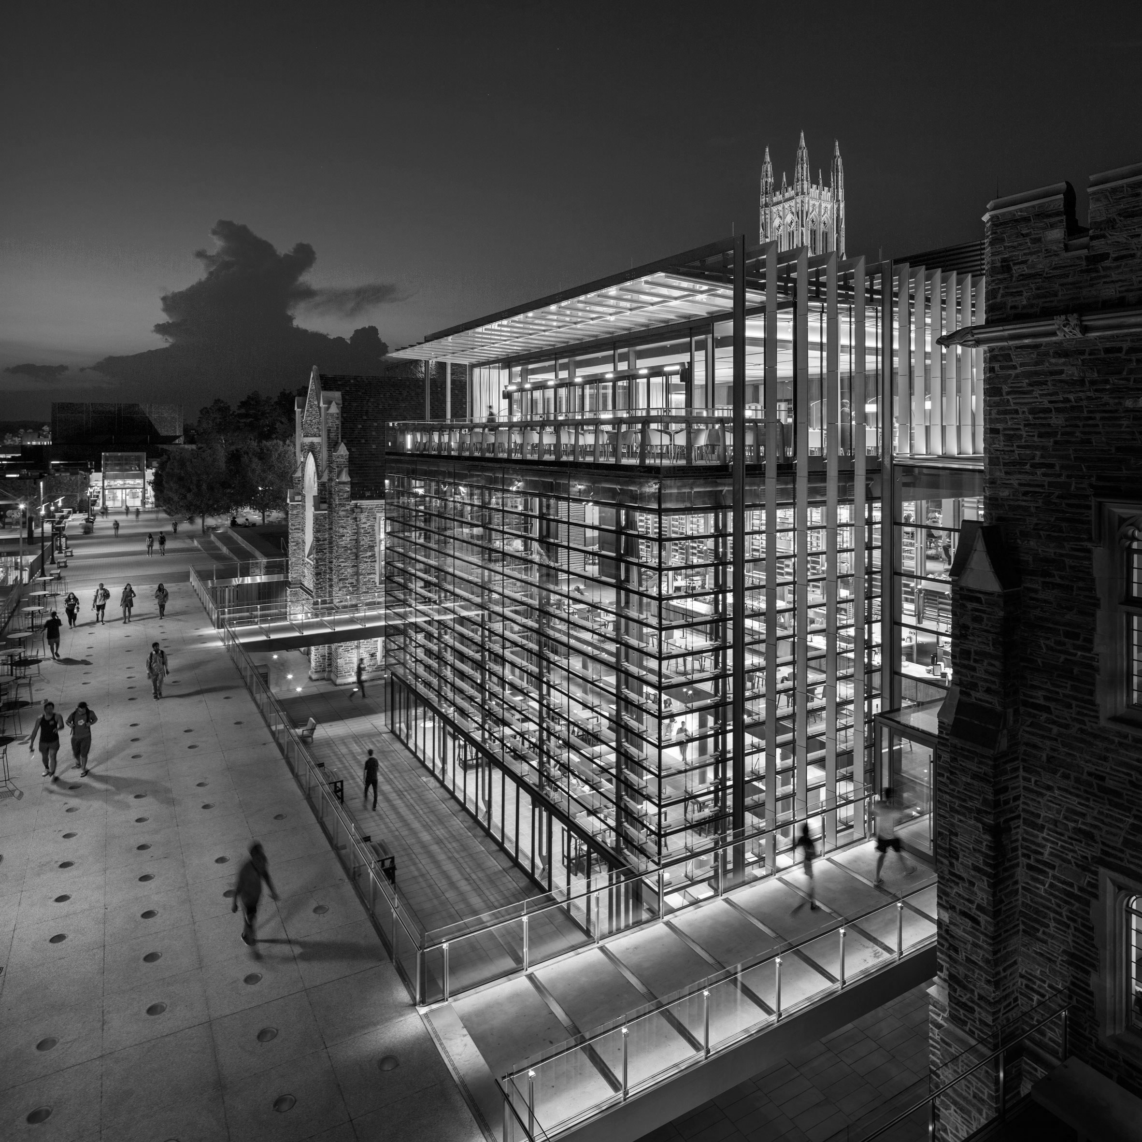
UT Health - Long School of Medicine
Saturday, March 30th
Rides will be provided

Slide 10
Entrance Exam Preparation
15% discount - prep courses
10% discount one on one tutoring
Our Partner

Slide 11
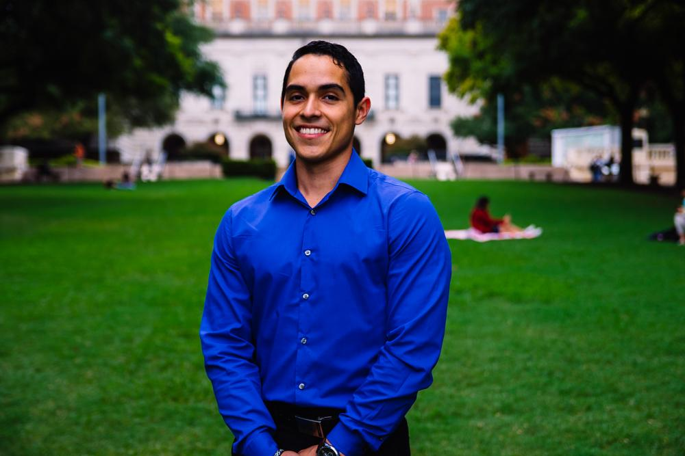
Javier Flores
VP of Community Development
Psychology Major, Pre-PA
3rd Year
Eagle Pass, TX
Fun Fact: I have three exams this week :).. RIP

Slide 12
Cesar E. Chavez Blood Drive
Date: Thursday, March 14th
Time: 1:30 PM- 4:30PM
Location: Winship circle on Campus in front of RLP
Sign up sheet will be provided soon.. ONLY 20 slots available.
Why donate?
You save lives!!
https://weareblood.org/about-us/mission-history/

Slide 13
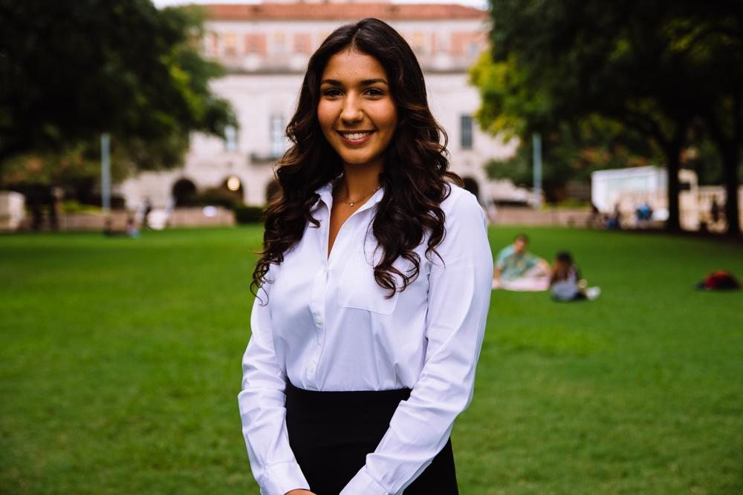
Bianca Garcia
Secretary
Kinesiology Major
3rd Year
Houston, TX
Fun Fact: I’m currently studying for the MCAT using Princeton in class courses! Reach out to me if you have any questions about it!
**Paid members receive discount when registering**

Slide 14
ACTIVE MEMBER POINTS
FIVE Volunteer
THREE Social
THREE Professional
THREE Fundraising
THREE General Body Meetings
The point sheet is up to date: https://tinyurl.com/yxecb6f7
Let me know if you have any questions!!
biancagarcia207@utexas.edu

Slide 15
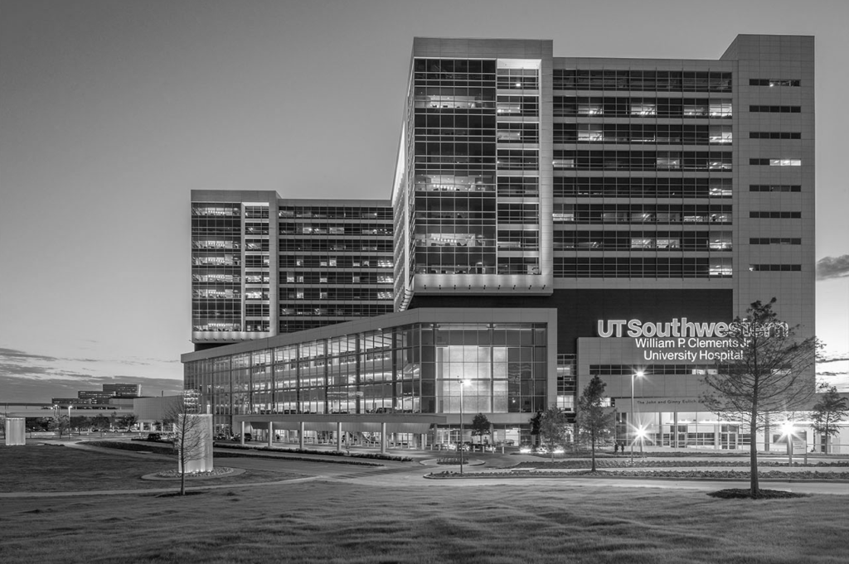
For ALL events involving head counts and ride confirmations, cancellation notice needs to be given 48 hours in advance with valid reasoning to officer hosting event.
** If no notification is received & you are not present at the event, points that would have been earned will be deducted from that respective category of points (volunteering, fundraising, etc.)**
Notes:
This includes

Slide 16
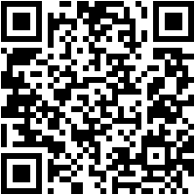
Join the GroupMe!

Slide 17
Google Calendar Link
Stay up to date!
https://tinyurl.com/yxs4qpkq

Slide 18
Member of the
Semester!

Slide 19
GERARDO
LOPEZ

Slide 20
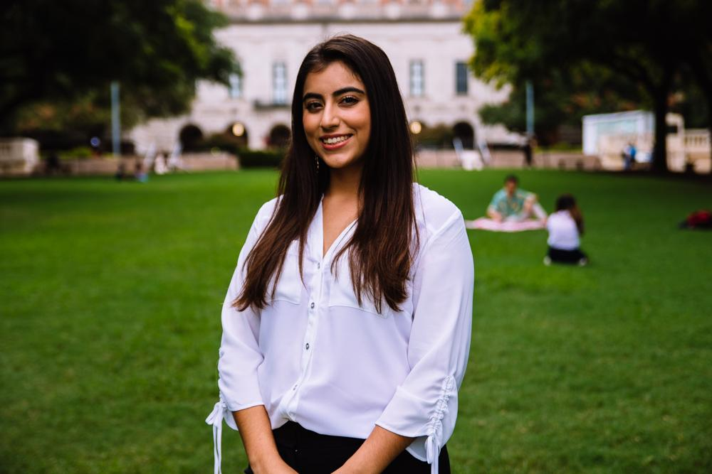
Suzett Fernandez
Financial Director
Human Development and Family Sciences Major
3rd Year
Eagle Pass, TX

Slide 21
DUES
$ 30 Returning Members
$35 New Members
Includes a Tshirt!
Venmo: @Texas-HHPO
(Please state New/Returner)
Paypal: texashhpo@gmail.com ($2 fee)
Cash or Card
**Email: sfdzz97@gmail.com
- include your name, EID, phone number
** Increases by $10 after 3rd GBM**

Slide 22
Burrito Factory Profit Share
Come join and help us fundraise at Burrito Factory!
When: Tuesday, February 26th
Where: Dobie food court
Time: 4-8pm
Why: with every purchase we’ll get 15% of the sales back! Please help us fundraise money for the organization! This goes to all of our future events and end of year scholarships.
*You will also earn a fundraising point for this and a social point if you bring a friend and take a picture for “comiendo con amigos”! For both of these opportunities we need a picture of you (and friends if so) with the receipt sent to sfdzz97@gmail.com

Slide 23
Notes:
This includes

Slide 24
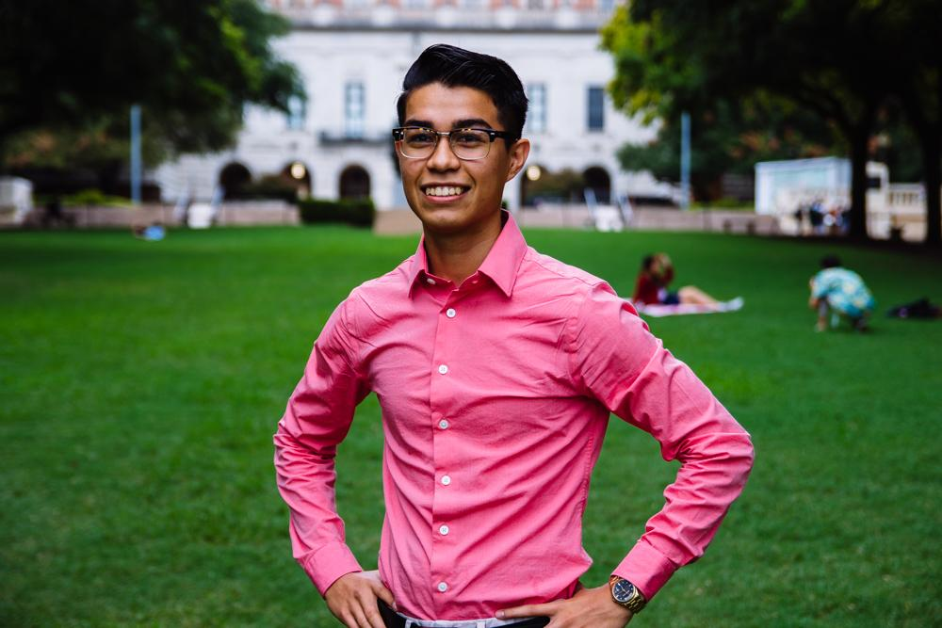
Emmanuel Rayas
Volunteer Director
Biochemistry, BSA
4th Year
San Antonio, TX
I’ve been saying I am going to meal prep this semester.. but it is already like the 5th week of school.
Notes:
I’ve been saying I am going to meal prep this semester.. but it is already the third week of school and...

Slide 25
Population Based Volunteering
The Youth
Communities in Schools
The Elderly
Bingo at The Nursing Home
The Homeless
Homecooked Fridays
The Incarcerated
Inside Books
The Public
We Are Blood

Slide 26
Recurring on your Schedule
Thursday
Inside Books
7-11PM
3121 E 12th St
Austin, TX 78702
insidebooksproject@gmail.com
Friday
Homecooked Fridays
1-3PM & 3-5PM
209 W. 27th St. Austin, TX 78705
Sign-up found on digest.
HHPO Bingo at the Nursing Home
7-8PM
2806 Real St Austin, TX 7872*
Bus Route 18 on MLK & Trinity
Sunday
Inside Books
5-9PM
3121 E 12th St
Austin, TX 78702
insidebooksproject@gmail.com

Slide 27
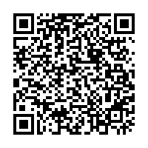
Volunteer Programs Survey
New Events
Psychiatric
Patients
Community
Gardens
Environmental
Movements
Group-Me
Volunteer
Together
With fellow
HHPO’ers
Who like the
same events.

Slide 28
Nursing Home-Bingo
Friday
Feb 19, 7:00p
We take the bus together
(6:45p)
Or you can drive
Where
Bus stop 18 on
Trinity and MLK
2806 Real St
Austin, TX 78722

Slide 29
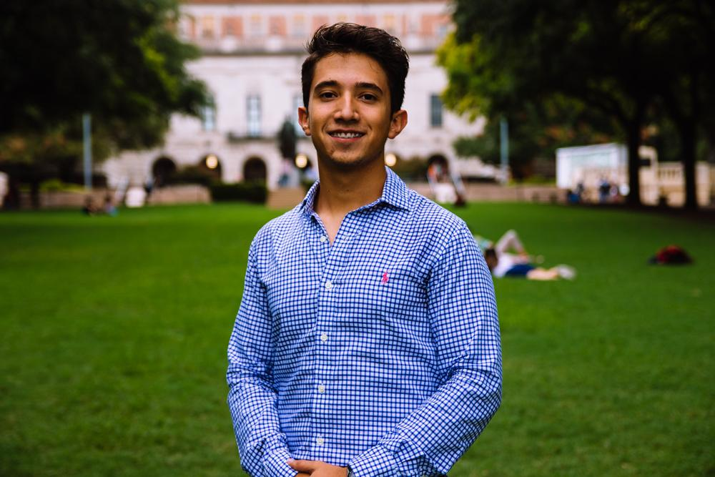
Marcelo Pintos
Social Director
Biochemistry BSA Major
3rd Year
Mcallen, TX/ Reynosa MX

Slide 30
Social Activities
Poll
Top 5 activities chosen:
Cielo night
Mt. Bonelle
Barton Springs
Mozarts Coffee Roasters
21+ raspas (snow cones)
1st Event
CIELO - 6th Street
March 1st - (age 18 and above)

Slide 31
Study Socials
Starting tomorrow - Wednesday Feb 20
PCL 4.114
Regular date: Tuesday’s in PCL 5.114

Slide 32
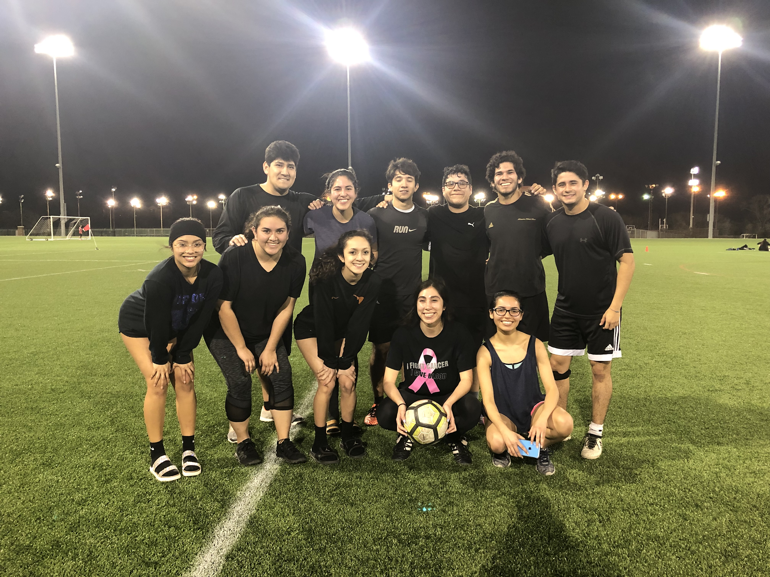
Leaving It All On The Field!!
IM Soccer Team 2k19
We play Thursdays at 7pm this semester, sign up!

Slide 33
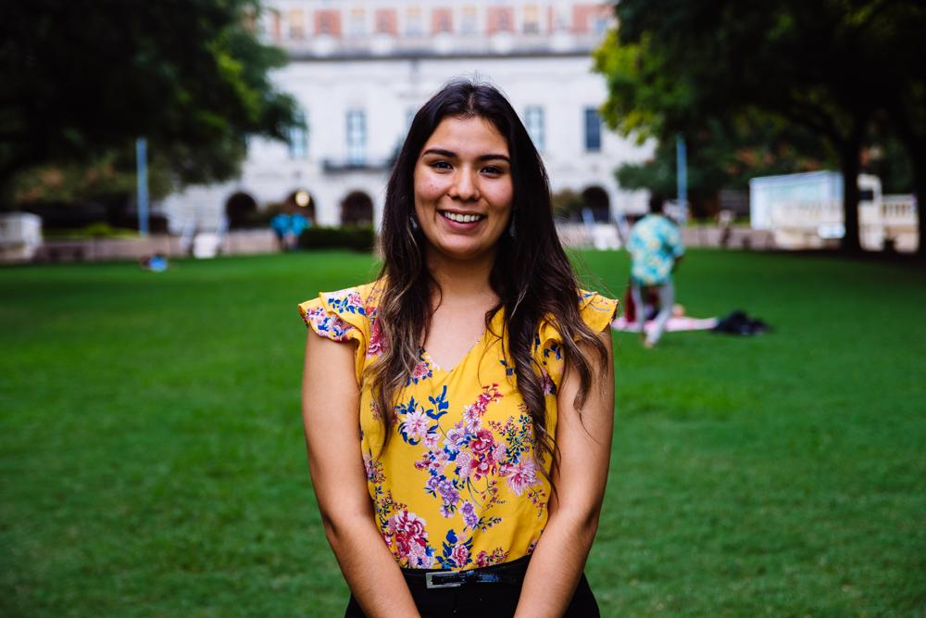
Andrea Martinez
Archives Director
Human Development and Family Sciences Major
3rd Year
Eagle Pass, TX
Currently out because of my wisdom tooth - getting it extracted tomorrow :(
- Scrapbook updates @ next meeting!

Slide 34
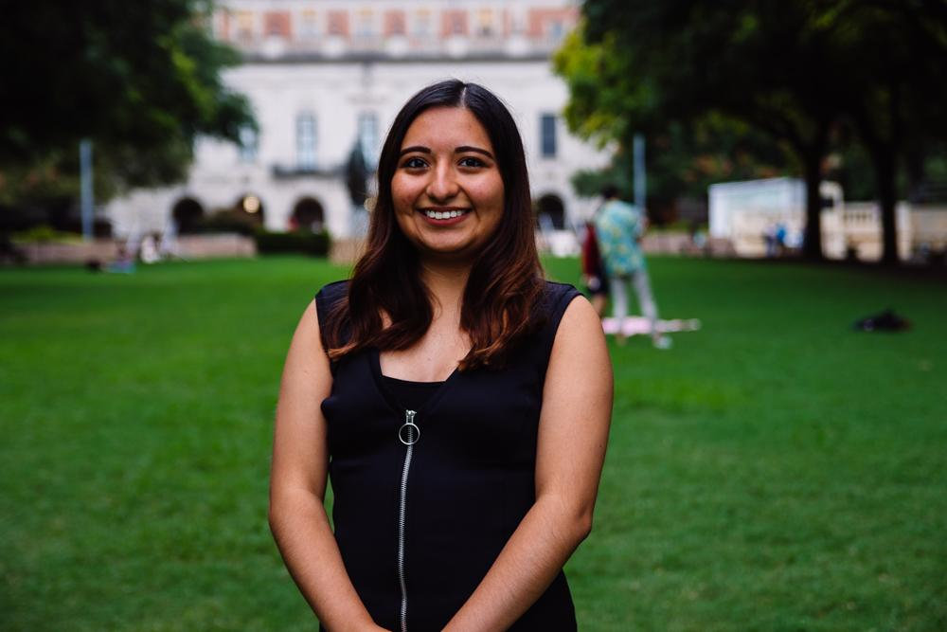
Valeria Sornia
Public Relations Director
Neuroscience Major
3rd Year
Eagle Pass, TX
I saw Jared Padalecki from Supernatural run at the Austin Marathon!

Slide 35
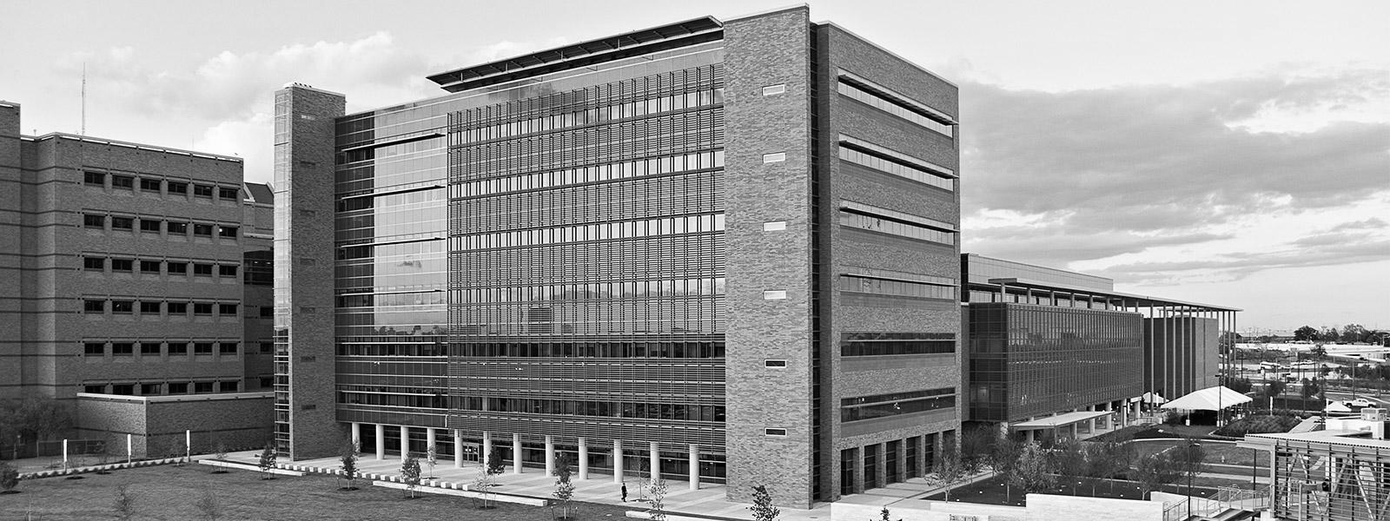
Explore UT
Saturday March 2nd
Minute to Win It: Pin the Organ on Anatomy Juan!
We will be creating a series of challenges and ask attendees to participate in learning about human physiology.
Location: UNB 3.202 Ballroom
Time: 11-5 PM
Sign up here: https://goo.gl/forms/Q5ZY2iDBbG6A5Go83
Notes:
Sign up link: https://goo.gl/forms/lxvrn03VPdcSoklr1
Shifts:
9:30 - 12:30
11:30-3:30
2:30-5:30

Slide 36
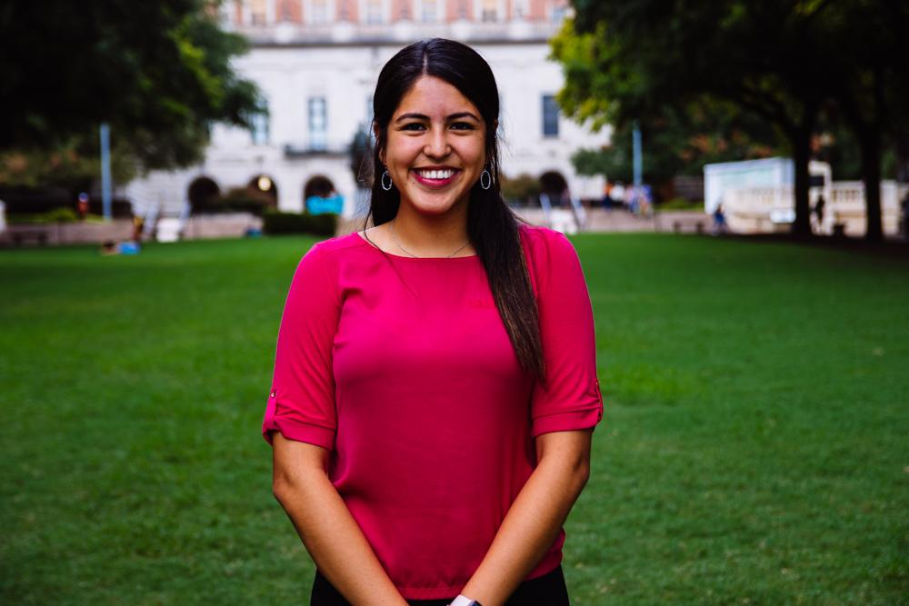
Jessica Medrano
IT Director
Neuroscience Major
3rd Year
Houston, TX
Fun fact: I have 3 exams this week… y’all pray for me pls, but SHOUTOUT TO MY FAMILY!

Slide 37
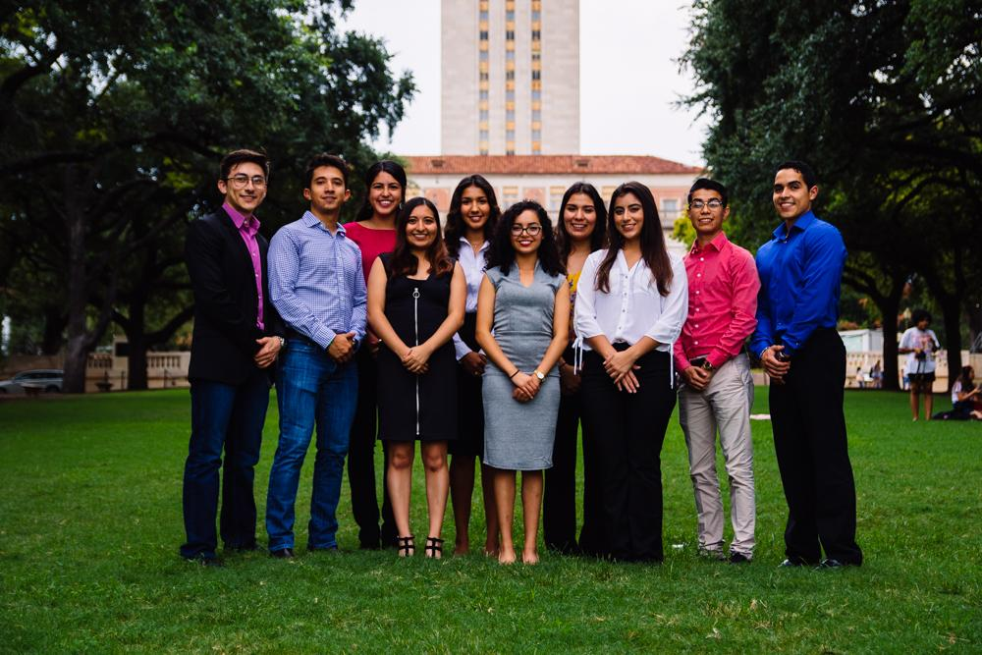
Let us know if you have any questions!!

Slide 38
Thank You for Coming!!
Sign in here:
https://tinyurl.com/y4999k68
2nd General Body Meeting:
5 March 2019
6:45 pm
Website: Texashhpo.weebly.com
Email: texashhpo@gmail.com
HHPO (Hispanic Health Professions Organization)
@texashhpo

