Slide 1
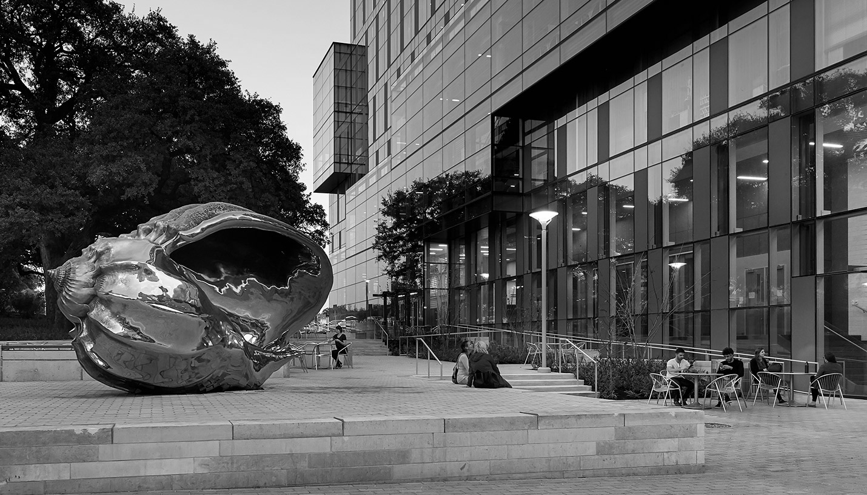
Hispanic Health Professions Organization
General Body Meeting
April 23, 6:45 pm
MEZ B0.306
Sign In Here:

Slide 2
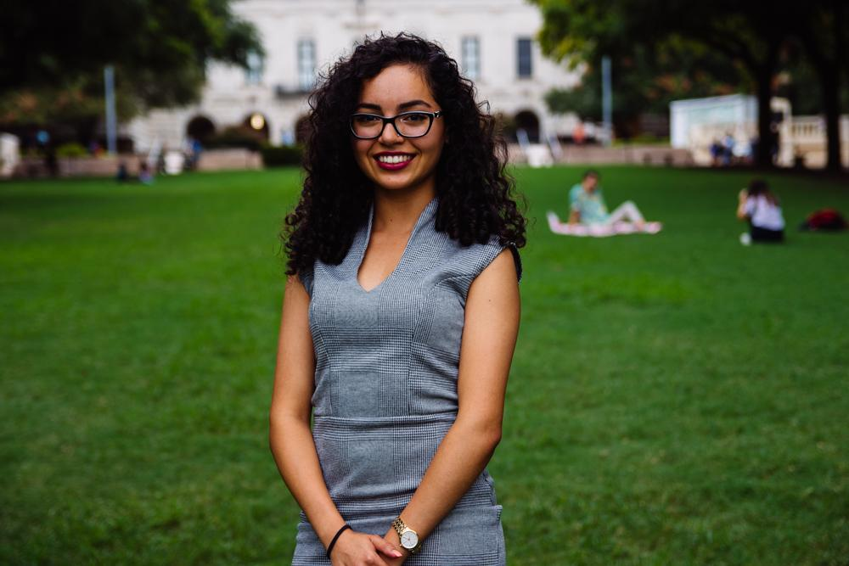
Evangelina Vaghefi
President
Psychology & Nutrition Double Major
5th Year
Fort Worth, TX
I’m so grateful for HHPO
Notes:
Announce new officer board
Banquet
Scholarship
Graduating Seniors

Slide 3
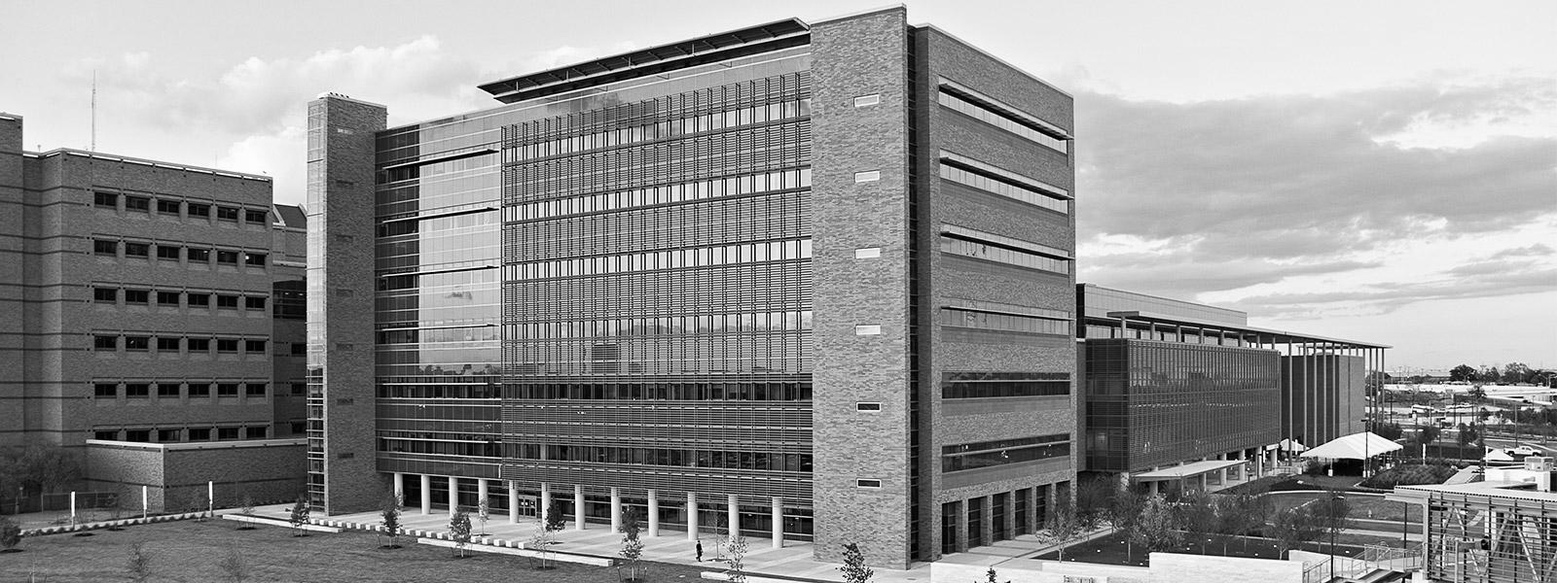
2019-20 HHPO Exec. Board
President: Suzett Fernandez
VP of Professional: Bianca Garcia
VP of Professional: Christopher Rogel
VP of Community: Valeria Sornia
Secretary: Carlos Arevalo
Financial Director: Olivia Martinez
Volunteer Director: Ximena De La Cruz
Social Director: Alyssa Garza
PR Director: Ariana Ramos
Archives: Jessica Medrano
IT Director: Andrea Martinez

Slide 4
HHPO Scholarship
Deadline to apply: Friday April 26th
At 11:59 PM
We will be awarding 3 scholarships of $300, $200 and $100. All current active members are eligible to apply.
Make sure to give yourself ample time to consider these questions in depth. All recipients will be announced at our banquet on
Friday May 3rd.

Slide 5
HHPO Banquet - Dundies Ed.
Tickets $6
Join us in celebrating the year’s collection of failures, success and growth!!
Why should you go??? Theme/Attire: Oscar’s (Refer to
Food (as always) Dundies ep. Of the Office)/
Raffles Semi-Formal
Dancing
Awards Date & Location are being
Confirmed

Slide 6
GRADUATING?
We have a cord for that!!!
Qualifications: Active member status for at least 3 semester (flexible)
If you believe you qualify please send me a message/ talk to me after the meeting.
:)

Slide 7
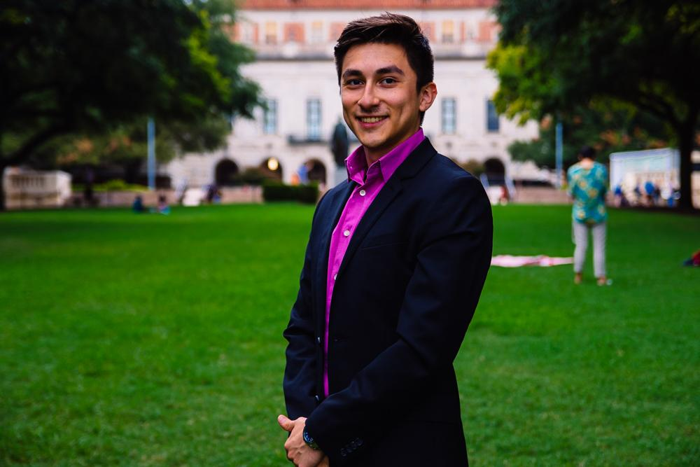
Cesar Gonzalez
VP of Professional Development
Neuroscience Major
Visual Media Minor
3rd Year
Roma, TX
I tried my first 5 hr energy today, i’m a caffeine junkie now

Slide 8
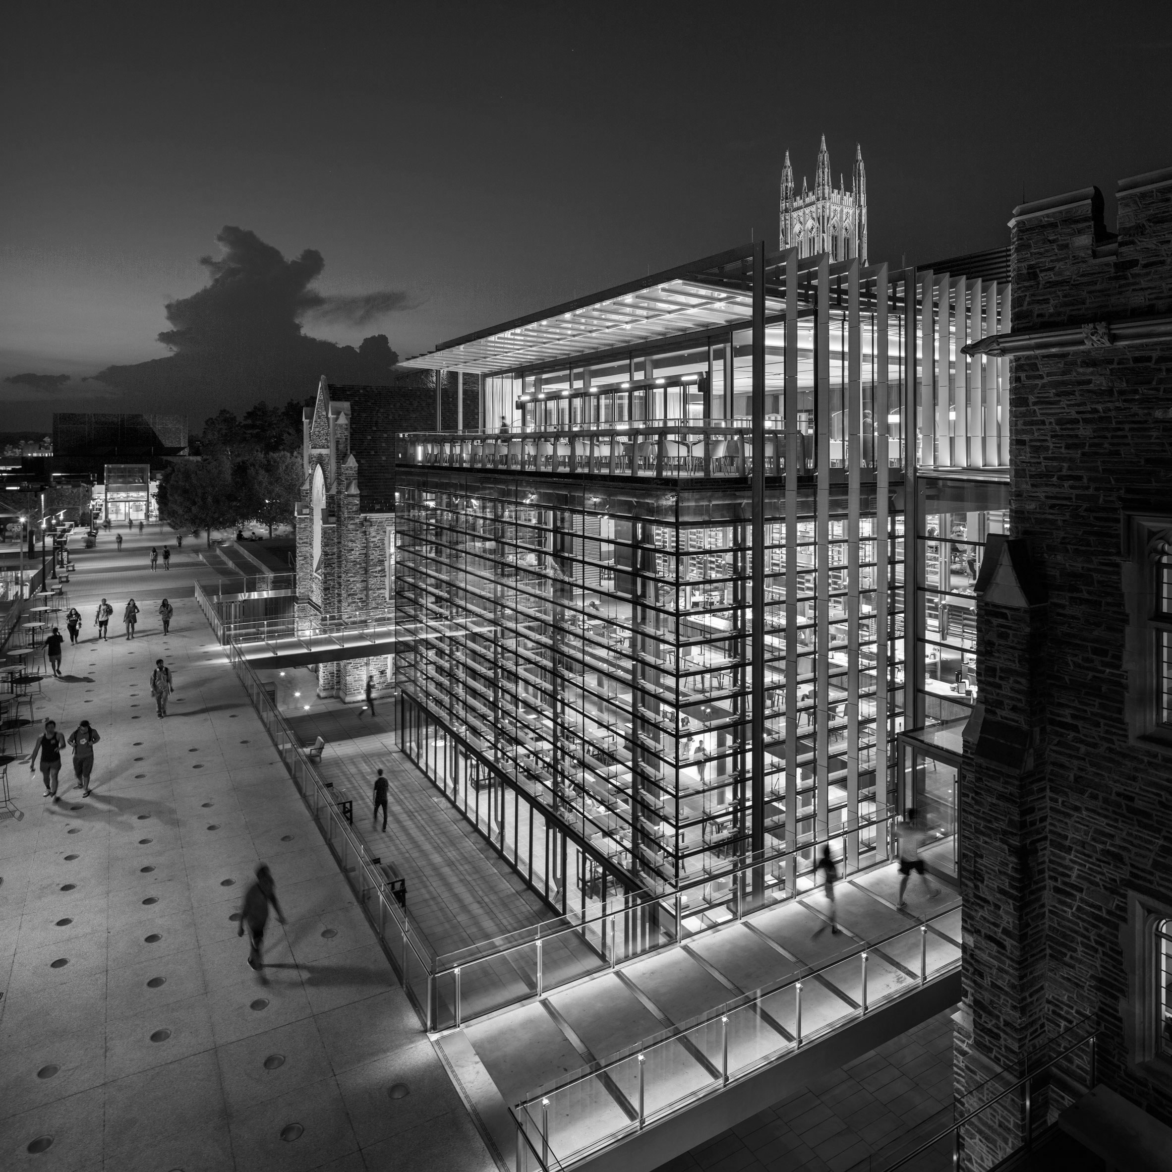
UT Health - Long School of Medicine
Saturday, March 30th / 9:45 am - 2:00 pm
Rides will be provided

Slide 9
Entrance Exam Preparation
15% discount - prep courses
10% discount one on one tutoring
Our Partner

Slide 10
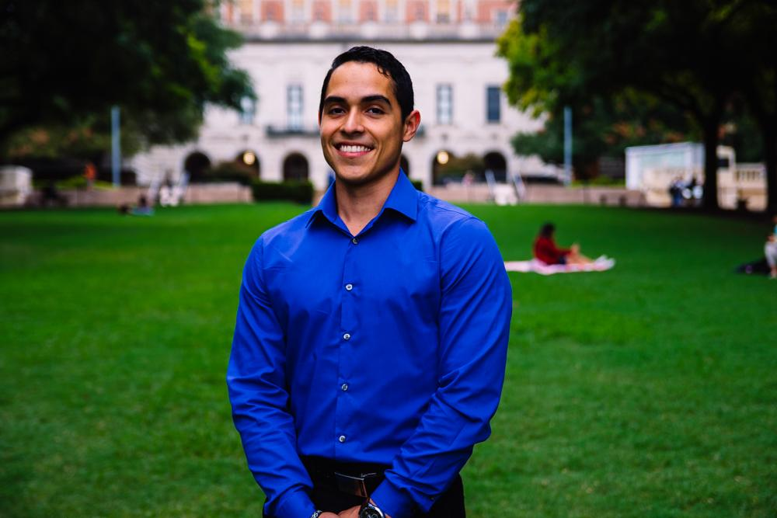
Javier Flores
VP of Community Development
Psychology Major, Pre-PA
3rd Year
Eagle Pass, TX
Fun Fact: WE HAVE A KILLER SOFTBALL TEAM!

Slide 11
Survival of the Fittest
Date: Saturday, April 27th
Time: 10:00AM-12:00PM
Location: Pease Park, 1100 Kingsbury St.
Prizes: 1st place team - Cabo Bob’s Gift cards
2nd place team - HHPO Shirts + Gear
3rd Place team - UT Lanyards
Then after.. We will be having a Officer + Member social at Pluckers! Hope to see you there :)

Slide 12
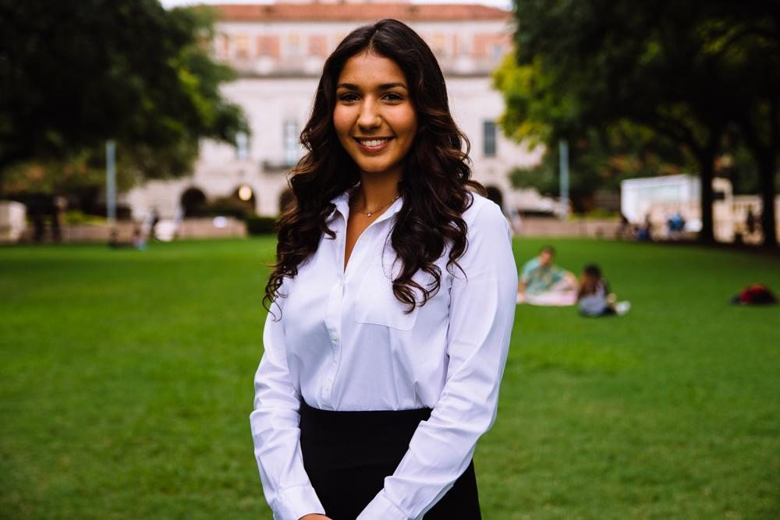
Bianca Garcia
Secretary
Kinesiology Major
3rd Year
Houston, TX
Fun Fact: I’m going to Israel this summer!

Slide 13
ACTIVE MEMBER POINTS
FIVE Volunteer
THREE Social
THREE Professional
THREE Fundraising
THREE General Body Meetings
The point sheet is up to date: https://tinyurl.com/yxecb6f7
Let me know if you have any questions!!
biancagarcia207@utexas.edu

Slide 14
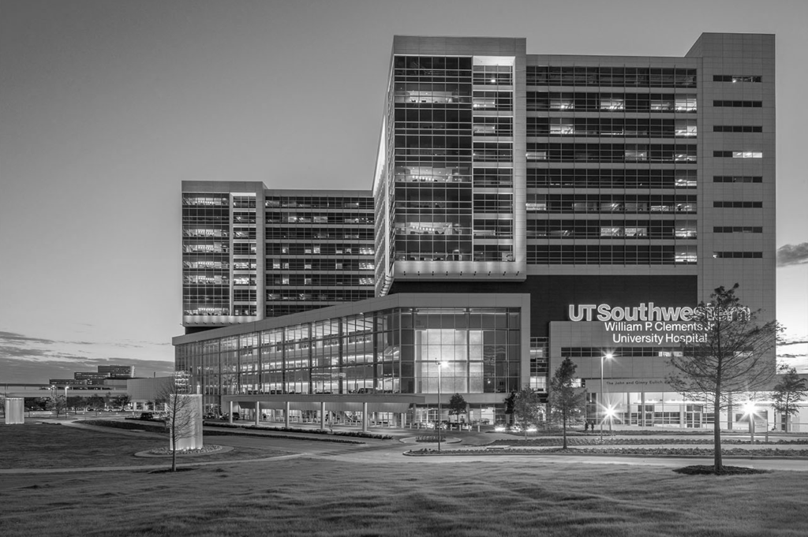
For ALL events involving head counts and ride confirmations, cancellation notice needs to be given 48 hours in advance with valid reasoning to officer hosting event.
** If no notification is received & you are not present at the event, points that would have been earned will be deducted from that respective category of points (volunteering, fundraising, etc.)**
Notes:
This includes

Slide 15
Join the GroupMe!

Slide 16
Google Calendar Link
Stay up to date!
https://tinyurl.com/yxs4qpkq

Slide 17
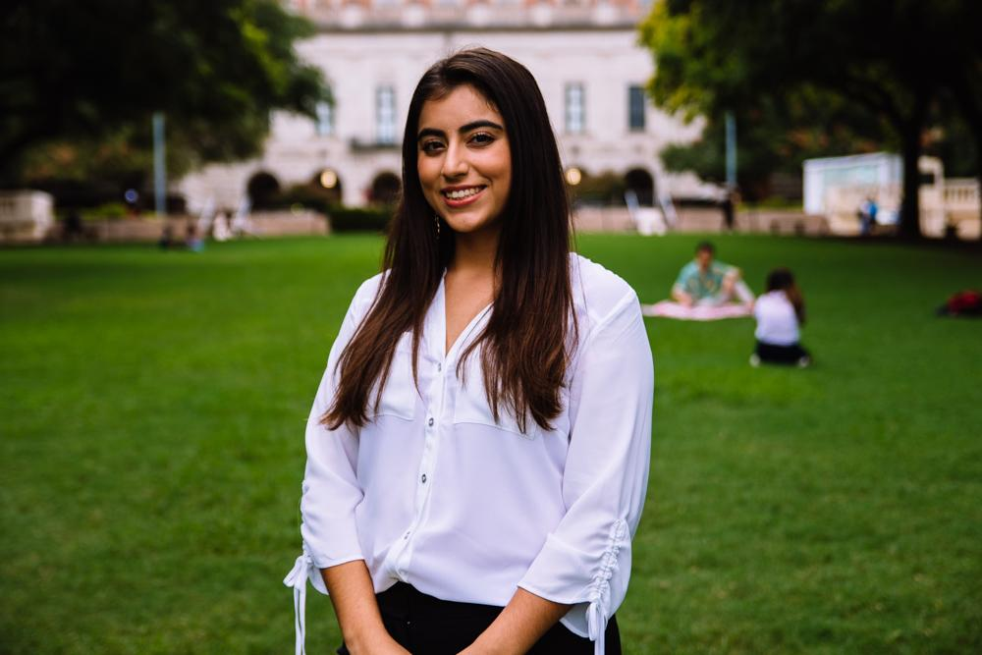
Suzett Fernandez
Financial Director
Human Development and Family Sciences Major
3rd Year
Eagle Pass, TX
I could have 888 (Vietnamese food) any day, every day

Slide 18
DUES
$ 30 Returning Members
$35 New Members
Includes a Tshirt!
Venmo: @Texas-HHPO
(Please state New/Returner)
Paypal: texashhpo@gmail.com ($2 fee)
Cash or Card
**Email: sfdzz97@gmail.com
- include your name, EID, phone number
** Increases by $10 after 3rd GBM**

Slide 19
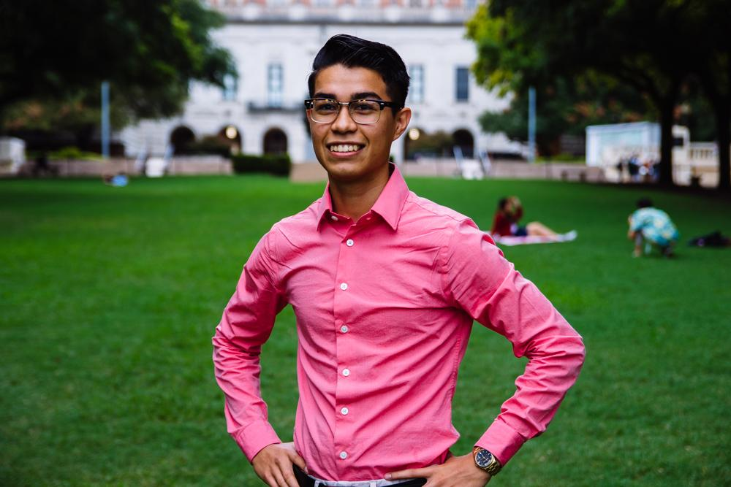
Emmanuel Rayas
Volunteer Director
Biochemistry, BSA
4th Year
San Antonio, TX
Cesar is really slow.

Slide 20
Women’s Health Care-Packages
Tuesday
April 30, 6-8:00p
SZB 286
Volunteer Point Options
Donate money
Donate one or more:
Deodorant
Insect repellent
Toothbrush
Pads/Tampons
(3) Attend the event to decorate and deliver the care-packages to a women and children’s shelter.
Sign-Up

Slide 21
5 Populations, 5 RE’s
The Youth
Communities in Schools
Recurring Events
(RE’s)
The Homeless
Homecooked Fridays
The Incarcerated
Inside Books
The Elderly
Bingo at The Nursing Home
The Public
We Are Blood

Slide 22
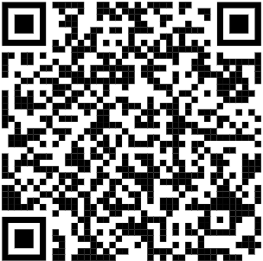
Nursing Home-Bingo
Friday
April 26, 7:00p
We take the bus together
(6:45p)
Or you can drive
Where
Bus stop 18 on
Trinity and MLK
2806 Real St
Austin, TX 78722

Slide 23
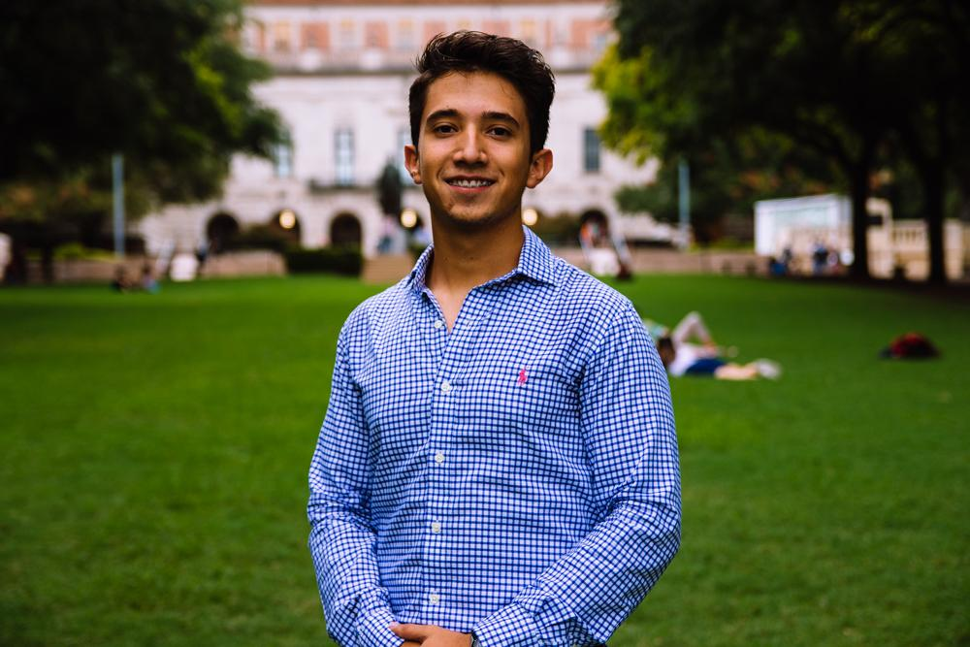
Marcelo Pintos
Social Director
Biochemistry BSA Major
3rd Year
Mcallen, TX / Reynosa MX
Fun fact: I’ve been in school all day so I am going casual

Slide 24
HHPO’s Boat Party
nndjd
Your ticket includes:
Party bus ride to and from the boat (45min)
Food
Drinks
BOAT PARTY IN LAKE TRAVIS!!
$30 for members and $40 for non-members
Bus departs at 3:00pm
Deadline to pay is May 3rd
Notes:
This includes

Slide 25
Notes:
This includes

Slide 26
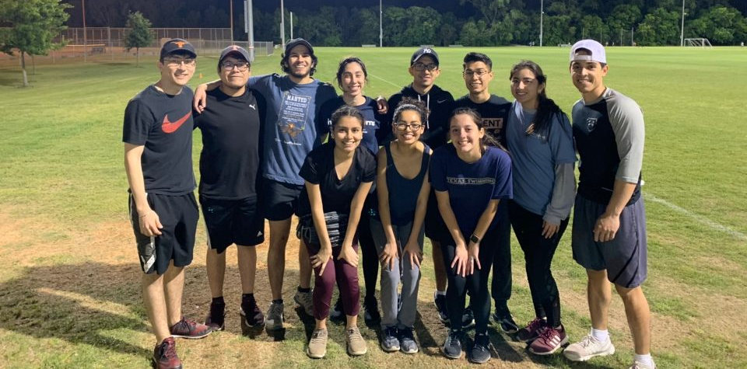
Softball Team

Slide 27
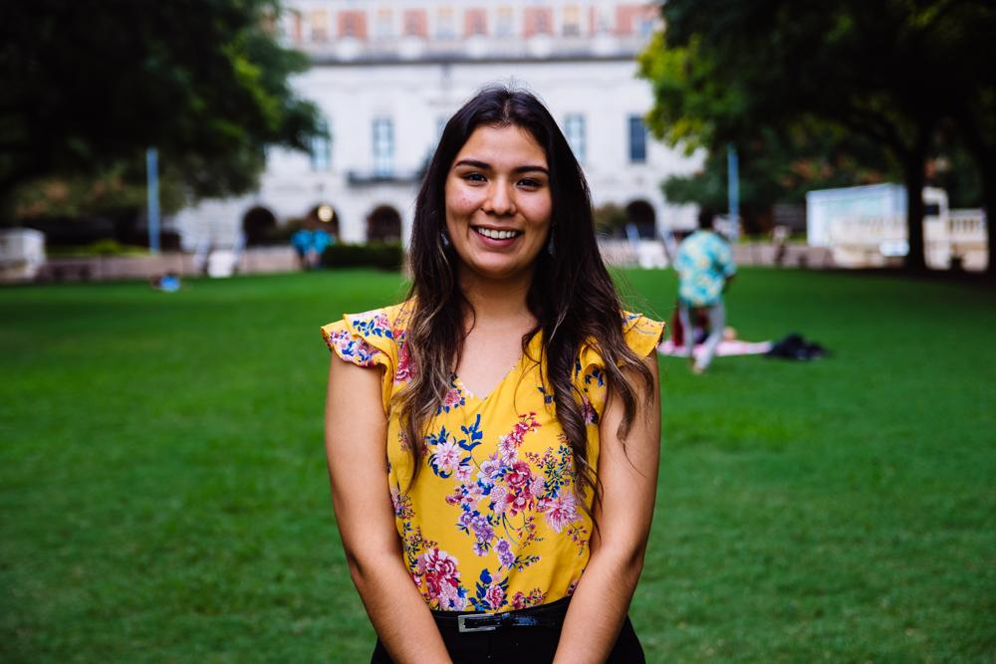
Andrea Martinez
Archives Director
Human Development and Family Sciences Major
3rd Year
Eagle Pass, TX
Fun fact: 7 more weeks til the semester ends!! :)

Slide 28
Scrapbooking Social
Sunday 4/31 @ 6pm in the SAC activity room -
Sign up here for live updates via GroupMe:

Slide 29
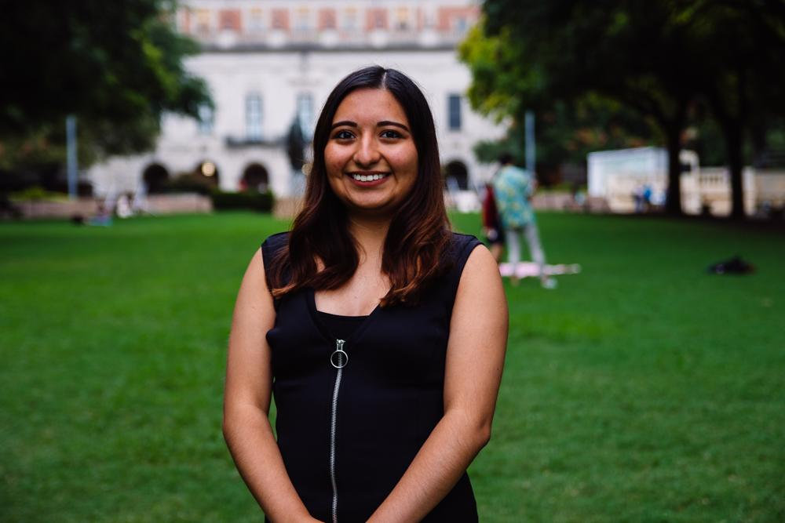
Valeria Sornia
Public Relations Director
Neuroscience Major
3rd Year
Eagle Pass, TX
I’m going to Lollapalooza Chicago in the summer and I AM HYPED!! :D

Slide 30
Professor/Class Review Sheet
BRAND NEW!
EXCLUSIVELY for HHPO Members/Officers
Can view + edit
Great resource for pre-reqs, anyone in the pre-health field
https://docs.google.com/spreadsheets/d/1yFiFYk8PxIwB7DDM9KXw0afmJlyQE1fdwDvrMkjPbh8/edit?usp=sharing

Slide 31
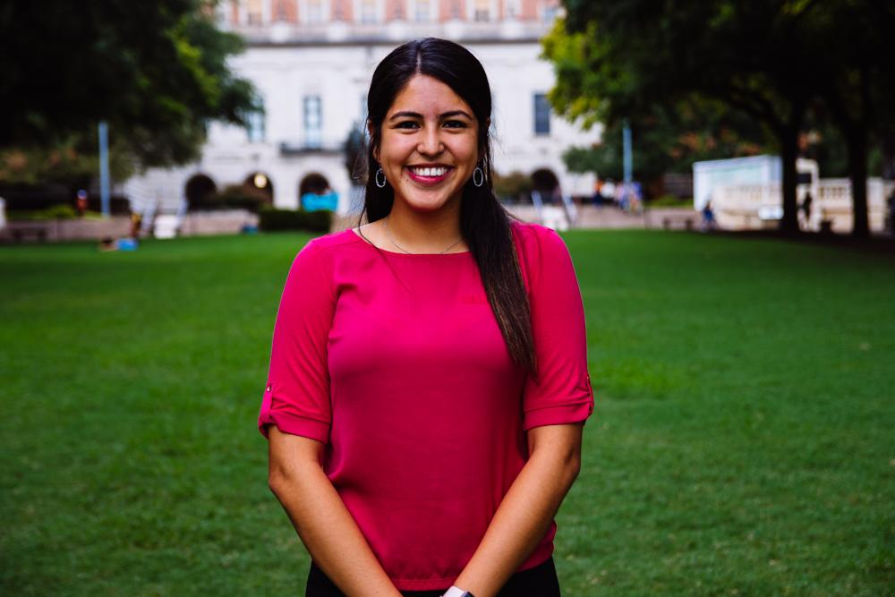
Jessica Medrano
IT Director
Neuroscience Major
3rd Year
Houston, TX
Fun fact: I’m salvadorian <3

Slide 32
Thank You for Coming!!
Sign in here:
6th General Body Meeting:
Website: Texashhpo.weebly.com
Email: texashhpo@gmail.com
HHPO (Hispanic Health Professions Organization)
@texashhpo

