Slide 1
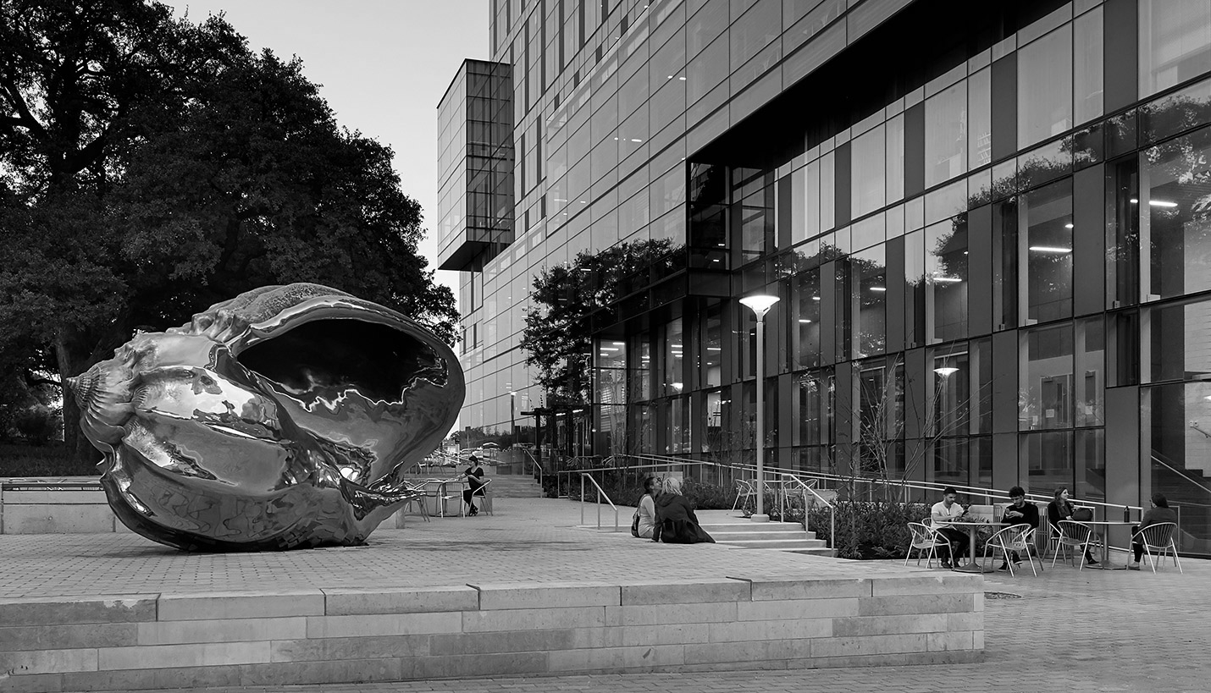
Hispanic Health Professions Organization
Information Body Meeting
March 5th, 6:45 pm
MEZ B0.036
Sign In Here:
https://tinyurl.com/y44zja6k

Slide 2
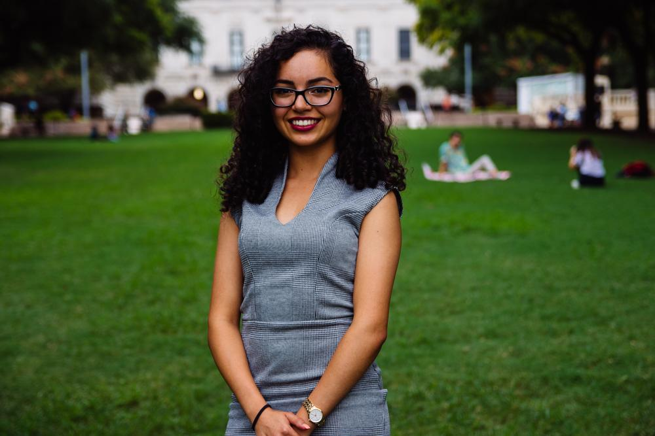
Evangelina Vaghefi
President
Psychology & Nutrition Double Major
5th Year
Fort Worth, TX
I despise coffee :)

Slide 3
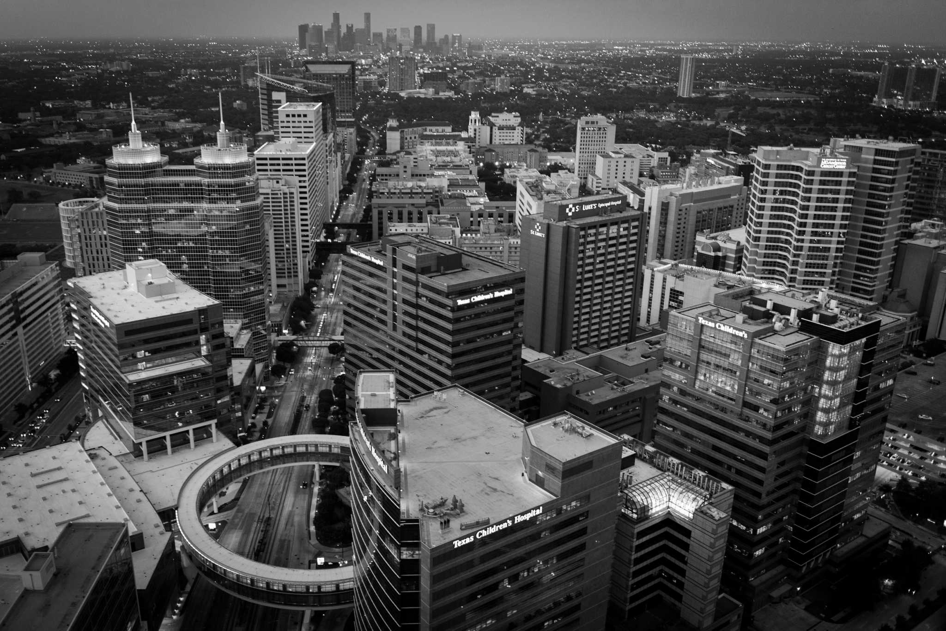
T-shirts
Notify me if you have paid your dues and have not received a t-shirt!
evaghefi1@gmail.com

Slide 4
Aspire Banquet
Monday March 25th @ 6 PM
SAC Ballroom
The annual Aspire Awards Banquet celebrates African-American and Hispanic students who have excelled in the sciences. During this event, two peer-nominated awards will be given in: Leadership and Service.
Leadership and Service Award: Recipients have exhibited strong skills in leading and motivating others and have made a lasting contribution, through outstanding works of voluntary service, to The University of Texas and the surrounding communities.
Inspire Award: Recipients have proven inspirational by virtue of their courage and integrity and have acted as outstanding examples for others in the College of Natural Sciences community.
Awards are nomination based, so if you would like to nominate a fellow CNS student do so here by Wednesday February 27th.
RSVP before March 15th!
https://utexasscience.wufoo.com/forms/z1dzpkgi06l9xd2/

Slide 5
Spring GBM Timeline
MARCH 26
APRIL 2
APRIL 23
MAY 7
NOMINATIONS
ELECTIONS
NEW BOARD ANNOUNCED
GBM RUN BY NEW BOARD

Slide 6
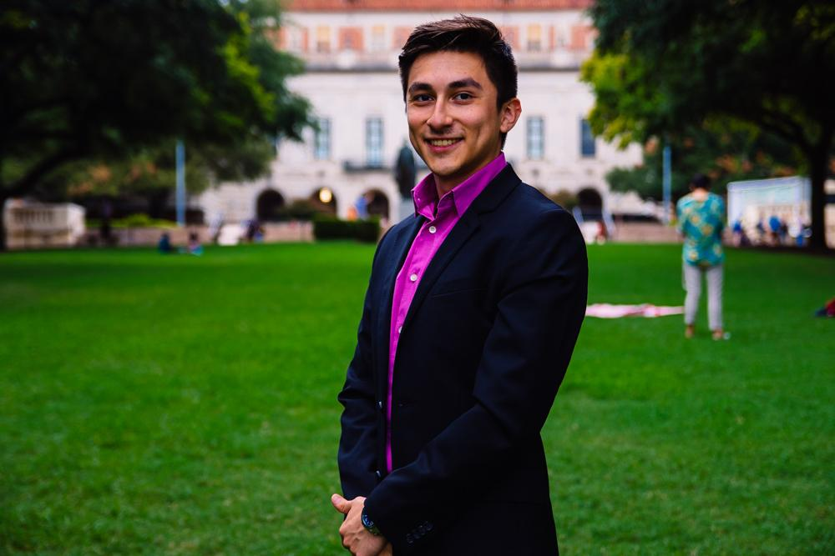
Cesar Gonzalez
VP of Professional Development
Neuroscience Major
Visual Media Minor
3rd Year
Roma, TX
I tried my first 5 hr energy today, i’m a caffeine junkie now

Slide 7
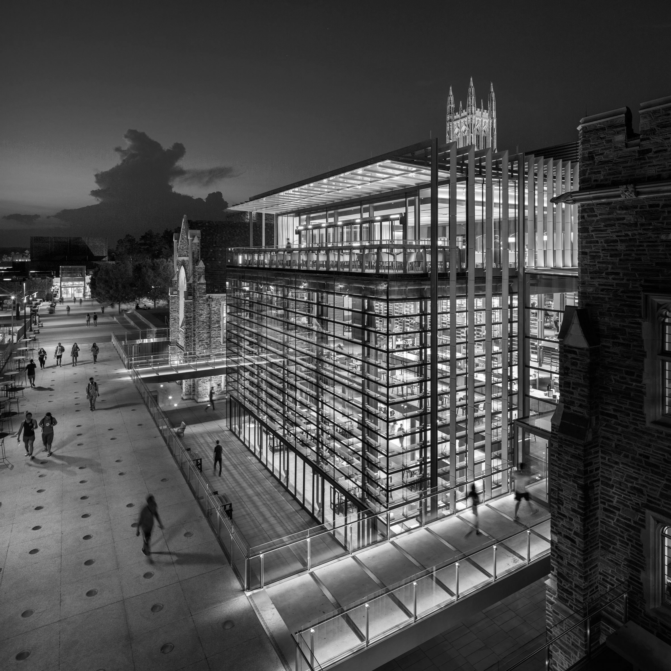
UT Health - Long School of Medicine
Saturday, March 30th / 9:45 am - 2:00 pm
Sign up here by March 10!
https://goo.gl/forms/z3mTXl8KU7PnOSu42
Rides will be provided

Slide 8
Entrance Exam Preparation
15% discount - prep courses
10% discount one on one tutoring
Our Partner

Slide 9
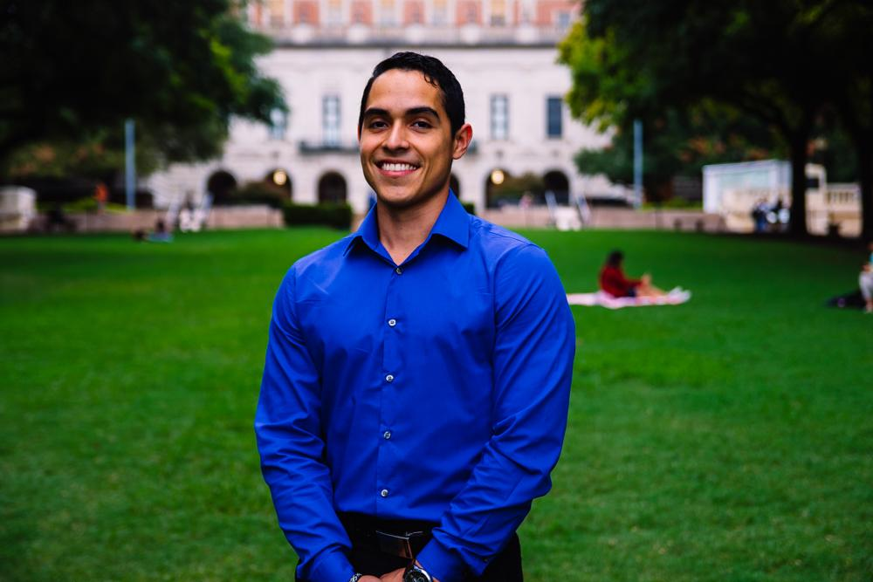
Javier Flores
VP of Community Development
Psychology Major, Pre-PA
3rd Year
Eagle Pass, TX
Fun Fact: I take a Bang energy drink every TTH

Slide 10
Cesar E. Chavez Blood Drive
Date: Thursday, March 14th
Time: 1:30 PM- 4:30PM
Location: Winship circle on Campus in front of RLP
Sign up sheet will be provided.. ONLY limited number of slots available.
Why donate?
You save lives!!
https://weareblood.org/about-us/mission-history/

Slide 11
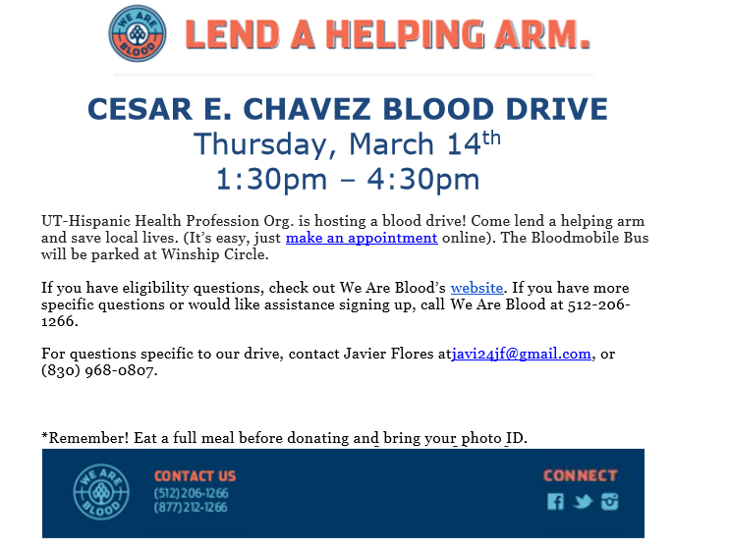

Slide 12
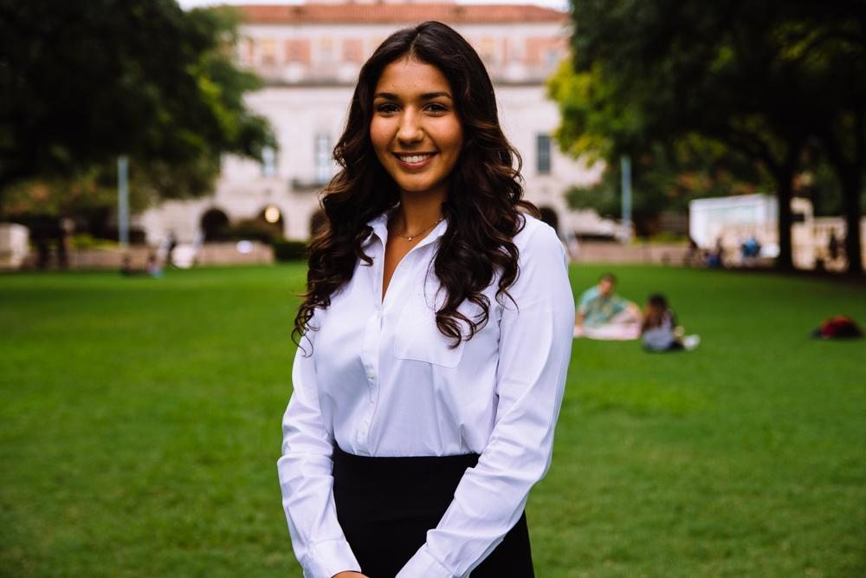
Bianca Garcia
Secretary
Kinesiology Major
3rd Year
Houston, TX
Fun Fact: Fresa’s is my go to restaurant in Austin!

Slide 13
ACTIVE MEMBER POINTS
FIVE Volunteer
THREE Social
THREE Professional
THREE Fundraising
THREE General Body Meetings
The point sheet is up to date: https://tinyurl.com/yxecb6f7
Let me know if you have any questions!!
biancagarcia207@utexas.edu

Slide 14
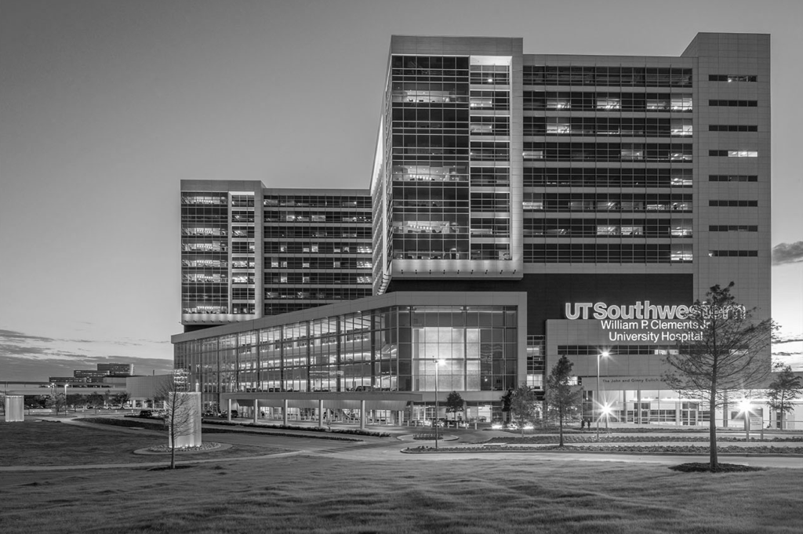
For ALL events involving head counts and ride confirmations, cancellation notice needs to be given 48 hours in advance with valid reasoning to officer hosting event.
** If no notification is received & you are not present at the event, points that would have been earned will be deducted from that respective category of points (volunteering, fundraising, etc.)**
Notes:
This includes

Slide 15
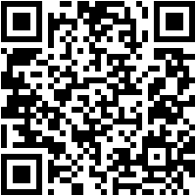
Join the GroupMe!

Slide 16
Google Calendar Link
Stay up to date!
https://tinyurl.com/yxs4qpkq

Slide 17
Member of the
Semester!

Slide 18
GERARDO
LOPEZ

Slide 19
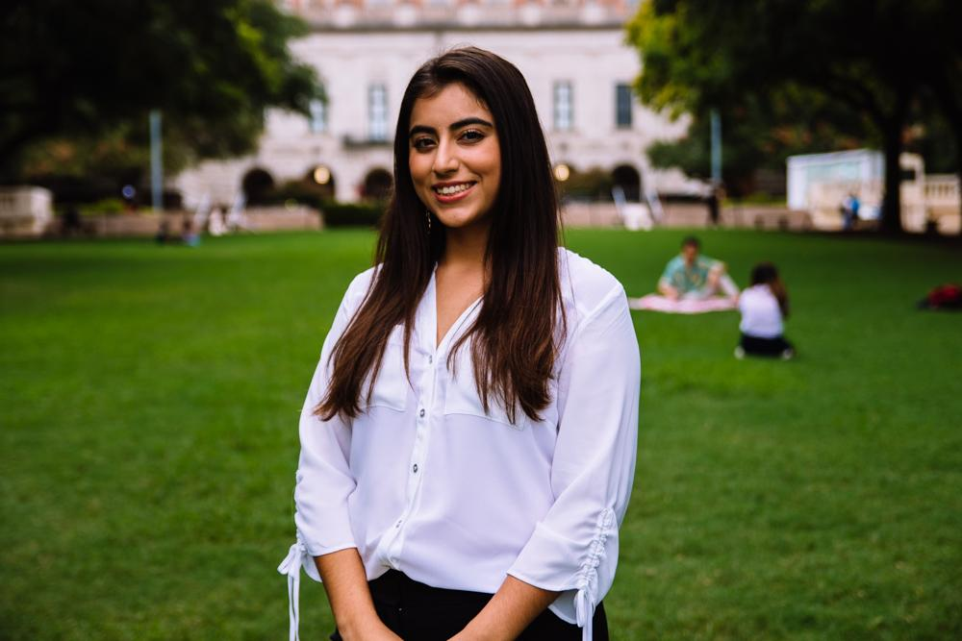
Suzett Fernandez
Financial Director
Human Development and Family Sciences Major
3rd Year
Eagle Pass, TX

Slide 20
DUES
$ 30 Returning Members
$35 New Members
Includes a Tshirt!
Venmo: @Texas-HHPO
(Please state New/Returner)
Paypal: texashhpo@gmail.com ($2 fee)
Cash or Card
**Email: sfdzz97@gmail.com
- include your name, EID, phone number
** Increases by $10 after 3rd GBM**

Slide 21
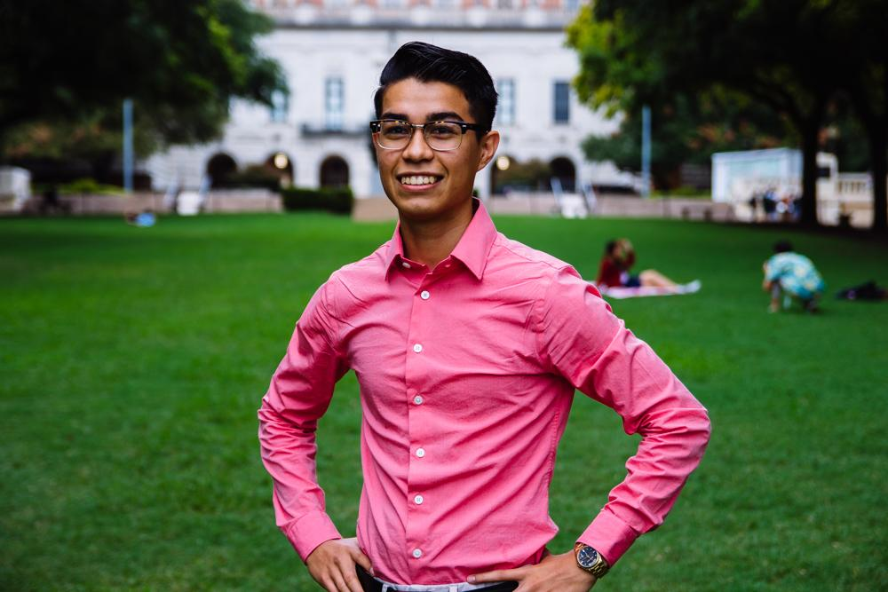
Emmanuel Rayas
Volunteer Director
Biochemistry, BSA
4th Year
San Antonio, TX
Physics II is stressing me out and consuming most of my study time...I am excited for spring break! I am going to NOLA.

Slide 22
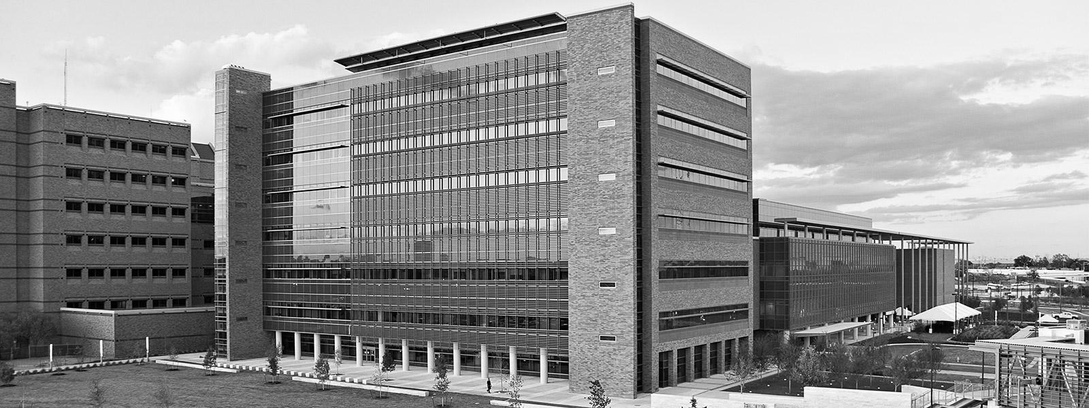
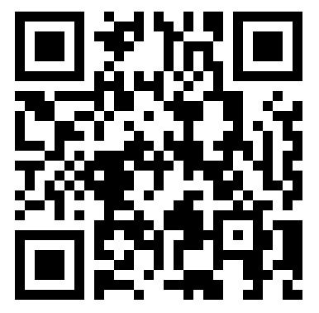
Activites w/Psychiatric Patients
Saturday, March 9th
We will engage and socialize with psychiatric patients in a social setting, allowing you the opportunity to create a memorable experience that will serve everyone uniquely.
Address: will be sent out as the event approaches.
Time: 2-4pm
Sign-up: https://goo.gl/forms/a9XRsj3KugO0ZBbG3
Notes:
Sign up link: https://goo.gl/forms/lxvrn03VPdcSoklr1
Shifts:
9:30 - 12:30
11:30-3:30
2:30-5:30

Slide 23
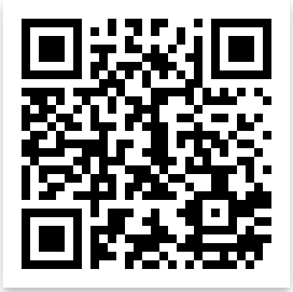
Nursing Home-Bingo
Friday
Mar 8, 7:00p
We take the bus together
(6:45p)
Or you can drive
Where
Bus stop 18 on
Trinity and MLK
2806 Real St
Austin, TX 78722

Slide 24
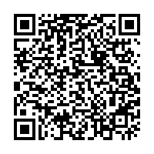
Volunteer Programs Survey
New Events
Psychiatric
Patients
Community
Gardens
Environmental
Movements
Group-Me
Volunteer
Together
With fellow
HHPO’ers
Who like the
same events.

Slide 25
Population Based Volunteering
The Youth
Communities in Schools
The Elderly
Bingo at The Nursing Home
The Homeless
Homecooked Fridays
The Incarcerated
Inside Books
The Public
We Are Blood

Slide 26
Recurring on your Schedule
Thursday
Inside Books
7-11PM
3121 E 12th St
Austin, TX 78702
insidebooksproject@gmail.com
Friday
Homecooked Fridays
1-3PM & 3-5PM
209 W. 27th St. Austin, TX 78705
Sign-up found on digest.
HHPO Bingo at the Nursing Home
7-8PM
2806 Real St Austin, TX 7872*
Bus Route 18 on MLK & Trinity
Sunday
Inside Books
5-9PM
3121 E 12th St
Austin, TX 78702
insidebooksproject@gmail.com

Slide 27
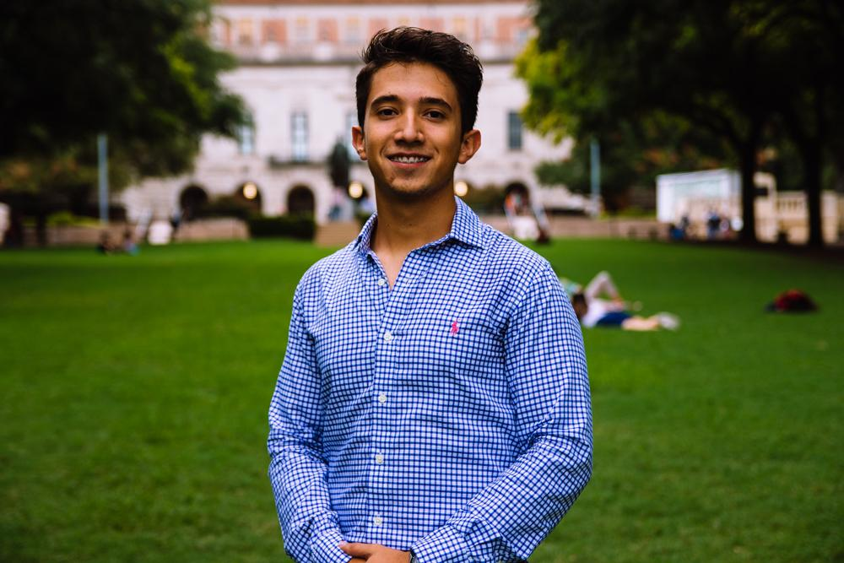
Marcelo Pintos
Social Director
Biochemistry BSA Major
3rd Year
Mcallen, TX/ Reynosa MX

Slide 28
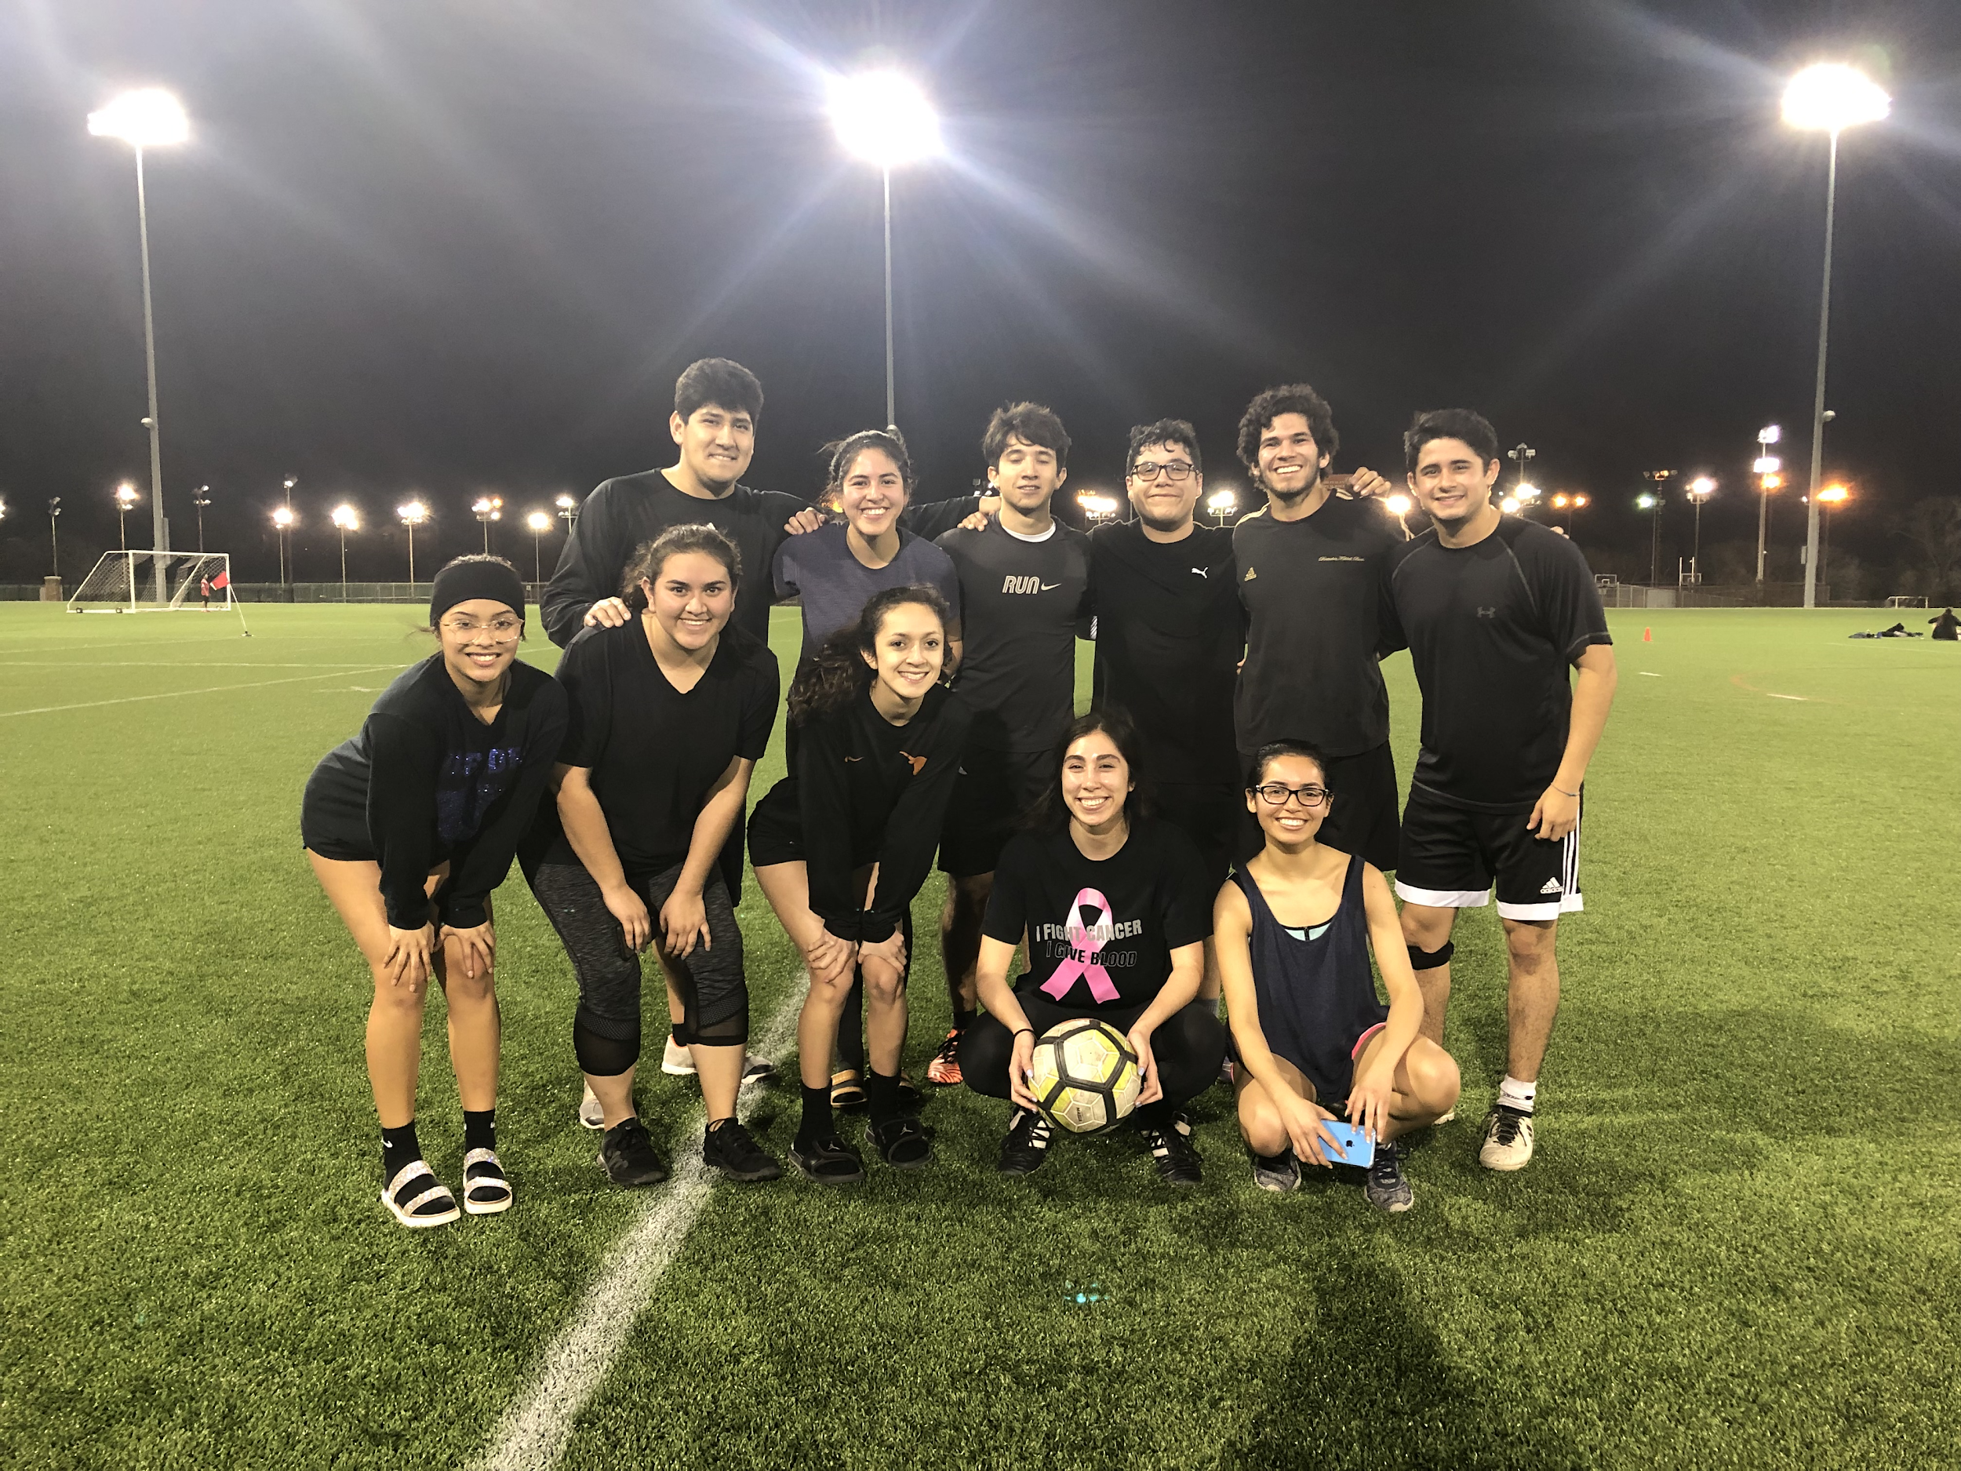
Thank you guys <3
We did leave it all on the field!
Divisional champs, won all three games of our division.

Slide 29
Cielo was a success!
Thanks to everyone who showed up

Slide 30
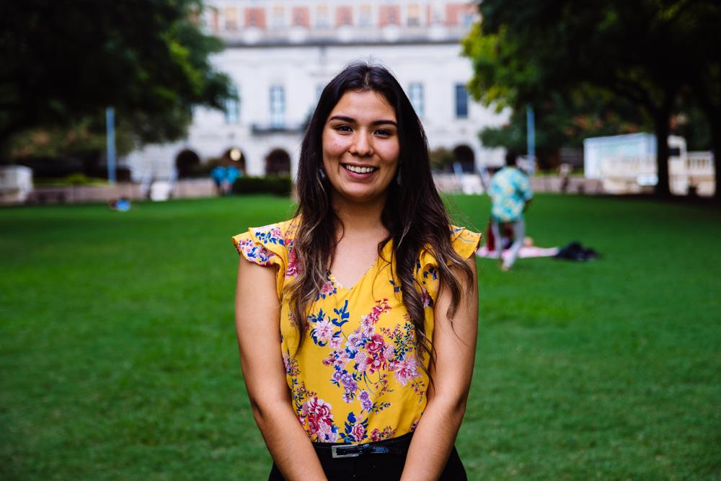
Andrea Martinez
Archives Director
Human Development and Family Sciences Major
3rd Year
Eagle Pass, TX
I may be listed as a co-author for a study my PI is submitting to the National Latino Psychological Association!

Slide 31
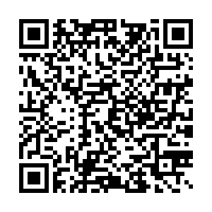
Scrapbooking Social
Multiple Dates (TBA) -
Sign up here for live updates via GroupMe:
Submit pictures here by Friday 3/15:

Slide 32
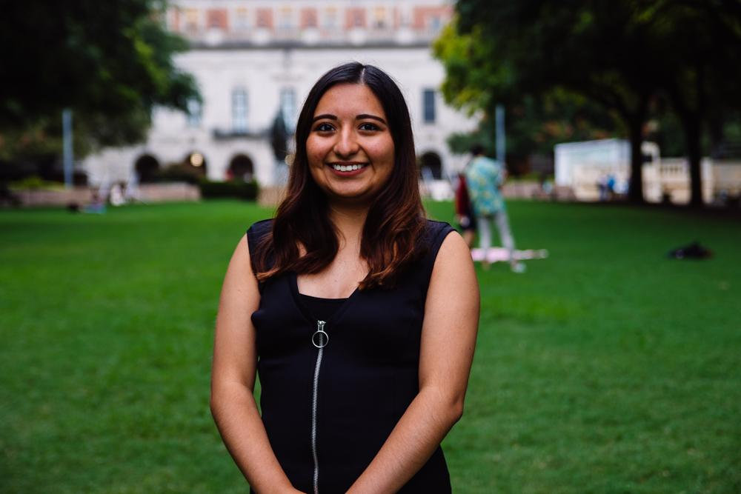
Valeria Sornia
Public Relations Director
Neuroscience Major
3rd Year
Eagle Pass, TX
Ariana Grande follows me on Twitter! :) #thankunext

Slide 33
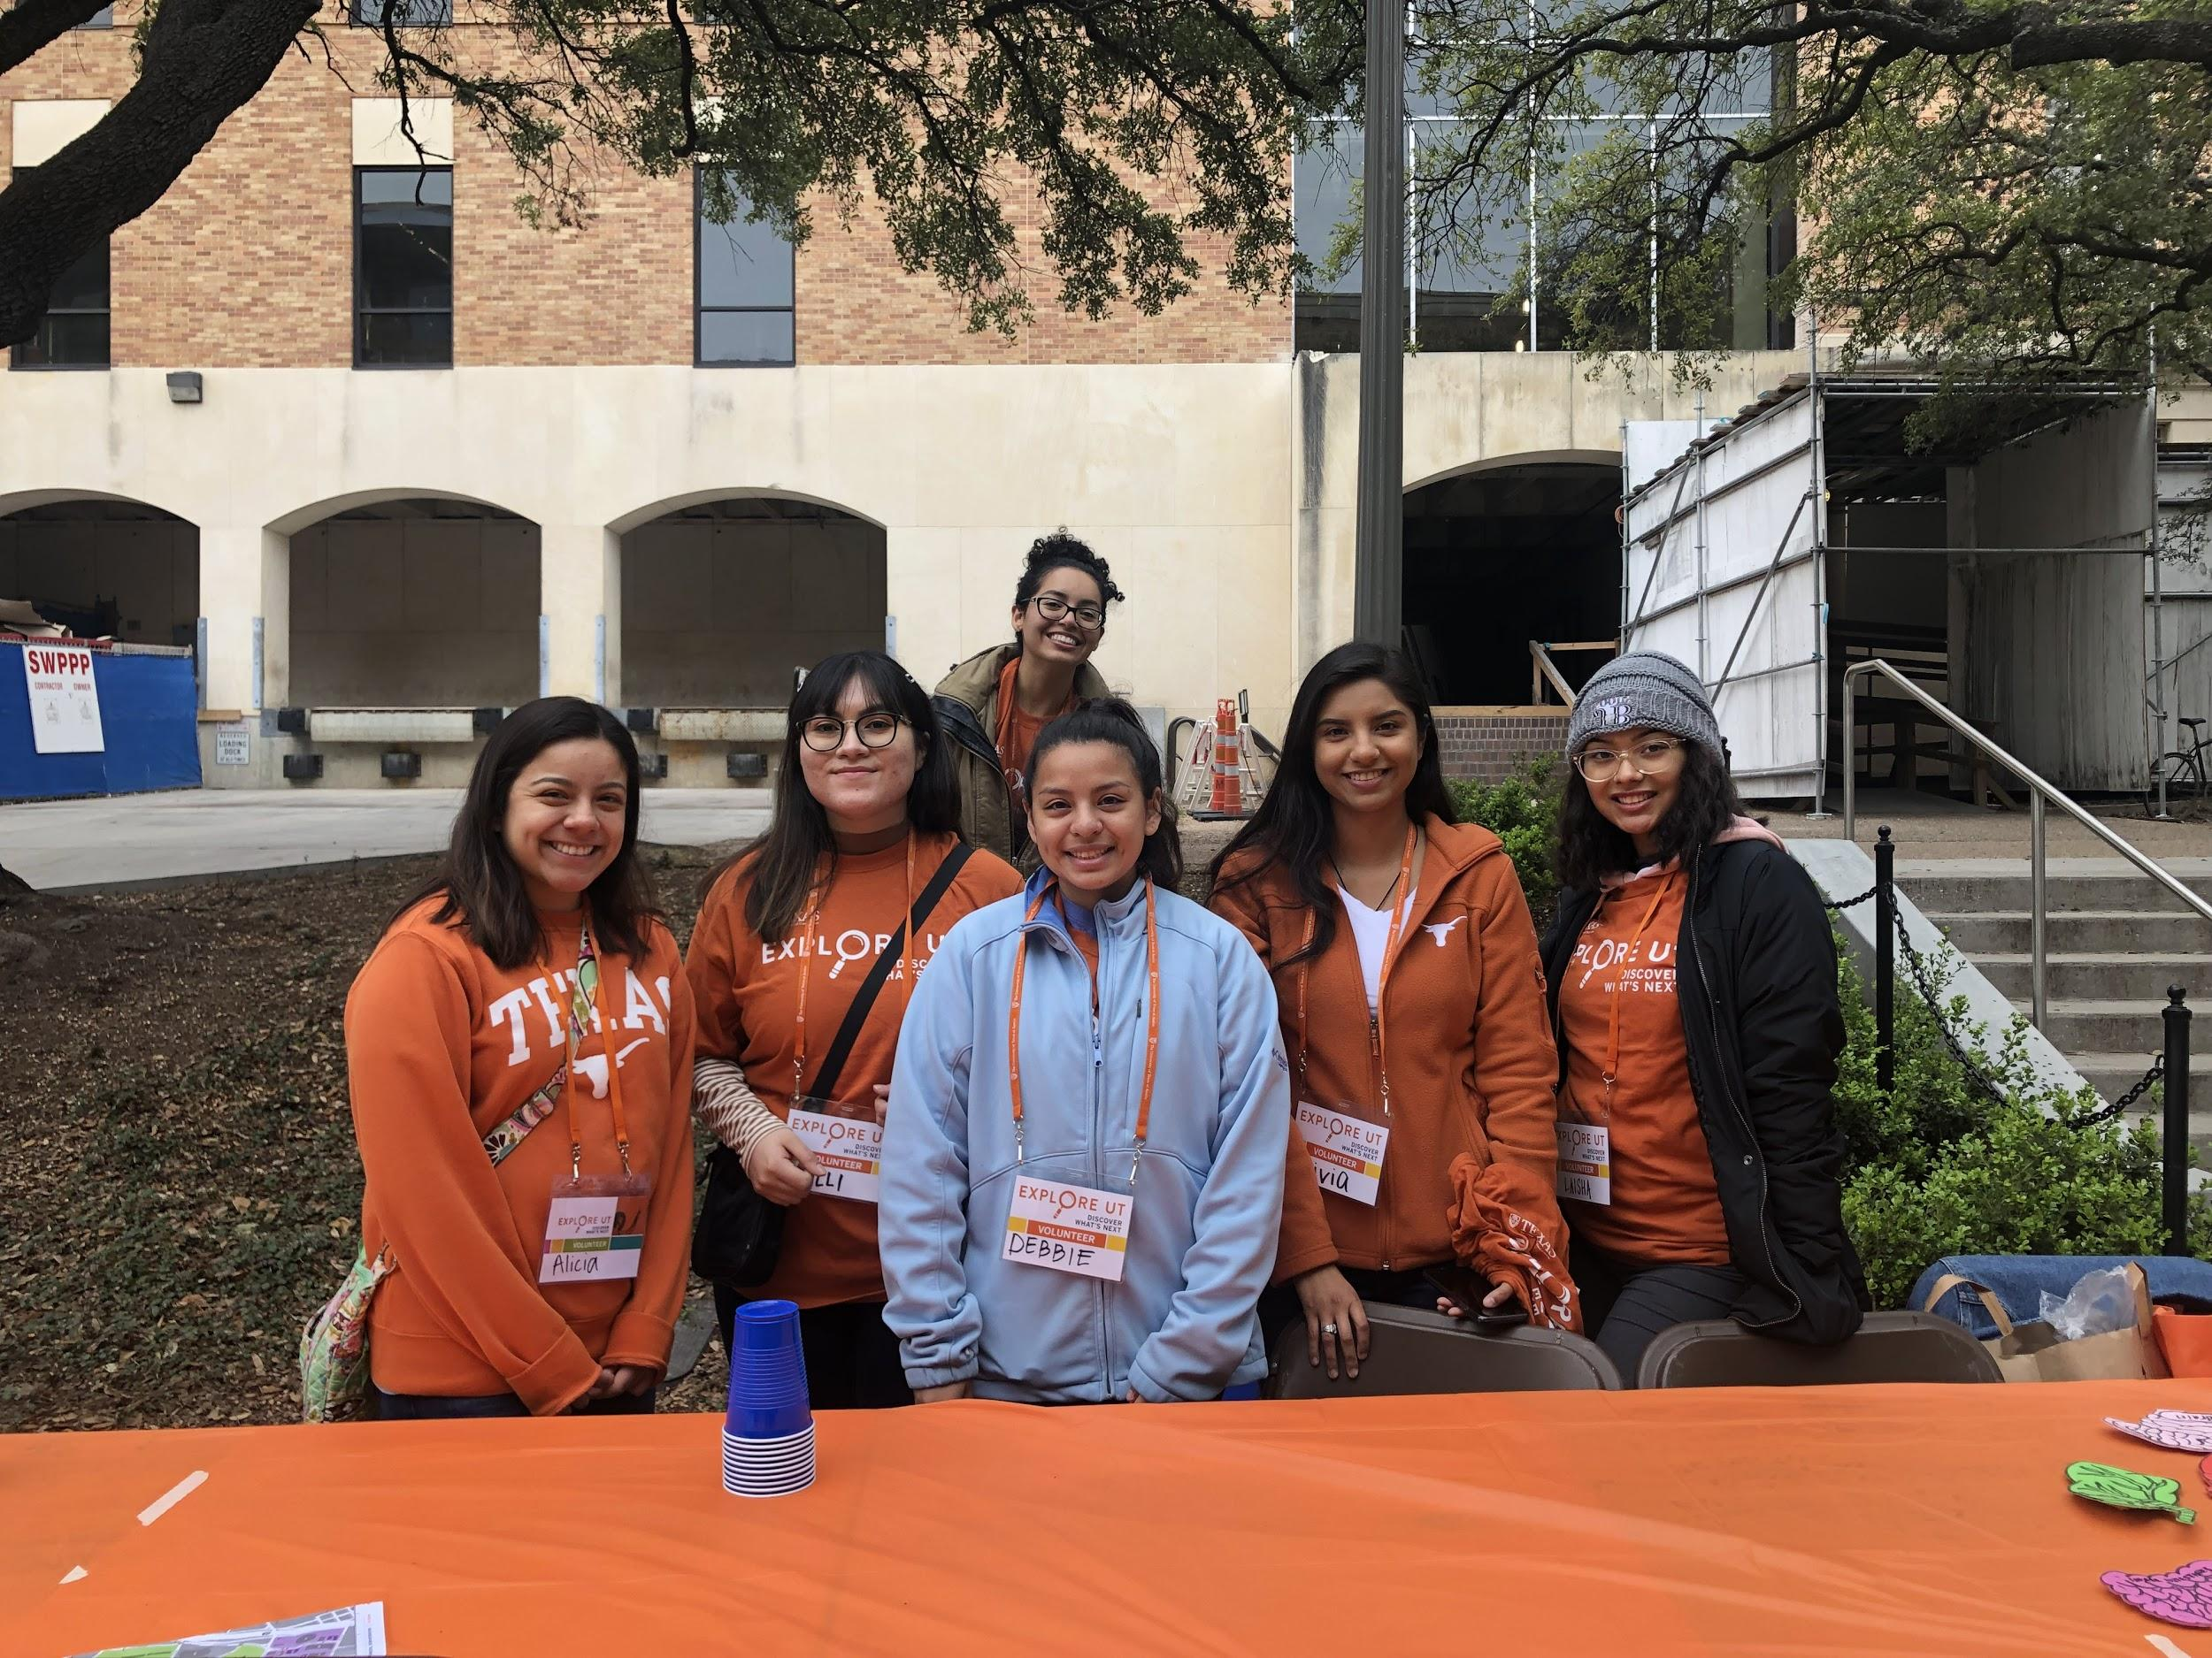
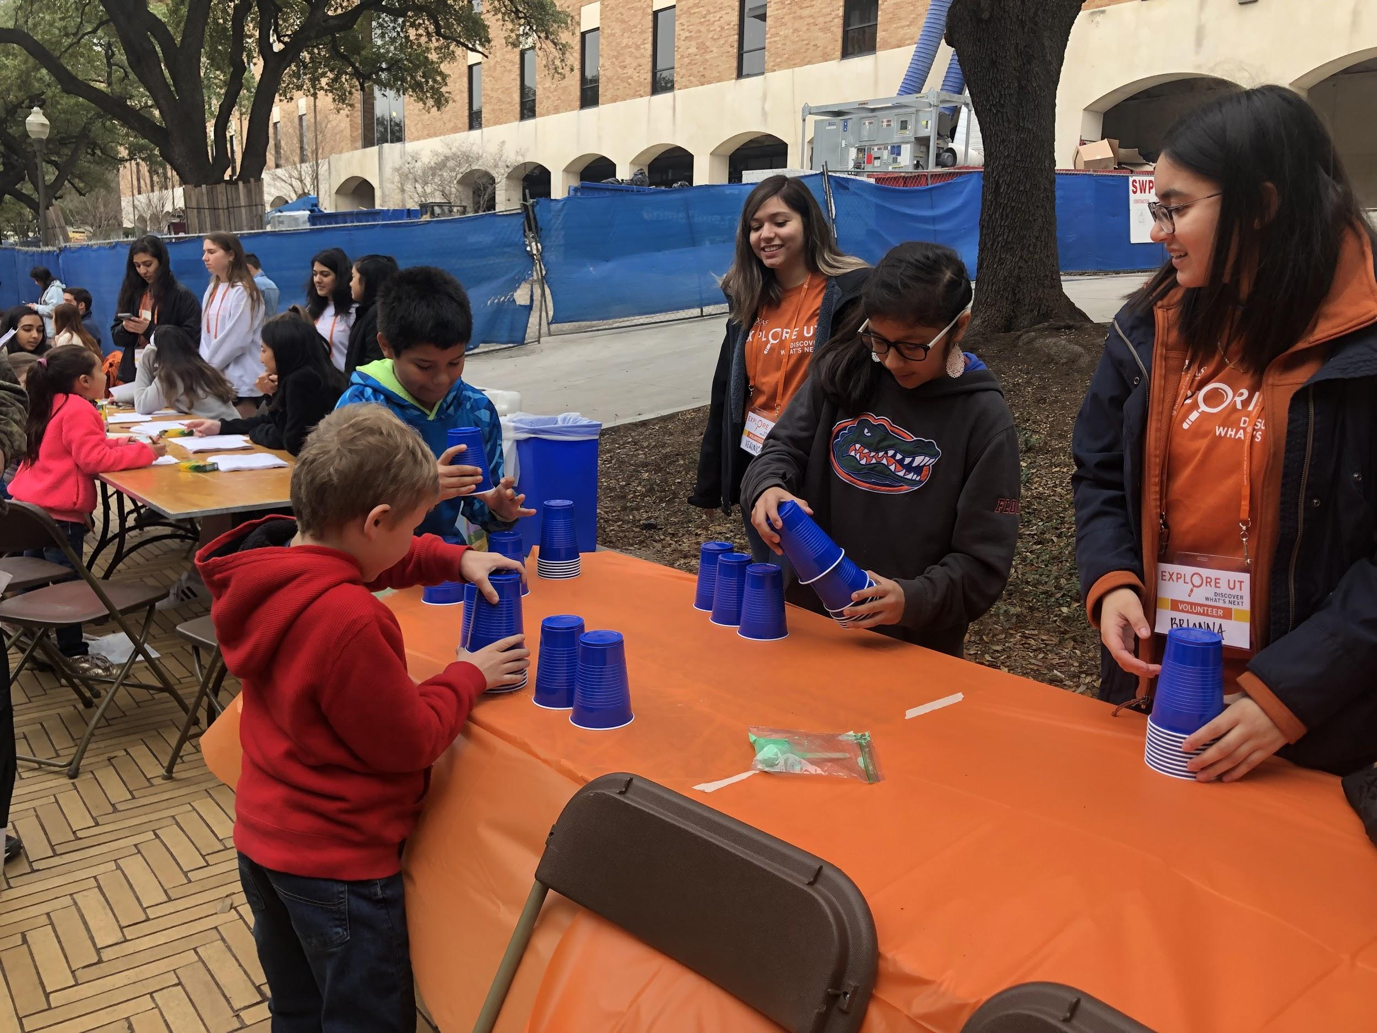
Explore UT
Notes:
Sign up link: https://goo.gl/forms/lxvrn03VPdcSoklr1
Shifts:
9:30 - 12:30
11:30-3:30
2:30-5:30

Slide 34
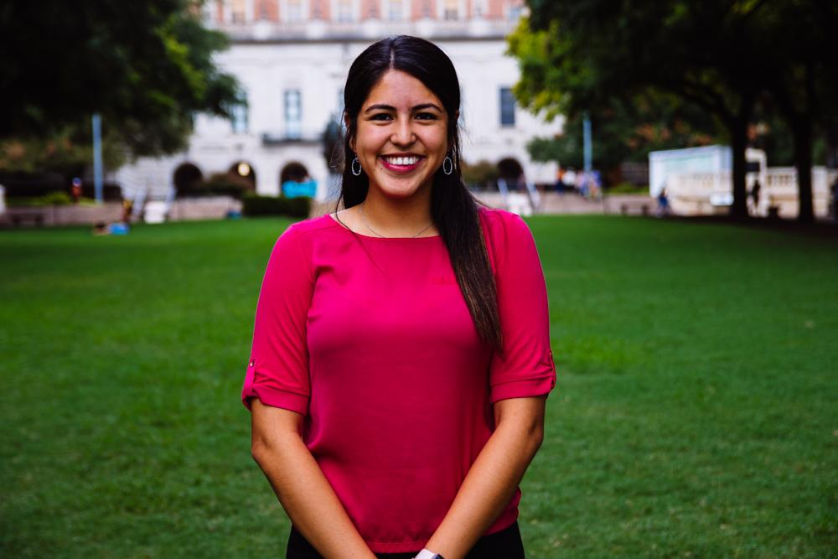
Jessica Medrano
IT Director
Neuroscience Major
3rd Year
Houston, TX
Fun fact: I love summermoon coffee <3

Slide 35
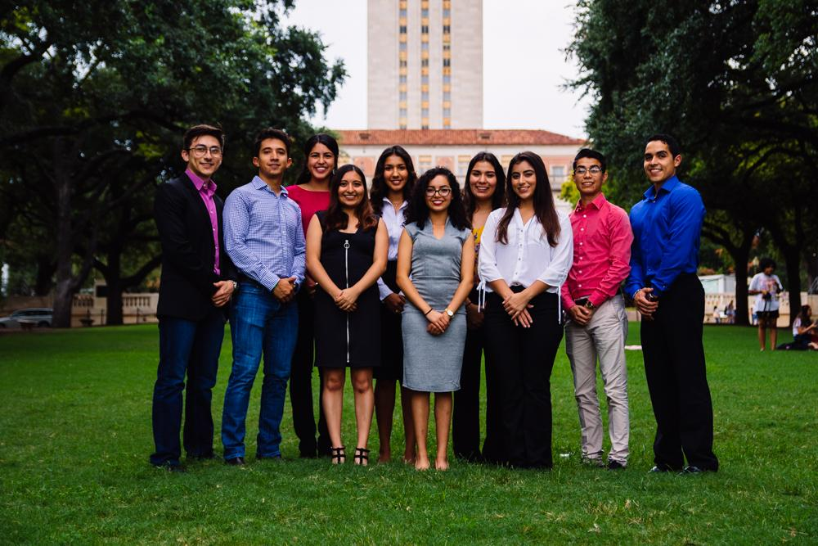
Let us know if you have any questions!!

Slide 36
Thank You for Coming!!
Sign in here:
https://tinyurl.com/y44zja6k
3rd General Body Meeting:
26 March 2019
6:45 pm
Website: Texashhpo.weebly.com
Email: texashhpo@gmail.com
HHPO (Hispanic Health Professions Organization)
@texashhpo

